Slide 1
Dayanand Education society
Dayanand Science College, Latur
Organic Synthesis Via Enolate Class : B. Sc.-II
Paper: VI Organic chemistry
Sem-: III
Asst. Prof. Dr. R. S. shinde
Department of chemistry

Slide 2
Organic Synthesis Via Enolate
A methylene group (-CH₂) which is attached from both sides by electron withdrawing groups (e.g. – CHO, >C=O, -COOH, -COOR, -CN, -X etc.) is called active methylene group.
O C
OC₂H₅
H₂C
dimethyl malonate
C OC₂H₅ O
06/02/2019
2

Slide 3




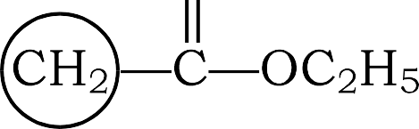
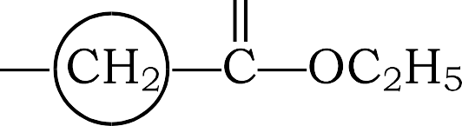







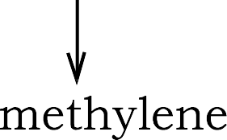


ENOLATES
The class of compounds which contain a methylene group (–CH₂–) directly bonded to the electron withdrawing groups such as –COCH₃, –COOC₂H₅, –CN, are called active methylene compounds. This is so because the –CH₂ group in them is acidic and reactive. The two examples are
Ethyl acetoacetate (Acetoacetic ester)
Diethyl molonote (Molonic ester) The structure of (a) and (b) are as
This reaction is known as claisen condensation

Slide 4

Acidity of α-hydrogen
The hydrogen atoms of active methylene group are acidic in nature.
The compounds containing active methylene group when treated with base, looses hydrogen atoms to form carbanion.
This carbanion is stabilized by another resonating structure called as enolate ion.The acidity of the C—H bond of methylene group is due to two factors that is inductive effect and resonance stabilitization of carbanion.
-
O
H C
O
O
OC H
C
OC₂H₅
C
OC₂H₅
-
2 5
- H₂O
-
C
HO
+
C
C
H C OC H O
H C OC₂H₅ O
carbanion
H
C OC₂H₅
2 5
O
enolate ion
06/02/2019 3
dimethyl malonate

Slide 5























Ethyl acetoacetate (CH₃COOCH₂COOC₂H₅)
It's IUPAC name is ethyl 3-oxobutanoate
Preparation: Ethyl acetoacetate is prepared by heating ethyl acetate with sodium ethoxide in ethanol, followed by acidification.

Slide 6
Aceto Acetic Ester (AAE) or Ethyl Aceto Acetate (EAA)
O C
O
C OC₂H₅
H₃C
CH₂
06/02/2019
4

Slide 7
Preparation of AAE (Claisen Condensation)
Ethyl acetate on refluxion with sodium ethoxide gives aceto acetic ester.
O
C OC H
O
C OC H
O C
O
C OC₂H₅
+
H C
i) C₂H₅ONa
H C
CH₂
H C
2 5
ii) H O⁺
3
3
2 5
3
3
ethyl acetate
aceto acetic ester
This base catalyzed condensation of ester containing α- hydrogen atom is called Claisen condensation.
Mechanism: It involves following steps.
a. a) Base abstract α- H atom from ethyl acetate to form carbanion.
O
⁻ ₊ H H C C OC H
2 2 5
ethyl acetate
O
-
H₂C C OC₂H₅
carbanion
+ C₂H₅OH
C₂H₅O
06/02/2019 5

Slide 8
b. This carbanion attacks on carbonyl carbon of another ethyl acetate molecule to form anion.
- _{O}
H₂C C OC₂H₅
O O
C
O
_{H} - _{C}
H C
+
₂C
OC H
H C
C
3
2 5
3
carbanion
OC H
OC H
anion
2 5
2 5
c. This anion looses ethoxide ion to form ethyl aceto acetate.
- _{O}
H₂C C OC₂H₅
O C
O
CH₂ C
O
H₃C
C
H₃C
OC₂H₅
ethyl aceto acetate
OC₂H₅
anion
06/02/2019 6

Slide 9
Keto-Enol Tatuomerism
Ethyl aceto acetate exists as an equilibrium mixture of two functional forms as keto and enol. These two forms are constantly interconvert into one another.
This phenomenon in which two structural isomers spontaneously interconvert and exist in dynamic equilibrium is called tatuomerism.
O C
OH
H₃C C CH COOC₂H₅
aceto acetic ester (enol form)
H₃C
CH₂
COOC₂H₅
aceto acetic ester (keto form)
The tatuomer which containing carbonyl group is called keto form while other tatuomer which containing hydroxyl group attached to double bonded carbon is called enol form. The tatuomerism is called keto-enol tatuomerism
06/02/2019
7

Slide 10
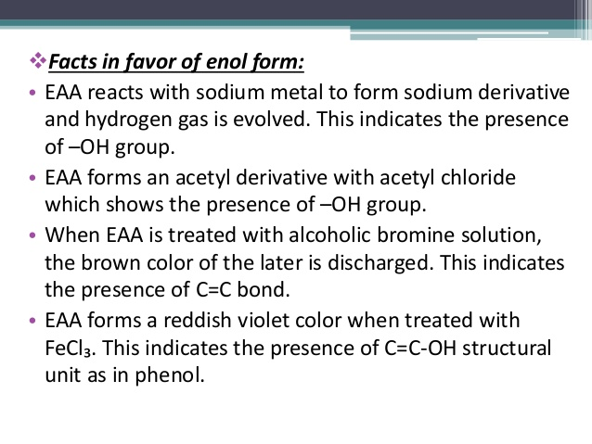

Slide 11
Mechanism: Keto and enol forms are isomers which are easily interconvertible in presence of small amount of acid or base.
Base Catalyzed Keto-Enol Tatuomerism:
  In first step, Base abstract proton from EAA to form carbanion which is resonance stabilized.
-
O
-
O
O
HO
- H₂O
-
COOC₂H₅
aceto acetic ester (keto form)
H₃C C CH COOC₂H₅
carbanion
H₃C C CH COOC₂H₅
enolate ion
H C C CH₂
3
In second step, enolate ion takes proton from water molecule to form enol form of EAA.
-
O
OH
H₃C C CH COOC₂H₅ + HO
-
H₃C C CH COOC₂H₅
+
H₂O
06/02/2019 8
enolate ion
EAA (enol form)

Slide 12

B. Acid Catalyzed Keto-Enol Tatuomerism
In first step, carbonyl oxygen takes proton from acid to form oxonium ion.
+ OH
O: C
+
H
H C
CH
COOC H
H C C CH
COOC H
3
2
2 5
3
2
2 5
aceto acetic ester (keto form)
oxonium ion
In second step, oxonium ion looses proton to form enol form.
+ OH
H₃C C CH COOC₂H₅
H
OH
H₃C C CH COOC₂H₅
+
+ H₂O
+ H₃O
aceto acetic ester (enol form)
06/02/2019 9
oxonium ion

Slide 13
In EAA, there is comparatively more percentage of keto form.
OH
C CH COOC₂H₅
O
H₃C C CH₂
COOC₂H₅
H₃C
keto form (92.5%)
enol form (7.5%)
06/02/2019
10

Slide 14










Reactions of EAA :
1. Salt formation
Ethyl acetoacetate is acidic and when treated with a strong base such as sodium ethoxide (C₂H₅ONa) forms it sodium salt

Slide 15


















Alkylation
Ethyl acetoacetate anion is nucleophilic and reacts with alkyl halides to give alkyl acetoacetic ester.
Ketonic hydrolysis
When ethyl acetoacetate is hydrolysed with did HCl, acetoacetic acid is formed. Which undergoes decarboxylation on heating.

Slide 16



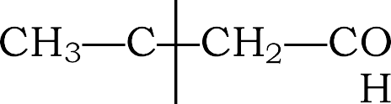














Acid Hydrolysis
When ethyl acetoacetate is hydrolysed, with concentration NaOH and then acidified with dil HCl, acetic acid is formed.

Slide 17



























Synthesis of alkylacetic acids
This involves the reaction of sodium ethyl acetoacetate with on alkyl halide followed by acid hydrolysis.

Slide 18
Synthetic Applications of EAA
1. Synthesis of alkyl aceto acetic ester:-
Aceto acetic ester when treated with sodium ethoxide gives carbanion which on further treatment with alkyl halide gives corresponding alkyl derivative.
O
H₃C C
O
O
-
C₂H₅ONa
- C₂H₅OH
_{H3C} C CH COOC₂H₅ Na
carbanion
+ H C I
HC COOC₂H₅
H C C CH₂
COOC₂H₅
3
- NaI
3
CH
aceto acetic ester
3
alkyl aceto acetic ester
This alkyl aceto acetic ester again on treatment with sodium ethoxide followed by reaction with alkyl halide gives dialkyl aceto acetic ester.
O C
O C
O C
CH₃
C₂H₅ONa
-
+
H₃C I
- NaI
H C
HC COOC H
H C
C COOC H Na
H C
C COOC H
3
2
⁵ - C₂H₅OH
3
2 5
3 2 5
CH₃
CH₃
carbanion
CH₃
dialkyl aceto acetic ester
06/02/2019 11

Slide 19
2. Synthesis of Mono-carboxylic acid: - Higher carboxylic acids prepared by alkyllating EAA followed by hydrolysis.
EAA when treated with sodium ethoxide and methyl iodide gives methyl EAA which on further hydrolysis gives propanoic acid.
O C
O
C HC COOC₂H₅
H₃C
CH
COOC H
i) C₂H₅ONa
H C
2
2 5
ii) H C
I
3
aceto acetic ester
3
CH₃
methyl aceto acetic ester
O
O
C OH
i) conc. KOH
+
+ 2 5
H C
H C H C C OH
C H OH
ii) H⁺/ H O
3
3
2
2
acetic acid
propanoic acid
EAA when treated with sodium ethoxide and ethyl iodide gives methyl EAA which on further hydrolysis gives butanoic acid.
O C
O
C HC COOC₂H₅
H C
CH
COOC H
i) C₂H₅ONa
H₃C
3
2
2 5
ii) H₃C-CH₂
I
CH₂-CH₃
ethyl aceto acetic ester
O
aceto acetic ester
O
C OH + H C CH H C C OH
i) conc. KOH
ii) H⁺/ H₂O
H C
+
C₂H₅OH
3
3
2 2
06/02/2019 12
acetic acid
butanoic acid

Slide 20
3. Synthesis of Dicarboxylic Acid: -
Aceto acetic ester on treatment with sodium ethoxide gives carbanion which on condensation with halo ester followed by hydrolysis gives corresponding dicarboxylic acid.
Aceto acetic ester on treatment with sodium ethoxide gives carbanion which on condensation with ethyl chloro acetate followed by hydrolysis gives succinic acid.
O
O
-
C H ONa
+ Cl-CH -COOC H
H C C CH
COOC H
2 5
H C C CH COOC₂H₅ Na
2 2 5
- NaCl
3
2
2
⁵ - C₂H₅OH
3
aceto acetic ester
O
carbanion
O
H₃C C OH
acetic acid
CH -COOH
H C C CH COOC H
2
₊ C H OH
i) conc. KOH
+
3
2 5
ii) H⁺/ H₂O
2 5
CH -COOH
CH₂-COOC₂H₅
2
succinic acid
06/02/2019 13

Slide 21
4. Synthesis of unsaturated acid:-
AAE on condensation with aldehyde or ketone in presence of base (pyridine) gives intermediate which on further acid hydrolysis gives α, β-unsaturated acid.
AAE on condensation with acetaldehyde in presence of base (pyridine) gives intermediate which on further acid hydrolysis gives crotonic acid.
H
H₃C C
pyridine
- H₂O
H₃C CO C COOC₂H₅
CH-CH₃
O
+
H C
CO
CH
COOC H
3
2
2 5
acetaldehyde
i) conc. KOH
ii) H⁺/ H₂O
aceto acetic ester
+
CH
CH
CH COOH
+
C H OH
H C COOH
2 5
3
acetic acid
3
crotonic acid
06/02/2019 14

Slide 22
5. Synthesis of ketone: -
AAE on alkylation gives corresponding alkyl aceto acetic acid which on hydrolysis gives corresponding carboxylic acid intermediate. This intermediate carboxylic acid further on decarboxylation gives ketone.
O C
O
C HC
COOC H
C₂H₅ONa
H₃C I
COOC H
H C
CH
H C
2 5
3
2
2 5
3
aceto acetic ester
CH₃
O C
O
i) dil. KOH
ii) H⁺/ H₂O
HC COOH CH₃
H C
C CH
CH₃
H C
2
3
- CO₂
3
2-butanone
O C
O C
CH
COOC H
i) C₂H₅ONa
H C
HC COOC H
H C
2
2 5
ii) H₃C-CH₂
I
3
2 5
3
aceto acetic ester
CH₂-CH₃
O C
O
C CH
i) dil. KOH
ii) H⁺/ H₂O
HC COOH CH₂-CH₃
H C
CH₂ CH₃
H C
2
3
- CO₂
3
06/02/2019 15
2-pentanone

Slide 23
6. Synthesis of 1, 3-diketone: -
EAA when treated with acetyl chloride in presence of Mg gives ethyl diacetyl acetone intermediate which on further hydrolysis followed by decarboxylation gives 1, 3- diketone.
O C
O C
O
+ H C
_{C Cl} Mg
CH COOC₂H₅ C CH₃
O O
H C
CH
COOC
H₃C
3
2
2 5
3
- HCl
aceto acetic ester
acetyl chloride
O C
O
i) dil. KOH
CH COOH C CH₃
O
CH₂ C CH₃
(Pentane-2, 4-dione)
H₃C
H₃C C
ii) H⁺/ H O
- CO
2
2
1, 3-diketone
06/02/2019
16

Slide 24
7. Synthesis of 4-methyl uracil: -
Enol form of EAA on condensation with urea in presence of phophoryl chloride gives 4-methyl uracil.
O C
O
OC₂H₅
+
C OH
CH₃
EAA (enol form)
C
HN
H₂N
POCl
HC
C O
3
- C₂H₅OH
- H₂O
HC
C O
H₂N
urea
C HN CH₃
4-methyl uracil
06/02/2019
17

Slide 25
ethyl acetoacetate on treatment with sodium ethoxide and ethylene diiodide gives intermediate. This intermediate on hydrolysis gives Hexanedioic acid and Acetic acid.
COOC₂H₅
I
COOC H
CH
CH
2 5
CH
2
CH
CH
2
+
CH₂
3
3
CH
COOC₂H₅
CH₃
CH
2
CH₂
2 COOC₂H₅
I
CH
ethylene Iodide
dimethyl malonate
CH₃
COOH
CH COOH
CH2
3
₊
CH3COOH
HCl / H O
CH₂
2
Hydrolysis
CH
COOH
2
Acetic acid
CH2
06/
02/2019
23

Slide 26















Synthesis of higher normal diacids (Synthesis of Adepic acid)
The reaction of sodium ethyl acetoacetate with an alkylene diiodede followed by acids hydrolysed gives a normal dicarboxylic acid.

Slide 27














Synthesis of antipyrine
Ethyl acetoacetate reacts with phenyl hydrozene to give antipyrine.

Slide 28


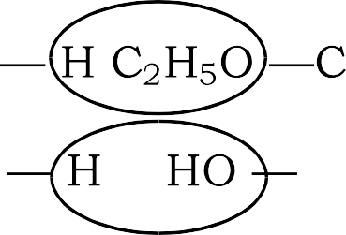
















Synthesis of 4-methyl uracil
Ethyl acetoacetate reacts with urea in the presence of phosphoryl chloride to give 4-methyl uracil.

Slide 29
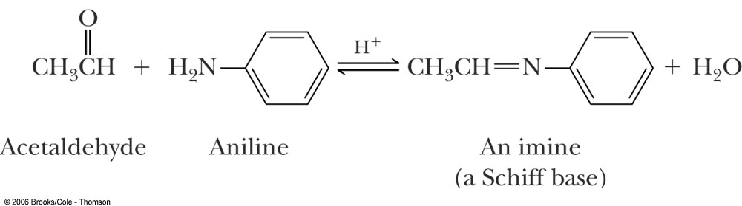
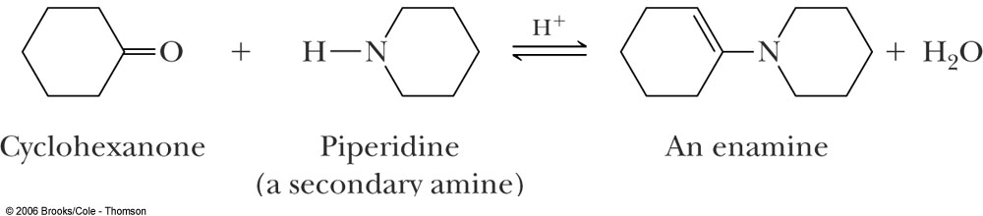
Enamines (and imines, Schiff bases)
Recall primary amines react with carbonyl compounds to give Schiff bases (imines), RN=CR₂.
Primary amine
But secondary amines react to give enamines
Secondary Amine

Slide 30
Formation of Enamines
Again, enamines are formed by the reaction of a 2° amine with the carbonyl group of an aldehyde or ketone.
  The 2° amines most commonly used to prepare enamines are pyrrolidine and morpholine.

Slide 31
Formation of Enamines
  Examples:

Slide 32
Enamines – Alkylation at α position.
The value of enamines is that the β-carbon is nucleophilic.
  Enamines undergo S_{N}2 reactions with methyl and 1° haloalkanes, α-haloketones, and α-haloesters.
  Treatment of the enamine with one equivalent of an alkylating agent gives an iminium halide.

Slide 33
Compare mechanisms of acid catalyzed aldol and enamine

Slide 34
Enamines - Alkylation
  Hydrolysis of the iminium halide gives an alkylated aldehyde or ketone.
Overall process is to render the alpha carbonss of ketone nucleophilic enough so that substitution reactions can occur.

Slide 35
Enamines – Acylation at α position
  Enamines undergo acylation when treated with acid chlorides and acid anhydrides.
Could this be made via a crossed Claisen followed by decarboxylation.

