Slide 1
Chapter 2
Visual Basic Languages

Slide 2
Content
Variable
Constants
Operators
Data types
Arrays
Collections
Procedures
Control flow & loop
Statements.

Slide 3
Variables
The named memory Location is called Variable. Variables are used to store values or data In Visual Basic; you use variables to temporarily store values during the execution of an application. Variables have a name and a data type. You can think of a variable as a placeholder in memory for an unknown value.
Declaring Variables
To declare a variable is to tell the program about it in advance. You declare a variable with the Dim statement, supplying a name for the variable:
Syntax: Dim variable name [As type]
In this syntax,
Dim is the keyword that tells Visual Basic that you want to declare a variable.
Variable Name is the name of the variable.
As is the keyword that tells Visual Basic that you're defining the data type for the variable.
Type is the data type of the variable.

Slide 4
Rules Of Defining Variable
Variables declared with the Dim statement within a procedure exist only as long as the procedure is executing. When the procedure finishes, the value of the variable disappears.
In addition, the value of a variable in a procedure is local to that procedure — that is, you can't access a variable in one procedure from another procedure.
These characteristics allow you to use the same variable names in different procedures without worrying about conflicts or accidental changes.
A variable name:
➢ Must begin with a letter.
➢ Can't contain an embedded period or embedded type-declaration character.
➢ Must not exceed 255 characters.
➢ Must be unique within the same scope, which is the range from which the variable can be referenced like a procedure, a form, and so on.

Slide 5
Declaring Variables : In most programming languages, variables must be declared in advance for the compiler.
Explicit Declarations : To declare a variable, use the Dim statement followed by the variable’s name and type as follows :
o Dim Meters as Integer
o Dim Names as String
Implicit Declarations : When Visual Basic meets an undeclared variable name, it creates a new variable on the spot and uses it. The new variable’s type is variant, the generic data type that can accommodate all other data types.
The reserved word Dim is really short for dimension, which means ‘Size
’. When you declare a variable, the amount of memory reserved depends on its data type. In the Dim statement [as data type] is optional. If you omit that statement the default data type is applied to the variable.
Dim var1, var2
var1=”Thank you”
var2=43.23
The var1 variable is a string variable, and var2 is a numeric one.

Slide 6
Constants
To greatly improve the readability of your code — and make it easier to maintain Constants is used.
A constant is a meaningful name that takes the place of a number or string that does not change.
Although a constant somewhat be similar to a variable, you can't modify a constant or assign a new value to it as you can to a variable.

Slide 7
Intrinsic or system-defined
constants are provided by applications and controls. Visual Basic constants are listed in the Visual Basic (VB) and Visual Basic for applications (VBA) object libraries in the Object Browser. Other applications that provide object libraries, such as Microsoft Excel and Microsoft Project, also provide a list of constants you can use with their objects, methods, and properties.

Slide 8
Symbolic or user-defined
constants are declared using the Const statement.
The syntax for declaring a constant is:
[Public|Private] Const constantname[As type] = expression
The argument constantname is a valid symbolic name (the rules are the same as those for creating variable names), and expression is composed of numeric or string constants and operators; however, you can't use function calls in expression.
A Const statement can represent a mathematical or date/time quantity:

Slide 9
Constants are preferred for two reasons:
1. Value of a constant can never change: This is the safety feature. Once the constant has been declared you cannot change its value from anywhere.
2. Constants are processed faster than variables: When the program is running, the values of constants don’t have to be looked up. The compiler replaces the constant names with their values, thus saving the program execution time.

Slide 10
A Const statement can represent a mathematical or date/time quantity:
Const conPi = 3.14159265358979
Public Const pi As Integer = 9
Const conReleaseDate = #1/1/2025#
The Const statement can also be used to define string constants:
Public Const conVersion = "07.10.A"
Const conCodeName = "Enigma"
You can place more than one constant declaration on a single line if you separate them with commas:
Public Const conPi = 3.14, conMaxPlanets = 9,conWorldPop = 6E+09

Slide 11
A Const statement has scope like a variable declaration, and the same rules apply:
• To create a constant that exists only within a procedure, declare it within that procedure.
• To create a constant available to all procedures within a module, but not to any code outside that module, declare it in the Declarations section of the module.
• To create a constant available throughout the application, declare the constant in the Declarations section of a standard module, and place the Public keyword before Const. Public constants cannot be declared in a form or class module.

Slide 12
Operator
An operator is a symbol that performs an operation on one or more code elements that hold values. Value elements include variables, constants, literals, properties, and returns from Function. Visual Basic provides the following types of operators:
1. Arithmetic Operators
2. Comparison Operators.
3. Concatenation Operators
4. Logical and Bitwise

Slide 13
1. Arithmetic Operators:
These operators are used to perform basics arithmetic operations.
Operator | Action
^ | exponentiation
− | Subtraction, also unary minus
+ | Addition
* | Multiplication
/ | Division
Mod | Modulus

Slide 14
2. Comparison Operators:
Compare two expressions and return a Boolean value representing the result of the comparison.
Operator | Action
> | Greater than
>= | Greater than or equal
< | Less than
<= | Less than or equal
== | Equal
Like | a pattern matching operator
Is | an object type comparer

Slide 15
3. Concatenation Operators:
Join multiple strings into a single string.
Operator | Action
& | String concatenation
+ | String concatenation

Slide 16
4. Logical and Bitwise Operators:
In Visual Basic combine Boolean or numeric values and return a result of the same data type as the values.
Operator | Action
And & | And
Or | | Or
Not ~ | Not
Xor ^ | exclusive or

Slide 17
Operator precedence & associativity
When several operations occur in an expression, each part is evaluated and resolved in a predetermined order called operator precedence.
Precedence Rules:
When expressions contain operators from more than one category, they are evaluated according to the following rules:
1. The arithmetic and concatenation operators have the order of precedence described below, and all have higher precedence than the comparison, logical, and bitwise operators.
2. All comparison operators have equal precedence, and all have higher precedence than the logical and bitwise operators, but lower precedence than the arithmetic and concatenation operators.
3. The logical and bitwise operators have the order of precedence described below, and all have lower precedence than the arithmetic, concatenation, and comparison operators.
4. Operators with equal precedence are evaluated left to right in the order in which they appear in the expression.

Slide 18
Precedence Order:
Operators are evaluated in the following order of precedence:
Arithmetic Operators | Comparison Operators | Logical and Bitwise | Concatenation
^ | = | Not | &, +
− negation | <> | And
*, / | < | Or
Mod | > | Xor
+, - | <=
 | >=
 | Like, Is

Slide 19
Associativity
When operators of equal precedence appear together in an expression, for example multiplication and division, the compiler evaluates each operation as it encounters it from left to right. The following example illustrates this.
Dim n1 As Integer = 96 / 8 / 4
The first expression evaluates the division 96 / 8 (resulting in 12) and then the division 12 / 4, resulting in 3. Because the compiler evaluates the operations for n1 from left to right
Dim n2 As Integer = (96 / 8) / 4
The evaluation is exactly the same when that order is explicitly indicated for n2. Both n1 and n2 have a result of
Dim n3 As Integer = 96 / (8 / 4)
By contrast, n3 has a result of 48, because the parentheses force the compiler to evaluate 8 / 4 first.
Because of this behavior, operators are said to be left associative in Visual Basic.

Slide 20
Data Types
Data type | Description | Range
Byte | 1-byte binary data | 0 to 255
Integer | 2-byte integer | – 32,768 to 32,767
Long | 4-byte integer | – 2,147,483,648 to 2,147,483,647
Single | 4-byte floating-point number | – 3.402823E38 to – 1.401298E – 45 (negative values)
 |  | 1.401298E – 45 to 3.402823E38 (positive values)
Double | 8-byte floating-point number | – 1.79769313486231E308 to – 4.94065645841247E – 324 (negative values)
 |  | 4.94065645841247E – 324 to 1.79769313486231E308 (positive values)
Currency | 8-byte number with fixed decimal point | – 922,337,203,685,477.5808 to 922,337,203,685,477.5807
String | String of characters | Zero to approximately two billion characters
Variant | Date/time, floating-point number, integer, string, or object. 16 bytes, plus 1 byte for each character if a string value. | Date values: January 1, 100 to December 31, 9999 Numeric values: same range as Double String values: same range as String Can also contain Error or Null values
Boolean | 2 bytes | True or False
Date | 8-byte date/time value | January 1, 100 to December 31, 9999
Object | 4 bytes | Any Object reference

Slide 21
I/O Statements
Visual Basic provides two basic I/O statements for displaying (or requesting) information to the user: MsgBox() and InputBox(). Windows applications should communicate with the user via nicely designed Forms, but the MsgBox() and InputBox() functions are still around and quite useful.
The Message Box (MSG Box)
One of the best functions in Visual Basic is the message box. The message box displays a message, optional icon, and selected set of command buttons. The user responds by clicking a button. The statement form of the message box returns no value (it simply displays the box):
MsgBox Message, Type, Title
where
Message Text message to be displayed
Type Type of message box
Title Text in title bar of message box

Slide 22
InputBox
One excellent use for a variable is to hold user input information. Often, you can use an object such as a file list box or a text box to retrieve this information. At times, though, you’ll want to deal directly with the user and save the input in a variable rather than in a property. One way to do this is to use the InputBox function to display a dialog box on the screen and then store in a variable the text that the user types.
Like a message box, an input box is a (relatively) small form (in reality, it is a dialog box) that displays a message to the user. Unlike a message box, an input box presents a small text box that expects the user to enter a value. After using it, the user can either send the form with the new value or dismiss it without any change.
To create an input box, you can use the InputBox function procedure prompts the user to enter some information in a message box, and the function will return the content of that box.

Slide 23
InputBox syntax looks like this:
VariableName = InputBox (Prompt)
where
VariableName is a variable used to hold the input.
Prompt is a prompt that appears in the dialog box.
The dialog box created with an InputBox function typically contains these features:
Ø A prompt for directing the user.
Ø A text box for receiving typed input.
Ø Two command buttons, OK and Cancel.

Slide 24
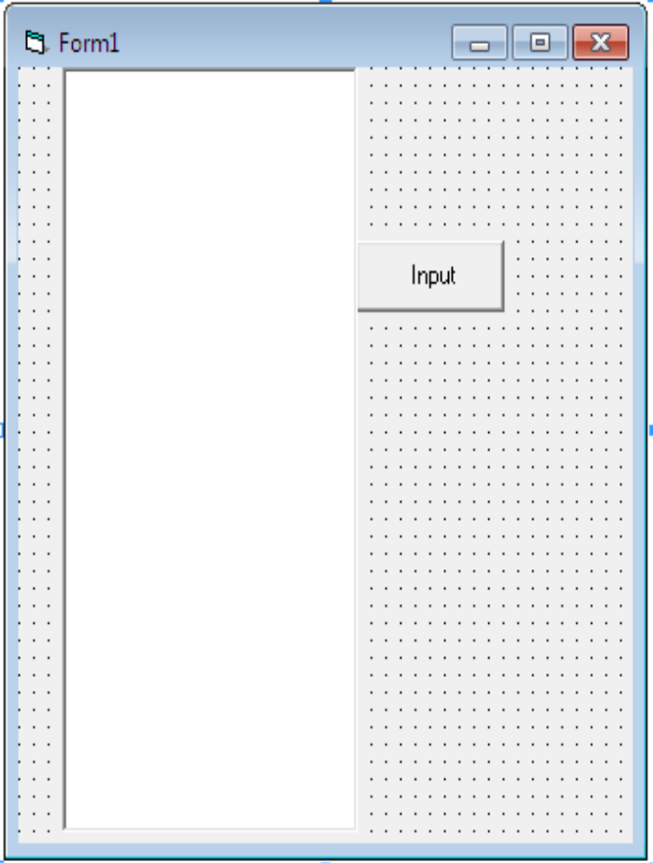
Example (For Practical):
1. Start a new project.
2. Place the one Textbox & 1 command button on the form as shown in following form.
3. Set the properties of the form and each object.
Form1: | Text1: | Command1
Caption: Input | Multiline: True. | Caption: Input

Slide 25
Private Sub Command1_Click()
Dim n, i, sum As Integer
Dim ms As String
sum = 0
n = InputBox("Enter The Number")
For i = 1 To 10
sum = 0
sum = n * i
ms = ms & sum & vbNewLine
Next i
Text1.Text = ms
MsgBox "You Print the Table of‖ & n
End Sub
Output:

Slide 26
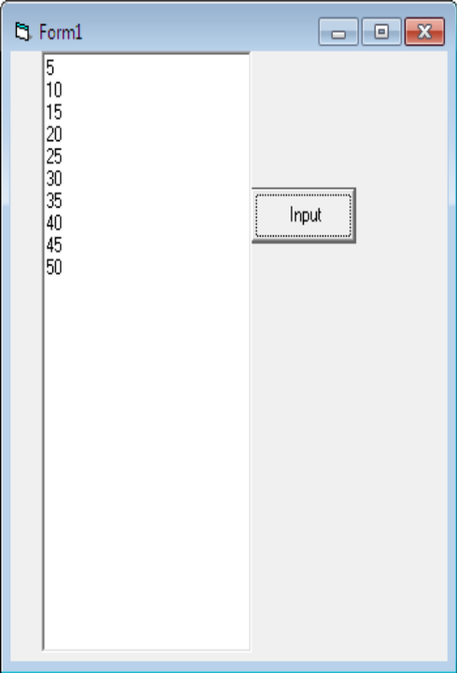
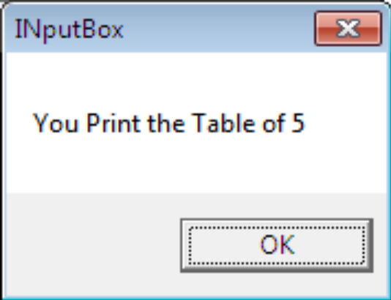
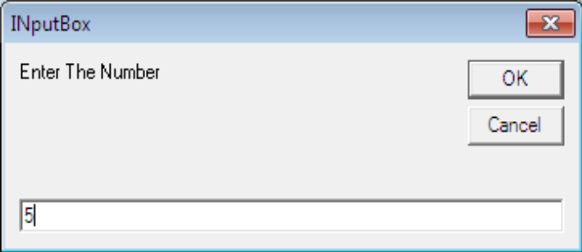

Slide 27
Control Flow Statements
An application needs a built-in capability to test condition and take a different course of action depending on the test. Visual Basic Provides three Control flow or Decision structures.
If….. Then
If……. Then …..Else
Select Case

Slide 28
If….. Then
The If…. Then structure tests the conditions specified, and if it’s true, executes the statement(s) that follow. The If structure can have a single line or a multiple line syntax. To Execute one statement conditionally. Use the Single-Line syntax as follows
Syntax
    IF
    (Condition)
    Then
    (Statement)
Eg:
  If Month(Date)=1 then
  Year=year+1
  You can also execute the multiple statements by separating them with a colon:

Slide 29
If….Then….Else
A variation of the If...Then statement is the If... Then... Else statement, which executes one block of statements if the condition is True and another if the condition is False. The syntax of the If...Then...Else statement is as follows:
Syntax
  If condition Then
  statementblock-1
  Else
  statementblock-2
  End If
Visual Basic evaluates the condition, and if it’s True, it executes the first block of statements and then jumps to the statement following the End If statement. If the condition is False, Visual Basic ignores the first block of statements and executes the block following the Else keyword.

Slide 30
If….Then….Else
Another variation of the If...Then...Else statement uses several conditions, with the ElseIf keyword:
  If condition1 Then
  statementblock-1
  ElseIf condition2 Then
  statementblock-2
  ElseIf condition3 Then
  statementblock-3
  Else
  statementblock-4
  End If

Slide 31
You can have any number of ElseIf clauses. The conditions are evaluated from the top, and if one of them is True, the corresponding block of statements is executed. The Else clause will be executed if none of the previous expressions are True
Here’s an example of an If statement with ElseIf clauses:
  score = InputBox(“Enter score”)
  If score < 50 Then
  Result = “Failed”
  ElseIf score < 75 Then
  Result = “Pass”
  ElseIf score < 90 Then
  Result = “Very Good”
  Else
  Result = “Excellent”
  End If
  MsgBox Result

Slide 32
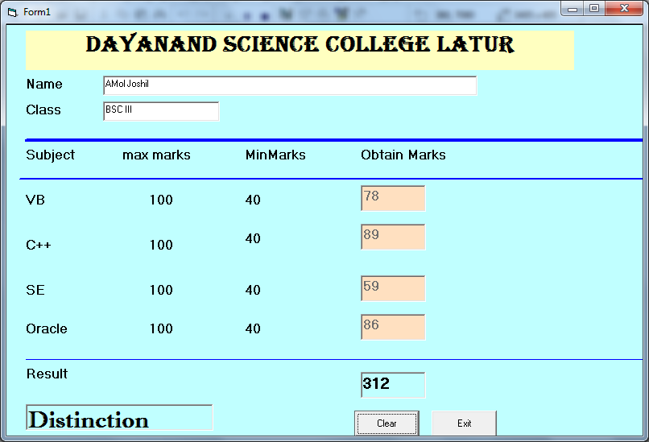
Example (For Practical):
1. Start a new project.
2. Place the labels, Textboxes & lines on the form as shown in following form.
3. Set the properties of the form and each object.

Slide 33
Form1:
BorderStyle 1-Fixed Single
Caption MarkMemo
Name frmMM
Label1: | Label2: | Label3:
Caption: Dayanand Science College, Latur Alignment 2- Center | Caption: Name | Caption: Class
Label4: | Label5: | Label6:
Caption Subject | Caption Max Mark | Caption Min Mark
Label7: | Label8: | Label9:
Caption Obtain Mark | Caption VB | Caption C++
Label10: | Label11: | Label12:
Caption SE | Caption Oracle | Caption 100
Label13: | Label14: | Label15:
Caption 100 | Caption 100 | Caption 100
Label16: | Label17: | Label18:
Caption 40 | Caption 40 | Caption 40
Label19: | Label20: | Label21:
Caption 40 | Caption Result | Caption [Blank]
Label22:
Caption [Blank]

Slide 34
4. Attach the following code to given event.
Dim total As Integer
Dim per As Double
Private Sub Text3_LostFocus()
Text3.Enabled = False
End Sub
Private Sub Text4_LostFocus()
Text4.Enabled = False
End Sub
Private Sub Text5_LostFocus()
Text5.Enabled = False
End Sub

Slide 35
Private Sub Text6_LostFocus()
Text6.Enabled = False
total = Val(Text3.Text) + Val(Text4.Text) + Val(Text5.Text) + Val(Text6.Text)
Label15.Caption = total
If Val(Text3.Text) >= 40 And Val(Text4.Text) >= 40 And Val(Text5.Text) >= 40 And Val(Text6.Text) >= 40 Then
per = total / 4
If per >= 70 Then
Label16.Caption = "Des"
ElseIf per >= 60 Then
Label16.Caption = "First Class"
ElseIf per >= 50 Then
Label16.Caption = "Second Class"
ElseIf per >= 40 Then
Label16.Caption = "Third Class"
Else
Label16.Caption = "Fail"
End If
Else
Label16.Caption = "Fail"
End If
End Sub
Private Sub Command1_Click()
Text1.Text = ""
Text2.Text = ""
Text3.Text = ""
Text4.Text = ""
Text5.Text = ""
Text6.Text = ""
Text3.Enabled = True
Text4.Enabled = True
Text5.Enabled = True
Text6.Enabled = True
Text1.SetFocus
End Sub
Private Sub Command2_Click()
End
End Sub

Slide 36
Select Case statements
The Select Case structure compares one expression to different values. The advantage of the Select Case statement over multiple If...Then...Else a statement is that it makes the code easier to read and maintain.
The Select Case structure tests a single expression, which is evaluated once at the top of the structure. The result of the test is then compared with several values, and if it matches one of them, the corresponding block of statements is executed. Here’s the syntax of the Select Case statement:
Select Case expression
Case value1
statementblock-1
Case value2
statementblock-2
.
.
.
Case Else
statementblock
End Select

Slide 37
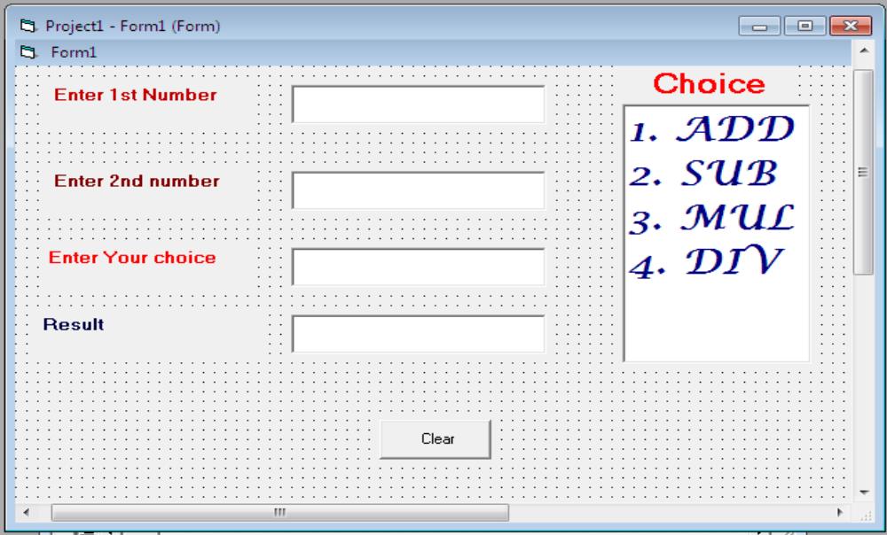
The expression variable is evaluated at the beginning of the statement. The value of the expression is then compared with the values that follow each Case keyword. If they match, the
block of statements up to the next Case keyword is executed, and the program skips to the statement following the End Select statement. The block of the Case Else statement is optional and is executed if none of the previous Case values match the expression.
Example (For Practical):
Start a new project.
Place the 5 labels, 5 Textboxes & 1 command button on the form as shown in following form.

Slide 38
6. Set the properties of the form and each object.
Form1: | Command1
Caption Select_Case | Caption Clear
Name frmSC
Label1: | Label2:
Caption Enter 1st Number | Caption Enter 2nd Number
Alignment 2- Center | Alignment 2- Center
Label3: | Label4:
Caption Enter Your Choice | Caption Result
Alignment 2- Center | Alignment 0- Left
Label5:
Caption Choice Multiline True.
Alignment 2- Center | 1. ADD
Multiline True | 2. SUB
Forecolor red | 3. MUL
Font | 4. DIV

Slide 39
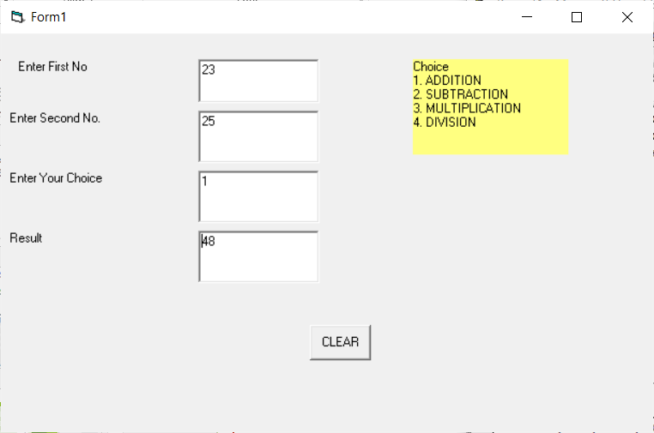
5. Attach the following code to given event.
Private Sub Command1_Click()
Text1.Text = ""
Text2.Text = ""
Text3.Text = ""
Text4.Text = ""
Text1.SetFocus
End Sub
Private Sub Text4_GotFocus()
Dim n1, n2, res, ch As Integer
n1 = Val(Text1.Text)
n2 = Val(Text2.Text)
ch = Val(Text3.Text)
res = Val(Text4.Text)
Select Case ch
Case 1
Text4.Text = n1 + n2
Case 2
Text4.Text = n1 - n2
Case 3
Text4.Text = n1 * n2
Case 4
Text4.Text = n1 / n2
End Select
End Sub

Slide 40
Loop Statements
Loop statements allow you to execute one or more lines of code repetitively. Many tasks consist of trivial operations that must be repeated over and over again, and looping structures are an important part of any programming language. Visual Basic supports the following loop statements:
Do...Loop
For...Next

Slide 41
Do...Loop
To execute a block of statements while a condition is True, use the following syntax:
Do While condition
statement-block
Loop
To execute a block of statements until the condition becomes True, use the following syntax:
Do Until condition
statement-block
Loop
The Do...Loop executes a block of statements for as long as a condition is True. Visual Basic evaluates an expression, and if it’s True, the statements are executed. If the expression is False, the program continues and the statement following the loop is executed.
There are two variations of the Do...Loop statement and both use the same basic model. A loop can be executed either while the condition is True or until the condition becomes True. These two variations use the keywords While and Until to specify how long the statements are executed.

Slide 42
When Visual Basic executes the previous loops, it first evaluates condition. If condition is False, the Do...While or Do...Until loop is skipped (the statements aren’t even executed once). When the Loop statement is reached, Visual Basic evaluates the expression again and repeats the statement block of the Do...While loop if the expression is True, or repeats the statements of the Do...Until loop if the expression is False.
The Do...Loop can execute any number of times as long as condition is True. Moreover, the number of iterations need not be known before the loops starts. If condition is initially False, the statements may never execute.

Slide 43
Another variation of the Do loop executes the statements first and evaluates the condition after each execution. This Do loop has the following syntax
Do
statements
Loop While condition
or
Do
statements
Loop Until condition
The statements in this type of loop execute at least once, since the condition is examined at the end of the loop.

Slide 44
For...Next
The For...Next loop is one of the oldest loop structures in programming languages. Unlike the Do loop, the For...Next loop requires that you know how many times the statements in the loop will be executed. The For...Next loop uses a variable (it’s called the loop’s counter) that increases or decreases in value during each repetition of the loop.

Slide 45
For...Next
The For...Next loop has the following syntax:
For counter = start To end [Step increment]
statements
Next [counter]
The keywords in the square brackets are optional. The arguments counter, start, end, and increment are all numeric. The loop is executed as many times as required for the counter to reach (or exceed) the end value.
In executing a For...Next loop, Visual Basic completes the following steps:
1. Sets counter equal to start
2. Tests to see if counter is greater than end. If so, it exits the loop. If increment is negative, Visual Basic tests to see if counter is less than end. If it is, it exits the loop.
3. Executes the statements in the block
4. Increments counter by the amount specified with the increment argument. If the increment argument isn’t specified, counter is incremented by 1.
5. Repeats the statements

Slide 46
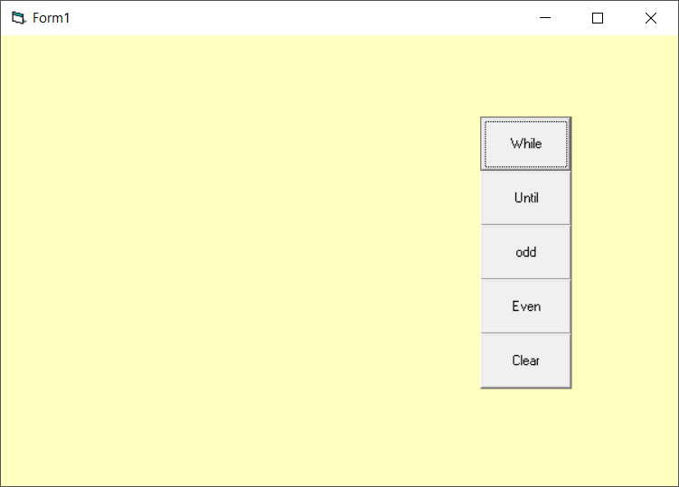
Example Of Looping statement

Slide 47
Private Sub Command1_Click()
Dim i As Integer
i = 1
Do While i <= 10
Form1.Print i
i = i + 1
Loop
End Sub
Private Sub Command2_Click()
Dim i As Integer
i = 1
Do Until i > 10
Form1.Print i
i = i + 1
Loop
End Sub
Private Sub Command3_Click()
Dim i As Integer
For i = 1 To 10 Step 2
Form1.Print i
Next
End Sub
Private Sub Command4_Click()
Dim i As Integer
For i = 2 To 10 Step 2
Form1.Print i
Next
End Sub
Private Sub Command5_Click()
Form1.Cls
End Sub

Slide 48
Arrays
A standard structure for storing data in any programming language is the array. Whereas individual variables can hold single entities, such as one number, one date, or one string, arrays can hold sets of data of the same type (a set of numbers, a series of dates, and so on). An array has a name, as does a variable, and the values stored in it can be accessed by an index.
An array is similar to a variable: it has a name and multiple values. Each value is identified by an index (an integer value) that follows the array’s name in parentheses. Each different value is an element of the array.
For eg.
Dim salaries (15) As Integer
If the array Salaries holds the salaries of 16 employees, the element Salaries(0) holds the salary of the first employee, the element Salaries(1) holds the salary of the second employee, and so on up the element Salaries(15).NET
The indexing of arrays in VB starts at zero.

Slide 49
Declaring Arrays
Arrays must be declared with the Dim statement followed by the name of the array and the index of the last element in the array in parentheses.
Syntax : Dim Array name( ) As Data type
for example,
Dim Salaries(15) As Integer
Salaries is the name of an array that holds 16 values (the salaries of the 16 employees), with indices ranging from 0 to 15. Salaries(0) is the first person’s salary, Salaries(1) the second person’s salary, and so on. All elements in an array have the same data type.

Slide 50
Initializing Arrays
Just as you can initialize variables in the same line where you declare them, you can initialize arrays, too, with the following syntax:
Dim arrayname() As type = {entry0, entry1, … entryN}
example that initializes an array of strings:
Dim names() As String = {“Joe Doe”, “Peter Smack”}
This statement is equivalent to the following statements, which declare an array with two elements and then set their values:
Dim names(1) As String
names(0) = “Joe Doe”
names(1) = “Peter Smack”
The number of elements in the curly brackets following the array’s declaration determines the dimensions of the array, and you can’t add new elements to the array without resizing it.

Slide 51
Array Limits
The first element of an array has index 0. The number that appears in parentheses in the Dim statement is one less than the array’s total capacity and is the array’s upper limit (or upper bound).
The index of the last element of an array (its upper bound) is given by the function UBound(), which accepts as argument the array’s name. For the array
Dim myArray(19) As Integer
its upper bound is 19, and its capacity is 20 elements.

Slide 52
Private Sub Command1_Click()
Dim a(5), i, max As Integer
For i = 0 To 4
a(i) = InputBox("enter a number")
Next
max = a(0)
For i = 0 To 4
If a(i + 1) > max Then
max = a(i + 1)
End If
Next
MsgBox ("Largest number is " & max)
End Sub

Slide 53
Example 2
Private Sub Command1_Click()
Dim matrix(1 To 3, 1 To 3) As Integer
matrix(1, 1) = 10
matrix(1, 2) = 20
matrix(2, 1) = 30
matrix(3, 3) = 40
MsgBox "Element at (2,1) = " & matrix(2, 1)
End Sub

Slide 54
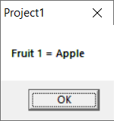
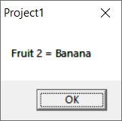
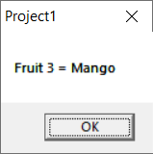
Looping through Arrays
Dim i As Integer
Dim fruits(1 To 3) As String
fruits(1) = "Apple"
fruits(2) = "Banana"
fruits(3) = "Mango"
For i = 1 To 3
MsgBox "Fruit " & i & " = " & fruits(i)
Next i

Slide 55
Multidimensional Arrays
One-dimensional arrays, such as those presented so far, are good for storing long sequences of one dimensional data (such as names or temperatures). But how would you store a list of cities and their average temperatures in an array? Or names and scores, years and profits. A two-dimensional array has two indices. The first identifies the row, and the second identifies the column.

Slide 56
Declaring Multidimensional Arrays
Multidimensional arrays must be declared with the Dim statement followed by the name of the array and the index of the row & column in the array in parentheses.
Syntax : Dim Array name(row, column ) As Data type
for example, Dim Marks(3,3) As Integer

Slide 57
Initializing Arrays
The following statements initialize a two-dimensional array.
Syntax :
Dim Array name( ) As Data type = {{element of 1st row}, { element of 2nd row }, { element of 3rd row },{ element of nth row }}
Dim a(,) As Integer = {{10, 20, 30}, {11, 21, 31}, {12, 22, 32}}

Slide 58
Dim i, j As Int16
For i = 0 To 2
For j = 0 To 3
a(i, j) = (i * 4) + j + 1
Next
Next
Label1.Text = a(0, 0)
Label2.Text = a(0, 1)
Label3.Text = a(0, 2)
Label4.Text = a(0, 3)
Label5.Text = a(1, 0)
Label6.Text = a(1, 1)
Label7.Text = a(1, 2)
Label8.Text = a(1, 3)
Label9.Text = a(2, 0)
Label10.Text = a(2, 1)
Label11.Text = a(2, 2)
Label12.Text = a(2, 3)

Slide 59
Important Points
Array index in VB6 can start from 0 or 1, depending on Option Base.
  Default is Option Base 0 (index starts at 0).
  You can set Option Base 1 at the top of the module to make arrays start from 1.
Arrays save memory and make programs easier to manage when dealing with lists or collections of data.
UBound(ArrayName) → returns the upper bound (last index).
LBound(ArrayName) → returns the lower bound (first index).

Slide 60
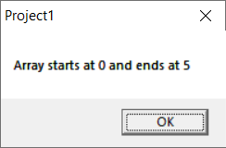
Example 1
Dim arr(5) As Integer
MsgBox "Array starts at " & LBound(arr) & " and ends at " & UBound(arr)

Slide 61
Example 2
Private Sub Form_Load()
Dim arr(5) As Integer
MsgBox "Array starts at " & LBound(arr) & " and ends at " & UBound(arr)
arr(0) = 20
arr(1) = 21
arr(2) = 22
arr(3) = 23
arr(4) = 24
arr(5) = 25
For n = 0 To 5
MsgBox "array element " & n & " = " & arr(n)
Next n
End Sub

Slide 62
Library Functions
Visual basic provides large set of built in functions. Following are the types of built in functions provided by Visual Basic:
  String Function
  Mathematical function
  Date and Time Function
  Conversion Functions

Slide 63
What is procedure
A procedure in Visual Basic is a block of code that performs a specific task. It helps break down a large program into smaller, manageable parts.
Using procedures in VB6.0 is essential for writing clean, organized, and efficient code. Here’s a breakdown of why they are important:
1. 🧱 Modular Programming
Procedures break a large program into smaller, manageable sections.
Each procedure handles one specific task.
This makes the program easier to understand and maintain.

Slide 64
2. 🔁 Code Reusability
You can write a procedure once and call it many times.
Avoids writing the same code again and again.
3. 🛠️ Easy to Debug and Test
Since procedures are self-contained blocks, you can test or debug them individually.
If there’s a bug, you know where to look!
4. 👀 Improves Readability
Procedures with meaningful names help others (and you) understand the logic quickly.
Example:
Call CalculateTotal()
Call PrintInvoice()
These names clearly show what the code is doing.

Slide 65
5. ⚙️ Handles Events Easily
VB6 is event-driven, and event procedures handle actions like clicks, typing, form loading, etc.
Without procedures, handling user interactions would be messy.
6. ⏱️ Saves Time and Effort
When you need to change a logic (like discount calculation), just update the procedure — no need to search and update everywhere.
7. 📚 Supports Structured Programming
Encourages good programming habits.
Makes it easier to work in teams (each person can work on different procedures).

Slide 66
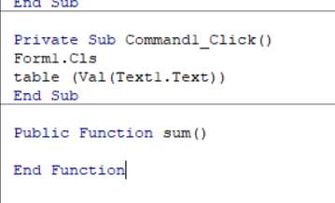
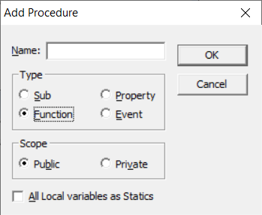

Slide 67
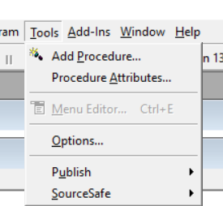
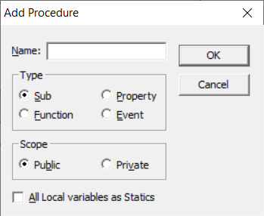
Procedures

Slide 68
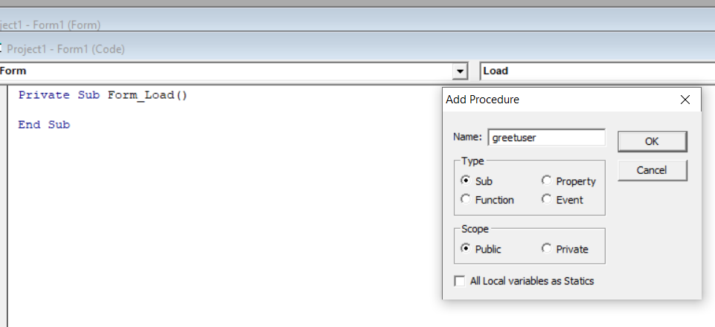
Example of sub procedure
Start a new project.
Open Code editor and click on Tools>> Add Procedure option
It will open Add Procedure dialog Box
Now Enter the name of procedure “greetuser”
Select its type as sub and scope as public

Slide 69
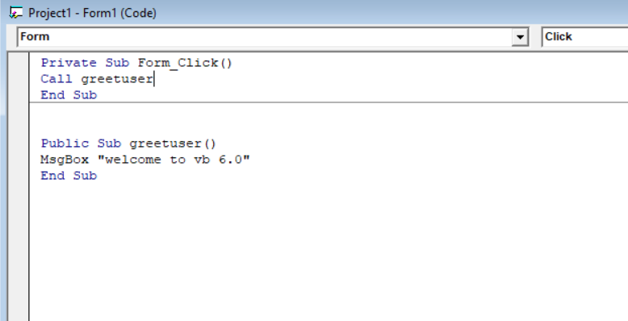
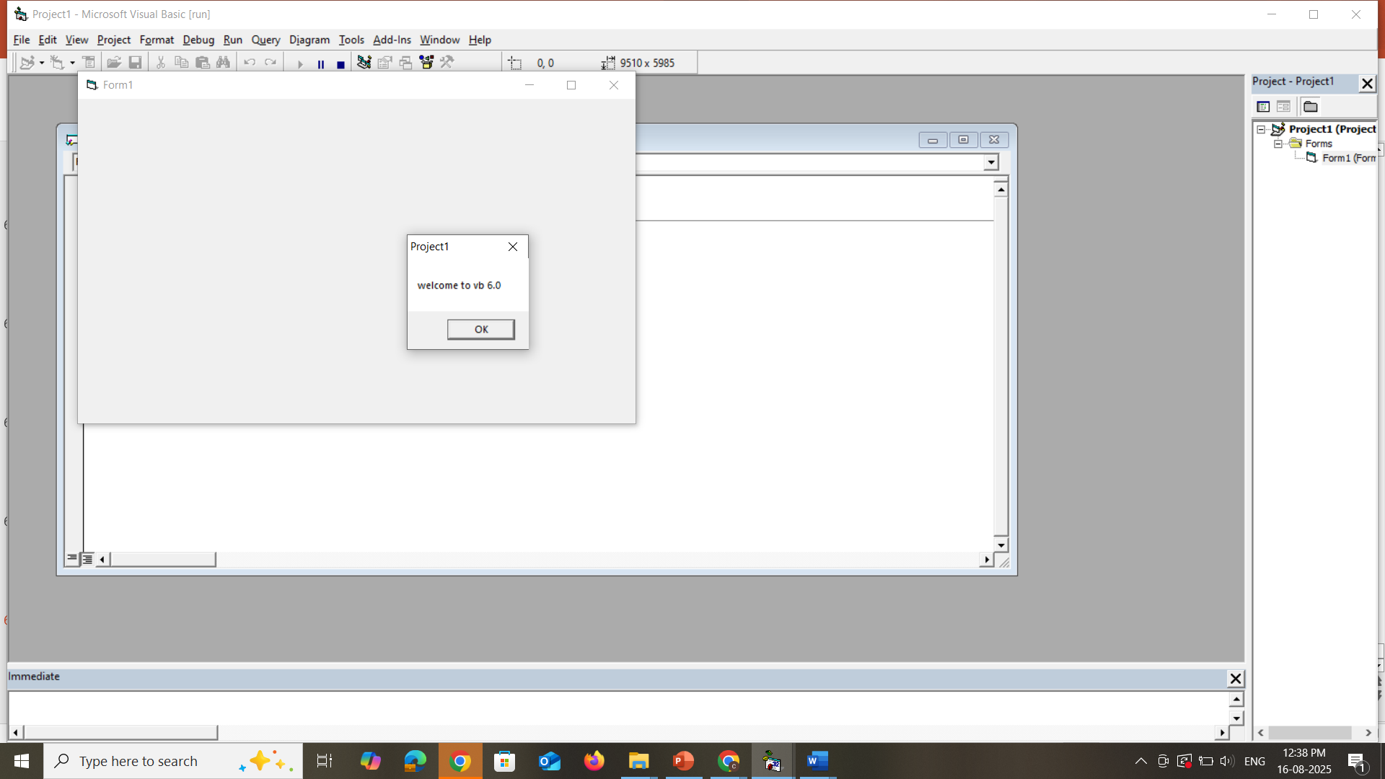
6. Now enter the following code with Public sub
  Public Sub greetuser()
  MsgBox "welcome to vb 6.0"
  End Sub
7. Next Procedure to call this procedure in your form. Write a code on form_click event
  Private Sub Form_Click()
  Call greetuser
  End Sub
8. Run this program and click on form you
will get output

Slide 70
Types of Procedures in VB6.0
Sub Procedures (Sub … End Sub)
  Perform an action but do not return a value.
  Called using their name.
  Example: showing a message, opening a file, clearing a textbox.
Function Procedures (Function … End Function)
  Perform an action and return a value.
  Used when you want to calculate something and get a result.
  Example: calculating sum, square, factorial, etc.

Slide 71
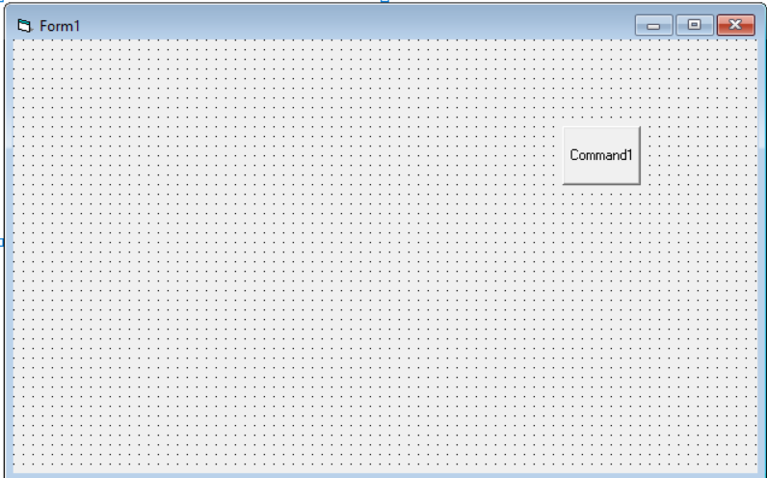
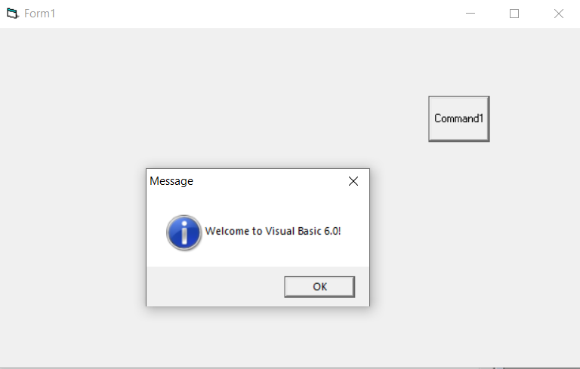
1. Sub Procedure Example
Private Sub ShowMessage()
MsgBox "Welcome to Visual Basic 6.0!", vbInformation, "Message"
End Sub
Private Sub Command1_Click()
' Calling the Sub Procedure
ShowMessage
End Sub

Slide 72
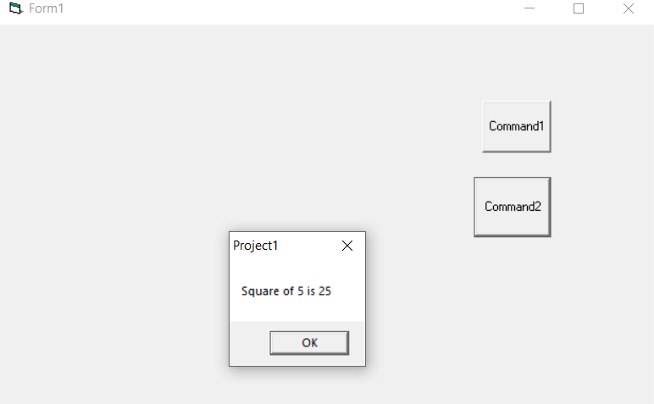
2. Function Procedure Example
Private Function SquareNumber (ByVal n As Integer) As Integer
SquareNumber = n * n
End Function
Private Sub Command2_Click()
Dim result As Integer
result = SquareNumber(5)
MsgBox "Square of 5 is " & result
End Sub

