Slide 1
Chapter 1
Getting Started with VB

Slide 2
Aim And Objective
Silent Features: Visual Basics is a Graphical User Interface language. We can design various forms and reports by drag and drop models. It is very convenient platform of modern software designing.
Learning Objectives:
To learn Graphical User Interface Language.
To develop an application using GUI Language.
Implement VB programs to solve simple problems.
Utility of the course: Confidence of becoming a Software developer in order to get placement as well as in research activities
Prerequisite: Knowledge of programming

Slide 3
Unit 01: Getting Started with VB
The IDE
The Elements of user interface
Designing user interface
Programming an Application Visual Development and
Event Driven Programming.

Slide 4
The IDE
IDE (Integrated Development Environment)
  This is a software application that combines all of the features and tools needed by a software developer. or
  An integrated development environment is a software application that provides comprehensive facilities to computer programmers for software development. An IDE normally consists of at least a source code editor, build automation tools and a debugger.

Slide 5

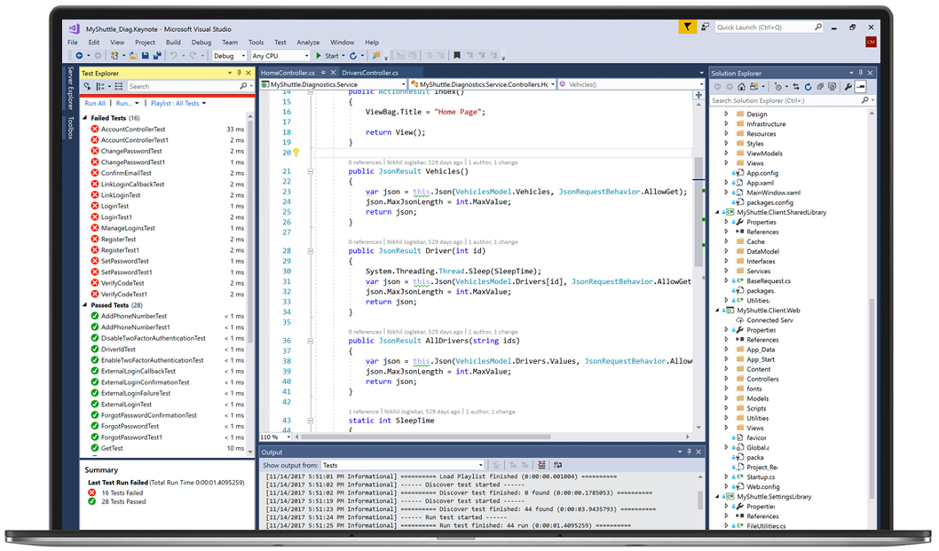
Microsoft Visual Studio
Microsoft Visual Studio
The many editions of this IDE are capable of creating all types of programs ranging from web applications to mobile apps to video games.
Languages supported: ASP.NET, DHTML, JavaScript, JScript, Visual Basic, Visual C#, Visual C++, Visual F#, XAML and more

Slide 6
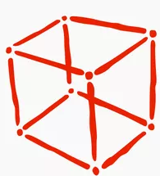
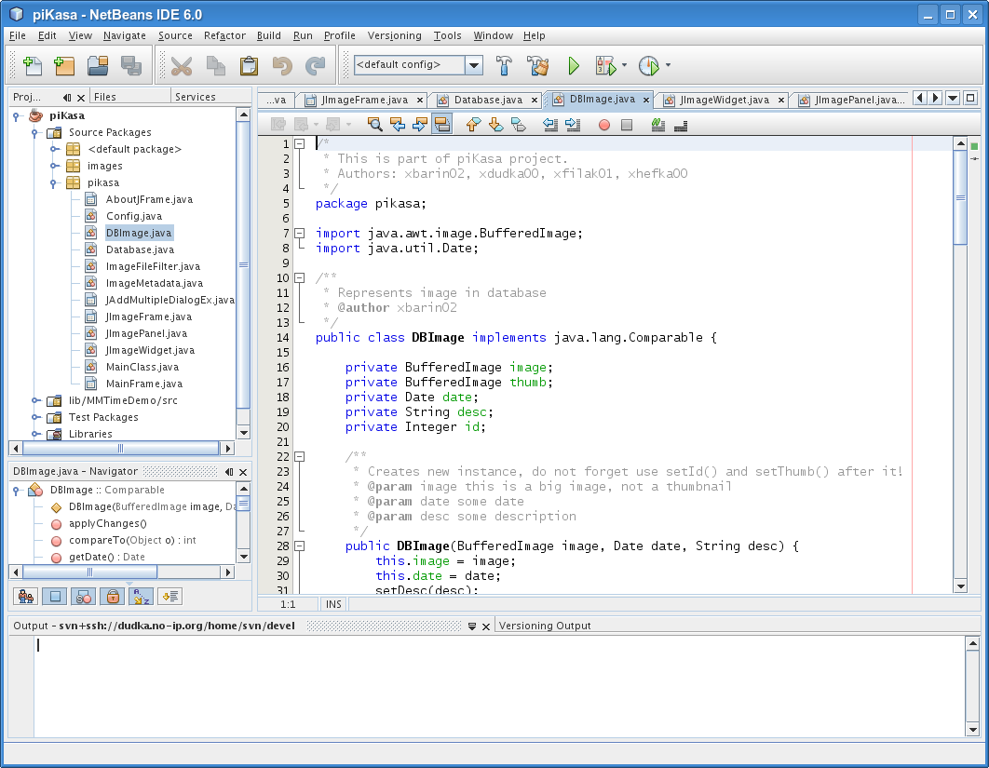
2. NetBeans
Netbeans is a free and open source IDE. Ideal for editing existing projects.
It is primarily used to develop Java applications, but you can download bundles that support other language
Languages supported: C, C++, C++11, Fortan, HTML 5, Java, PHP and more

Slide 7

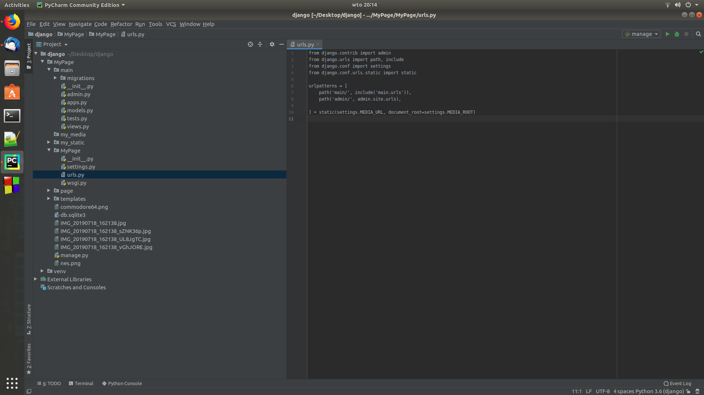
3. PyCharm
PyCharm is developed by the folks.
Comprehensive code assistance and analysis make PyCharm the best IDE for Python programmers of all ability levels.
PyCharm also supports other languages and works on multiple platforms, so practically anyone can use it.
Languages supported: AngularJS, Coffee Script, CSS, Cython, HTML, JavaScript, Node.js, Python, TypeScript and template languages

Slide 8

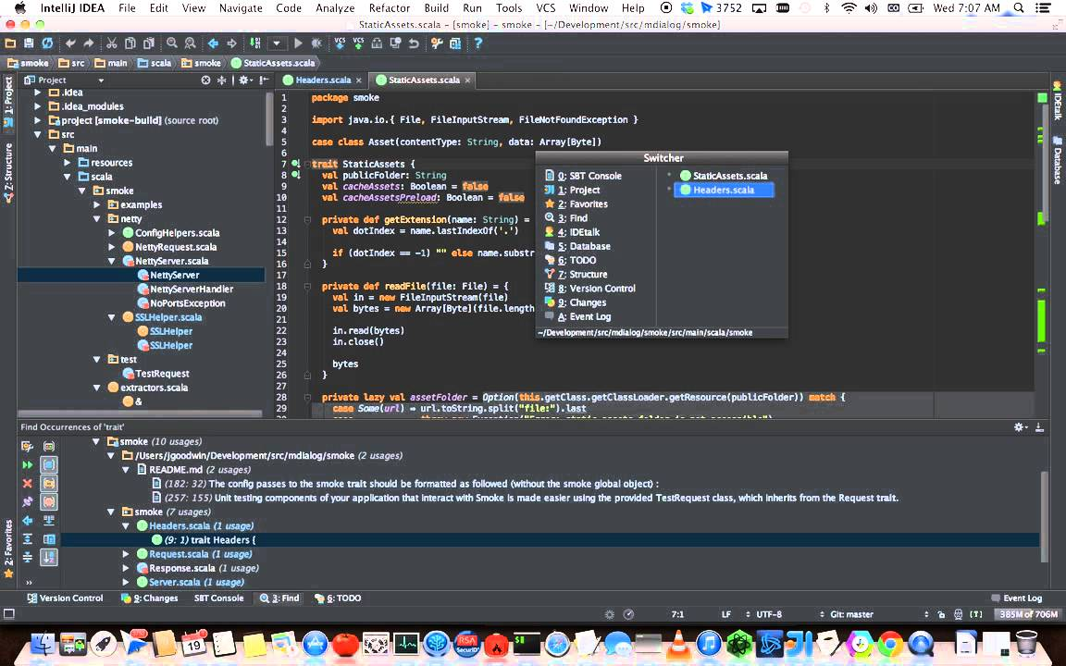
4. IntelliJ IDEA
IntelliJ IDEA is another IDE developed by Jet Brains. This IDE offers users a free Community Edition.
When it comes to cost, IntelliJ is a real deal due to the massive of list of features you get.
Languages supported: AngularJS, CoffeeScript, CS, HTML, JavaScript, Less, Node JS, PHP, Python, Ruby, Sass, TypeScript and more.

Slide 9

5. Eclipse
Eclipse is a free and flexible open source editor useful for beginners. Originally a Java environment, Eclipse now has a wide range of capabilities thanks to a large number of plugins and extensions.
There is plenty of other packages to choose from that include tools for charting, modeling, reporting, testing and building GUIs.
The Eclipse Marketplace Client gives users access to a treasure trove of plugins and information supplied by an expanding community of developers.
Languages supported: C, C++, Java, Perl, PHP, Python, Ruby and more

Slide 10
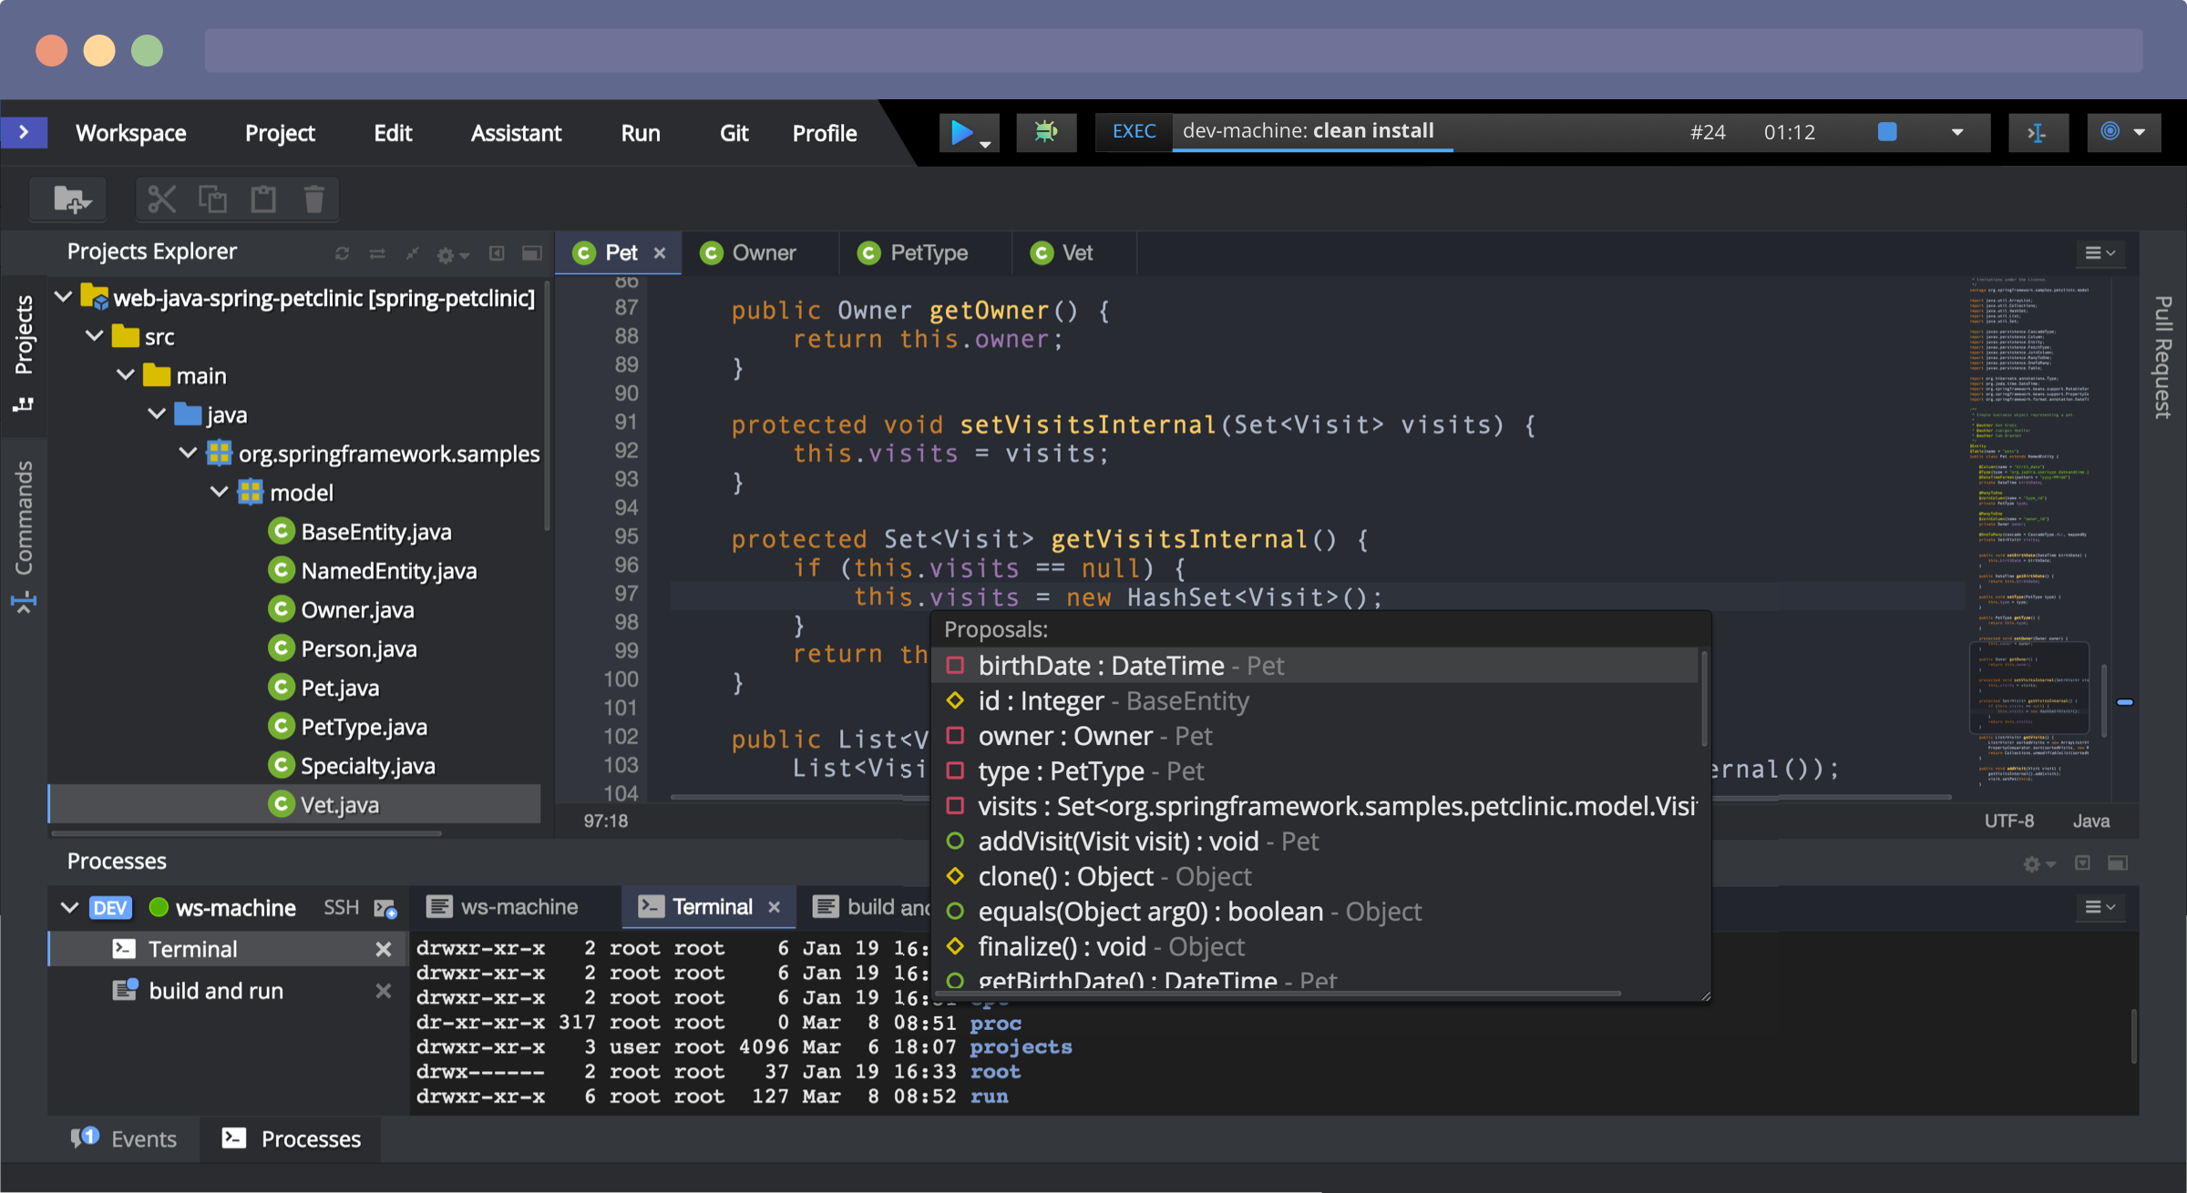

Slide 11
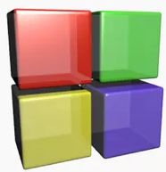
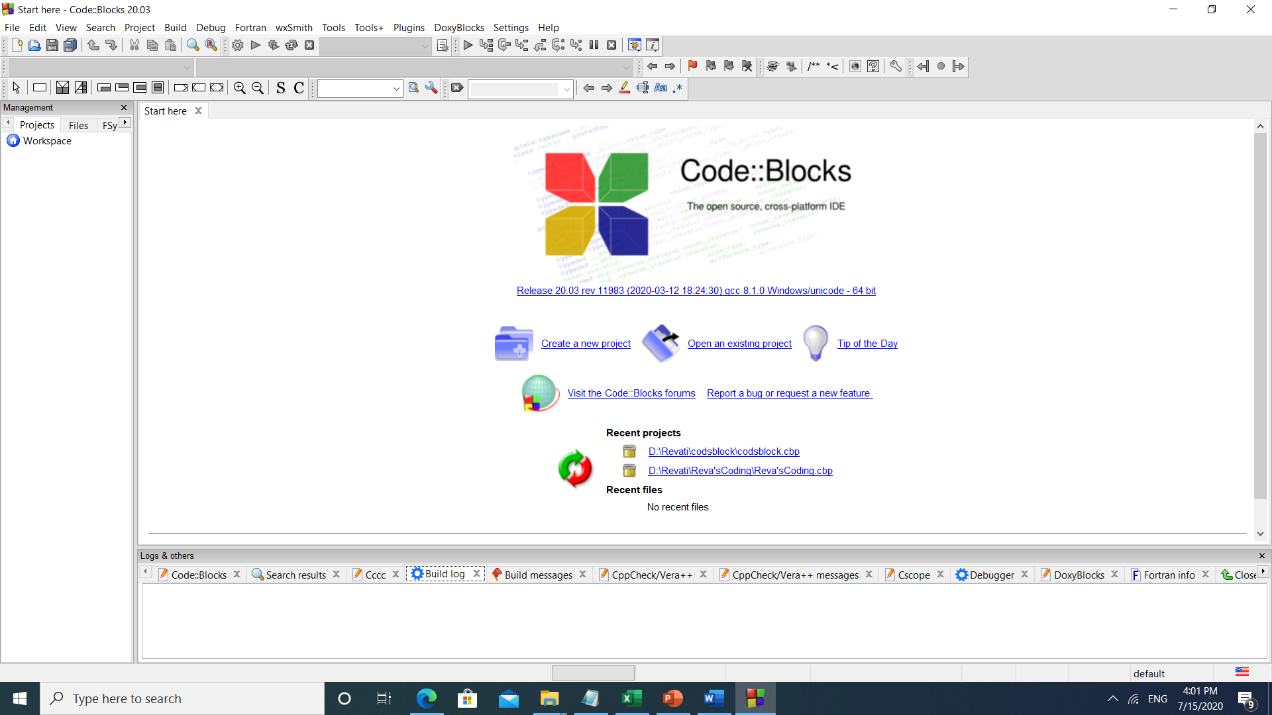
6. Code::Blocks
Code::Blocks is another popular free and open source option.
It is a highly customizable IDE that performs consistently across all platforms, so it is great for developers who frequently switch between workspaces.
The plug-in framework lets users tweak this IDE to meet their needs.
Languages supported: C, C++, Fortran

Slide 12

8.RubyMine
RubyMine is another premium IDE, developed by Jet Brains, that offers a 30 day free trial and costs $210 - 687 annually.
As its name implies, RubyMine is a favorite among Ruby enthusiasts; however, this IDE supports other programming languages as well.
Easy navigation, logical workflow organization, and compatibility with most platforms make RubyMine a workplace favorite.
Languages supported: CoffeeScript, CSS, HAML, HTML, JavaScript, Less, Ruby and Rails, Ruby and Sass

Slide 13
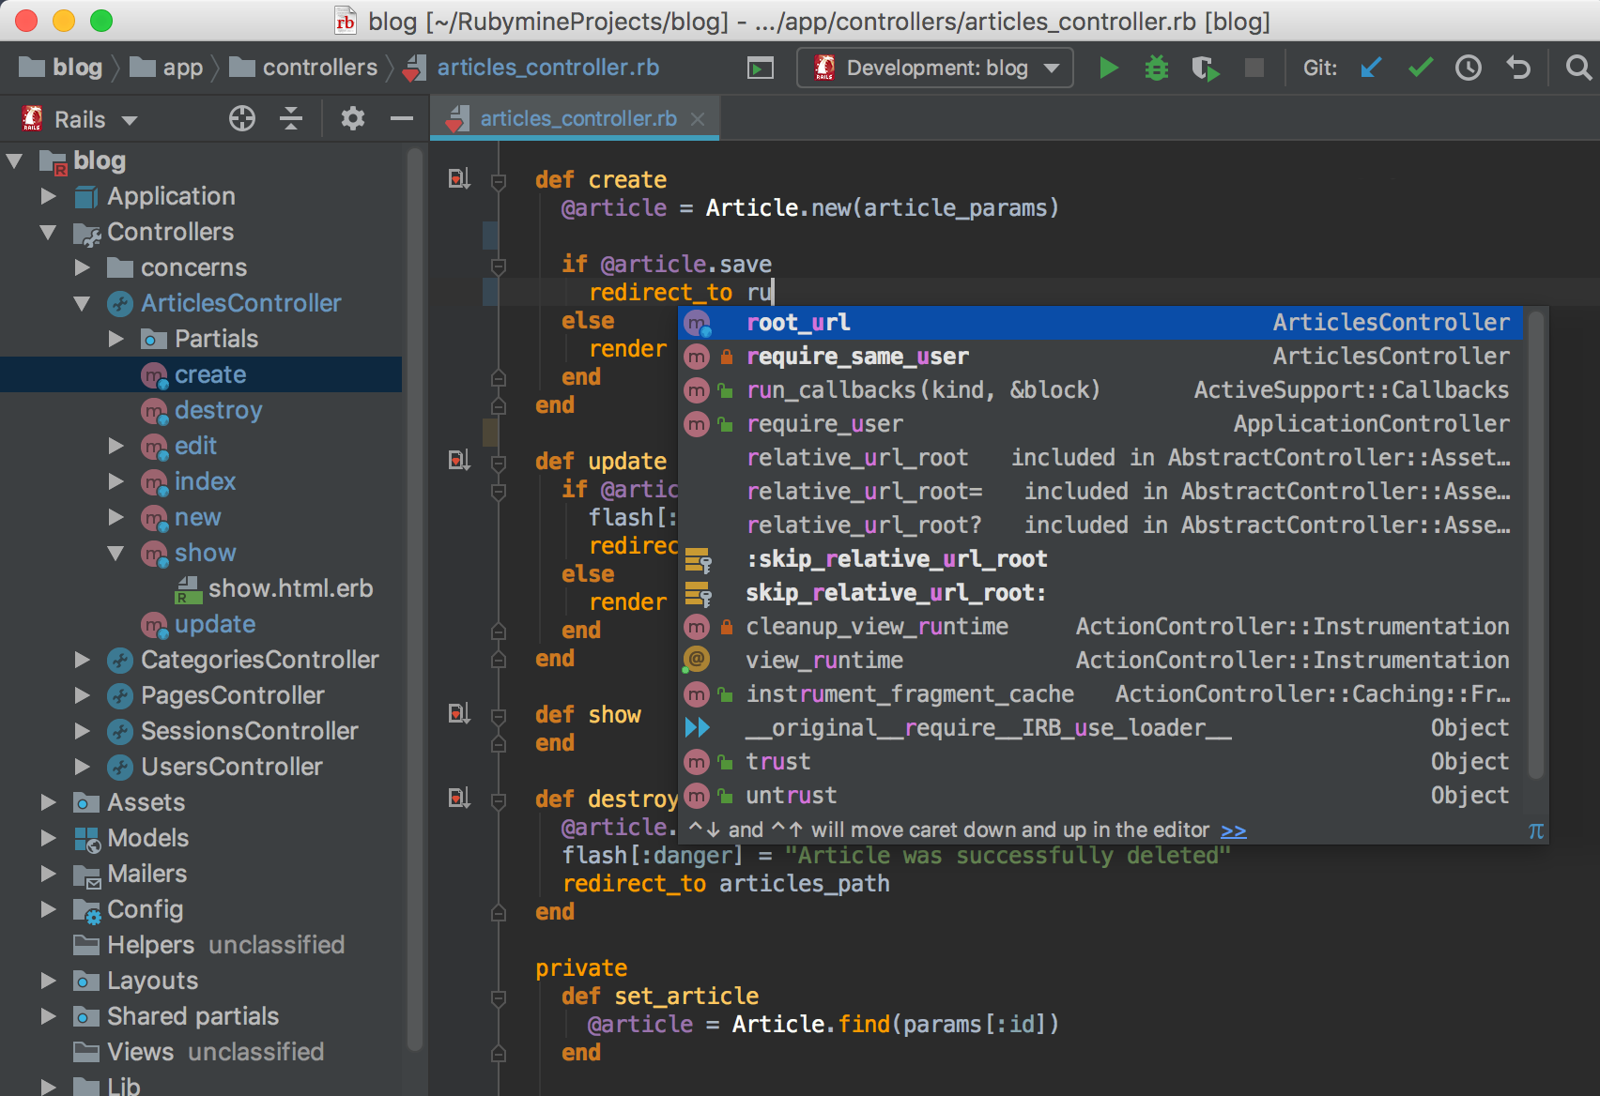

Slide 14
Revision Time
What IS IDE?

Slide 15
What are the examples of IDE

Slide 16
IDE must contain following features
1. Code completion or code insight : The ability of an IDE to know a language, knowledge and function names is crucial. The IDE may are knowledge to do such thing as highlight errors, suggest a list of available function based on the appropriate satiation or offer a function definition.
2. Resource Management : When creating application, language often rely on certain resources like library or header file to be act specific locations. IDE should be able to manage these resources.
3. Debugging tools : In an IDE, you should be able to thoroughly test your application before release. The IDE must be able to give variable values at certain points, connect to different data repositioneries or accept different run-time parameter.
4. Compile & build for language that require a compile or build stage, IDEs translate code from high level language to the object code of the targeted platform.

Slide 17
Advantages of using IDE :
1. Less time and effort : The entire purpose of an IDE is to make developing faster and easier its tools and features are supposed to help you organize resources, prevent mistakes and provide shortcuts.
2. Enforce project or Company Standard : Simply by working in the some development environment, a group of programmers will adhere to a standard way of doing things.
3. Project Management : This can be two fold,
a. first, many IDEs have documentation tools that either automate the entry of developer comments, or may actually force developers to write comments in different areas.
b. Second, simply by having a visual presentation of resources. It should be a lot easier to know how an application is laid out as opposed to traversing the file system.

Slide 18
Disadvantages of IDE :
1. Learning Curve - IDEs are complicated tools. Maximizing their benefit will require time and patience.
2. A sophisticated IDE may not be a good tool for beginning programmers. If you skip the learning curve of an IDE on top of learning how to program. It can be quite hard but the features and shortcut for experienced programmers often enjoy this programming.
3. Will not fir bad code, practices or design. An IDE will not eliminate efficiency or performance problems in

Slide 19
Visual Basic is initiated by using the
Programs option > Microsoft Visual Basic 6.0 > Visual Basic 6.0.
Clicking the Visual Basic icon, we can view a copyright screen enlisting the details of the license holder of the copy of Visual Basic 6.0.
Then it opens in to a new screen as shown in figure 1 below, with the interface elements Such as MenuBar, ToolBar, The New Project dialog box.
These elements permit the user to buid different types of Visual Basic applications.

Slide 20
The Integrated Development Environment
(Visual Basic)
One of the most significant changes in Visual Basic 6.0 is the Integrated Development Environment (IDE).
IDE is a term commonly used in the programming world to describe the interface and environment that we use to create our applications.
It is called integrated because we can access virtually all of the development tools that we need from one screen called an interface.
The IDE is also commonly referred to as the design environment, or the program.

Slide 21
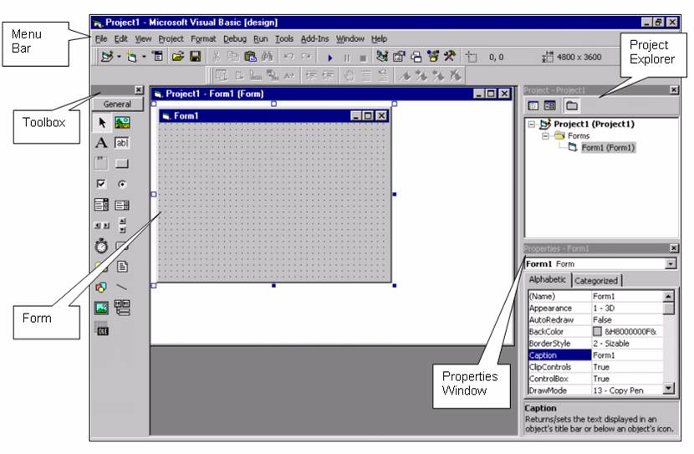

Slide 22
Syntax highlighting: The IDE editor usually provides syntax highlighting, it can show both the structures, the language keywords and the syntax errors with visually distinct colors and font effects.
Code completion: Code completion is an important IDE feature, intended to speed up programming. Modern IDEs even have intelligent code completion.
Refactoring: Advanced IDEs provide support for automated refactoring.
Version control: An IDE is expected to provide integrated version control, in order to interact with source repositories.
Debugging: IDEs are also used for debugging, using an integrated debugger, with support for setting breakpoints in the editor, visual rendering of steps, etc.
Code search: IDEs may provide advanced support for code search: in order to find class and function declarations, usages, variable and field read/write, etc. IDEs can use different kinds of user interface for code search, for example form-based widgets and natural-language based interfaces.

Slide 23
Visual programming:
Visual programming is a usage scenario in which an IDE is generally required. Visual Basic allows users to create new applications by moving programming, building blocks, or code nodes to create flowcharts or structure diagrams that are then compiled or interpreted

Slide 25
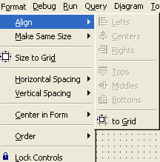
- After adding the elements (controls) on form we have to property organize the form because application user interface is the visible part.
- The visual basic IDE provides numerous commands for aligning controls, which are available on format menu.
- Align command align the edges or middles of the selected control to left, right or center, top, middles, bottom etc.
- Make same Size command make all selected control same size.
- Size to grid : Corners of selected control will align with nearest grid point.
- Horizontal Spacing : It controls the horizontal spacing between selected controls.
- Vertical Spacing : It controls the vertical spacing between selected controls.
- Center in form : It centers the selected control horizontally or vertically in the form.
- Order : It changes the order of the selected control by moving them in front or behind other controls.
- Lock Control : This command allow you to select a number of controls on the form and lock them. You can change the properties of locked control but you cannot move them.
Aligning the controls :

Slide 26
Running the application :
- Next process is to run and test the application. To run the application choose Run >> Start or Press F5.
- You may wondering that without entering a single line code, we create a application. It happens in Visual Basic because it uses visual tools to build a large section of the application.
- The user interface can be built almost entirely with point and click operation.
- To stop the application choose Run>>End.
- As you can see, the Visual Basic IDE is more than a program editor. It’s an integrated environment in which you can design and run your application.

Slide 27
Programming an application :
Designing user interface consist of drawing the elements on forms, aligning it properly and formatting it as per the requirement.
Designing is done in design view. Design is the visible part to the user. Programing is the another angle of the application development.
In the Designing user interface we take the example of login form. In the login form we add two labels, two text box and one common button.
We are going to create a code on command button. (login button). Double click on the command button and insert the
following code on command1_Click() event.

Slide 28
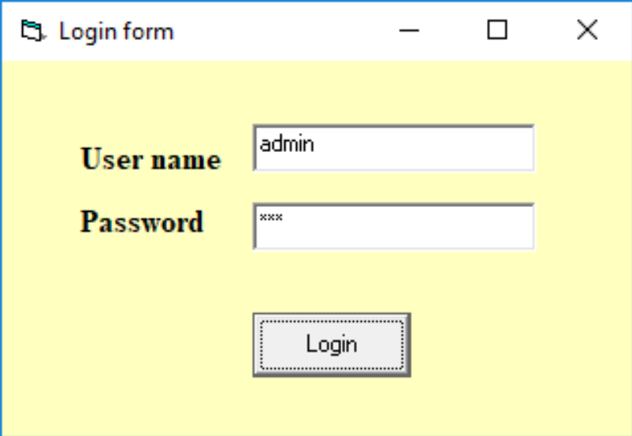
CODE:
Private Sub Command1_Click()
Dim user As String
Dim pass As String
user = "admin"
pass = "rvm"
If (user = username And pass = password) Then
MsgBox "welcome"
Else
MsgBox "Sorry"
End If
End Sub After completion of coding Run the program by pressing F5 key. Login form is displays as given below :

Slide 29
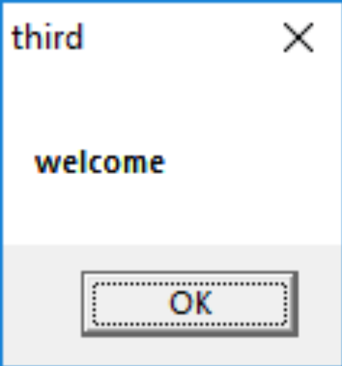
Now enter the username as “Admin” and password as “rvm” and click on login.
If username and password is matched then following message box is displayed.
If user name and password is not matched, then message box is displays “sorry” message,
Visual Basic IDE is an integrated environment in which you can design a user interface form and enter a code for it and run your application.

Slide 30
Visual Development and Event-Driven Programming :
Forms and controls are the basic elements in the user interface of any windows application. In visual basic, these elements are called as objects because are manipulated like objects.
Objects have properties and methods, and they react to external events as does any physical object. Normally properties are set when an object is created. Most control properties are set when the object is created. But you can change a property later by assigning a new value to it.
VB assigns a default properties to every new control you place on form. Like If you insert Command button it gives name as command1, commad2 etc.
Visual development and Event-Driven programming includes three basic things
1. properties of objects
2. Methods
3. Events

Slide 31
Properties of objects:
Following are the most common properties apply to most objects.
Name:
Name used to identify object. It is the name by which the object is referred to in your code. Visual Basic by default names the forms Form1, Form2, Form3, etc. three letter prefix for form names is frm
Appearance:
Return or set whether or not an object is painted at run time with 3D effects. There are two values of this property 0-Flat & 1- 3D. the default vale is 3D.
BackColor:
This property is used to sets the form background color.
BorderStyle
The BorderStyle property determines the style of the form’s border and the appearance of the form; it takes one of the values shown in following Table .You can make the form’s title bar disappear altogether by setting the form’s BorderStyle property to FixedToolWindow, the ControlBox property to False, and the Text property to an empty string. However, a form like this can’t be moved around with the mouse and will probably disturb users.
Table 3.2: The FormBorderStyle Enumeration
Value Effect

Slide 32
Sizable (default) : | Resizable window that’s used for displaying regular forms.
FixedDialog: | A fixed window, used to create dialog boxes.
FixedSingle: | A fixed window with a single line border.
FixedToolWindow: | A fixed window with a Close button only. It looks like the toolbar
 | displayed by the drawing and imaging applications.
SizableToolWindow: | Same as the FixedToolWindow but resizable. In addition, its caption font is smaller than the usual.
Caption:
It is the text that appears in the title bar of form. A caption can be changed at runtime. The caption must be informative and meaningful.
Font:
This property is used to sets font type, style, size.
ForeColor:
This property is used to sets color of text or graphics.
Height:
This property is used to sets the height of the form.
Left:
This property is used to sets the distance from left side of computer screen to left side of form.

Slide 33
Events
Event determines the control’s reactions to external conditions. Controls recognize events, but your application handles them. A command button will recognize that it was clicked, but it won’t react to the event unless you provide some code.
It means you must tell visual basic what to do when the user clicks the specific command button. This subroutine or code executes each time the control is clicked.
To write an event handler for a control, follow these steps.
Switch to the code window or double click the control for which you want to write the event handler.
Following is the view of code window. You will see two drop-down lists.
  The first contains the names of all control on the form. Select the control for which you want to write an event handler.
  The second list contains all the events the selected control can recognize.

Slide 34
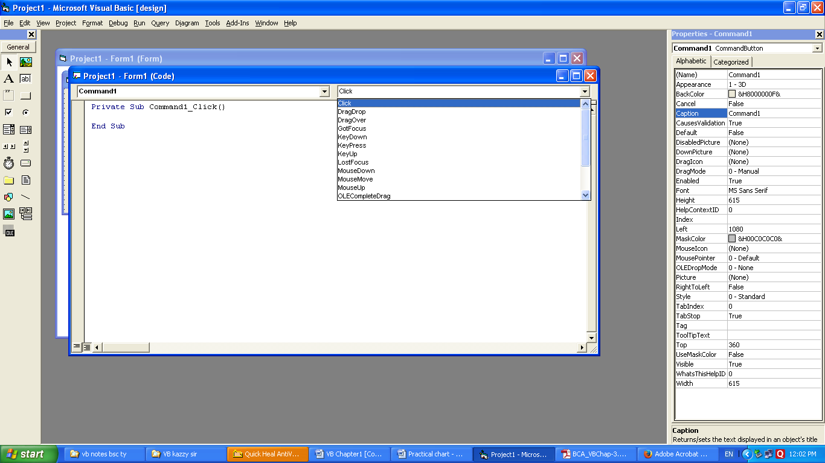
The combination of the control's name and event’s name is unique and is the name of the event
Visual basic looks for the subroutine made up of the name of the control on which the event took place and the name of the event. Two most common events are
  Mouse Event
  Keyboard Event.
  Focus

Slide 35
Mouse Event:
Most of the elements of the user in can be manipulated with the mouse, and programming mouse events is your number one job as a VB programmer. The form primarily acts as a container for other controls, but it does support events. That is it can respond to some user interactions. Some commonly used events are as follows:

Slide 36
Form Events:
Event Description
Click Event executed when user clicks on the form with the mouse.
DblClick Dblclick event triggered when user double clicks on form.
Activate Activate event is triggered when form becomes the active window.
Deactivate Deactivate event is triggered when form becomes the deactivate window.
Load Load event occurs when form is loaded. This is a good place to initialize variables and set any run time properties.
Unload Unload event occurs when user close the form.
Terminate This event is used to close or terminate the form. All the memory that was held for the form variables are released
Resize This event is occurred when the user resizes form.
MouseMove This event is occurred when the user mouse moves on the form.

Slide 37
Keyboard Events:
Keyboard events are generated by keystrokes, usually, you must program the keyboard events for the controls that can accept text. You must provide code for the keyboard events of controls that can be manipulated with both the mosue and keyboard.
Keypress Tis event is occurred when the user presses key from the keyboard.
Besides these events there are some events these are initialize keyup, keydown etc.

Slide 38
Focus:
A fundamental concept I developing user interface that comply with the windows standard is the focus. Focus is the ability of a control to receive user input via the keyboard . When an object has the focus, it can receive input from a user.
Suppose you have a form with two textbox controls on it. At any time, only one of them can accept input. The control that can accept input is said to have the focus.
GetFocus and LostFocus are two releated events. Whe the focus is moved from one control to the other, the first control receives the LostFocus event, and after that the second control receives the GotFocus event.

Slide 39
Methods:
Objects have methods too, which are the actions they can carry out You can think of methods as the actions of an object. For ex. Methods of your VCR are the play, Fast Forward, Rewind, Pause, and Record buttons. After you press one of these buttons, your VCR can perform without any further assistance from you.
Similarly Form object, knows how clear itself, and you can invoke the CLS method to clear a form. A form also knows how to Hide itself, an action that you can invoke from within your code with the hide method.
CLEAR, MOVE, AddItem, RemoveItem are some methods.

Slide 40
We use methods (or procedures) for reusing code and making code more understandable.
A method is just a block of code that you can call, and huge programs have methods.
You will see how we can use methods in later programs we create.
You have already used methods before, like WriteLine(); some methods allow you to pass data

Slide 41
In visual basic, we can create the Methods either by using Sub or Function
keywords like as shown below.
If we create a method with Sub keyword that will not allow us to return any value.
In case, if you want to return any value,
then you need to use Function keyword to create the method.

Slide 42
Syntax
Private Sub methodName()
End Sub

Slide 44
Question Bank For Assignment
Chapter 1. Unit 01: Getting Started with VB
Q1. What is IDE? Discus the following components of IDE?
1. Toolbar. 2. project explorer 3. from Designer 4. menu bar 5. immediate windows
Q2. Explain Project Explorer in detail.
Q3. Explain the elements if USER Interface.
Q4. Explain the toolbars in VB.
Q5. Explain the any two events used in VB.

Slide 45
Thank You

