Slide 1
DSC Latur Department of Physics
M.Sc. F. Y (Sem-I). Lecture- 02 Classical Mechanics-Syllabus Presented By Mr. L. H. Kathwate M.Sc. B.Ed., NET, SET, GATE

Slide 2
PHY 102 – Classical Mechanics
Credits: 04
Number of lecture: 60
Total Marks: 100
[MSA: 25 (T1+T2+HA=10+10+5) & ESA: 75]

Slide 3
What is mechanics?
Mechanics is a branch of physics which deals with study of physical objects which is in motion under the influences of internal and external interaction.
Types of Mechanics
Classical Mechanics
Quantum Mechanics
Statistical Mechanics

Slide 4
What is the difference between classical mechanics and quantum mechanics?
In classical mechanics, objects exist in a specific place at a specific time. However, in quantum mechanics, objects instead exist in a haze of probability; they have a certain chance of being at point A, another chance of being at point B and so on.

Slide 5
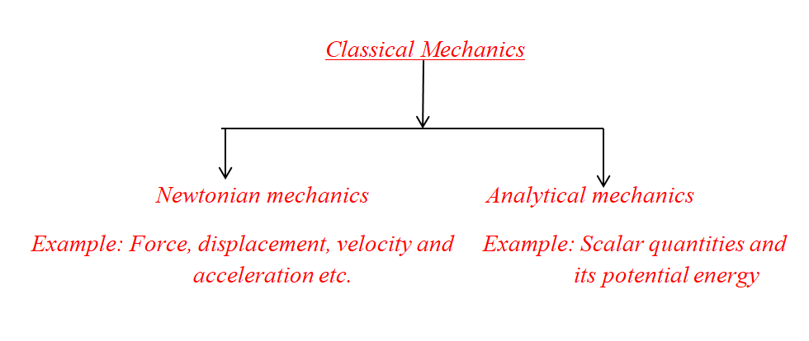
Classical Mechanics:
The mechanics which is based on Newton’s laws of motion and alternatively developed by Lagrangian Hamiltonian and others is called classical mechanics.

Slide 6
Syllabus
Module I: Elementary Principles (15 Hours)
Module II: Lagrangian Formulation (15 Hours)
Module III: Hamiltonian Formulation and Central Force (15 Hours)
Module IV: Rigid body dynamics and small oscillations (15 Hours)

Slide 7
Module-I: Elementary Principles
Review of Newtonian mechanics; Inertial reference frame; Galilean transformations; Motion of a charged particle in electromagnetic field; Conservative and non-conservative forces; Mechanics of a single particle; Mechanics of a System of particles; Motion in a resistive medium; Constraints and its types; Generalized coordinates, cyclic coordinates and degrees of freedom; Virtual displacement and virtual work; D’ Alembert’s principle.

Slide 8
Module-II: Lagrangian Formulation
Lagrangian equation of motion from D’ Alembert’s principle, procedure for formation of Lagrange’s equation; Variation technique; Generalized momenta and cyclic coordinates; Kinetic energy in terms of generalized coordinates; Jacobi integral; Jacobi integral in terms of kinetic energy; Rayleigh’s dissipation function; Gauge transformation for Lagrangian; Symmetry properties and conservation laws; Invariance of Lagrangian equations under Galilean transformation; Variational principle; Derivation of Lagrangian equation from Variational principle.

Slide 9
Module-III: Hamiltonian Formulation and Central Force
Part –I Hamiltonian Formulation
Transformation from Lagrangian to Hamiltonian; Derivation of Hamiltonian equations of motion from Hamiltonian principle; Δ Variation technique; Principle of least action; Canonical transformation; Condition for a transformation to be Canonical; Poisson brackets; Properties of Poisson’s bracket; Poisson’s bracket of Canonical variables; Jacobi identity; Poisson’s theorem; Invariance of Poisson’s bracket under canonical transformation; Hamilton-Jacobi method.

Slide 10
Part-II Small oscillations
Potential energy and equilibrium; Stable and unstable equilibriums; Small oscillations in a system with one degree of freedom; small oscillations in a system with more than one degree of freedom; Normal coordinates; Normal modes and normal frequencies of vibration

Slide 11
Module-IV: Rigid body dynamics and small oscillations
Part-I Rigid body dynamics
Coordinate systems; Euler’s angles; Angular momentum and inertia tensor; Principle axes; Components of angular velocity; Rotational kinetic energy of a body; Euler’s equation of motion for a rigid body; Torque free motion of a rigid body.
Part-II Small oscillations
Potential energy and equilibrium; Stable and unstable equilibriums; Small oscillations in a system with one degree of freedom; small oscillations in a system with more than one degree of freedom; Normal coordinates; Normal modes and normal frequencies of vibration

Slide 12
Reference books:
1. Classical Mechanics by J. C. Upadhyaya, Himalaya Publishing House, New Delhi
2. Classical Mechanics by V. B Bhatia, Joag, Tata Mc Graw Hill Publishing Co. Ltd., New Delhi
3. Classical Mechanics by P. V. Panat, Joag, Tata Mc Graw Hill Publishing Co. Ltd., New Delhi
4. Classical Mechanics by S. L Gupta, V Kumar and H. V Sharma Pragati Prakashan Meerut.
5. Classical Mechanics by Suresh Chandra, Narosa Publishing House, New Delhi
6. Classical Mechanics by N. C. Rana and P. S. Joag, Tata Mc Graw Hill Publishing Co. Ltd.,New Delhi

Slide 13
Question Paper Pattern End Semester Assessment Time: 03 Hrs Total Marks: 75 --------------------------------------------------------------------------------------------------------
Question 1 – Single long questions 15 marks
OR
Two sub-questions (a and b of 8 and 7 marks) 15 marks
(Note: This question will be based on Module I)
Question 2 – Single long questions 15 marks
OR
Two sub-questions (a and b of 8 and 7 marks) 15 marks
(Note: This question will be based on Module II)

Slide 14
Question 3 – Single long questions 15 marks
OR
Two sub-questions (a and b of 8 and 7 marks) 15 marks
(Note: This question will be based on Module III)
Question 4 – Single long questions 15 marks
OR
Two sub-questions (a and b of 8 and 7 marks) 15 marks
(Note: This question will be based on Module III)
Question 5 – Write Short Notes on ANY THREE (each of 5 marks) 15 marks
a. ------------------
b. ------------------
c. ------------------
d. ------------------
(Note: This question shall be based on entire syllabus and must have one sub-question from each of the module)
***************

Slide 15
Question Paper Pattern
(MCQ ) End Semester Assessment Time: 01 Hrs Total Marks: 40 ------------------------------------------------------------------------
There are total 50 MCQ types questions out of which only 40 question need to be solved.

