Slide 1
Tobacco Mosaic Virus
Presented By
Dr. Madhuri M. Deshmukh
Asst. Prof. Dayanand Science College, Latur

Slide 2
HISTORY
Tobacco mosaic virus (TMV) is a single stranded RNA virus that infects plants, especially tobacco and other members of the family Solanaceae.
It can infect well over 350 different species of plants. The infection causes characteristic patterns, such as "mosaic"-like mottling and discoloration on the leaves (hence the name). TMV was the first virus to ever be discovered by Ivanoskey in (1893).
W. M. Stanley in 1935 who also showed that TMV remains active even after crystallization. For his work, he was awarded Nobel Prize in Chemistry in 1946.

Slide 3
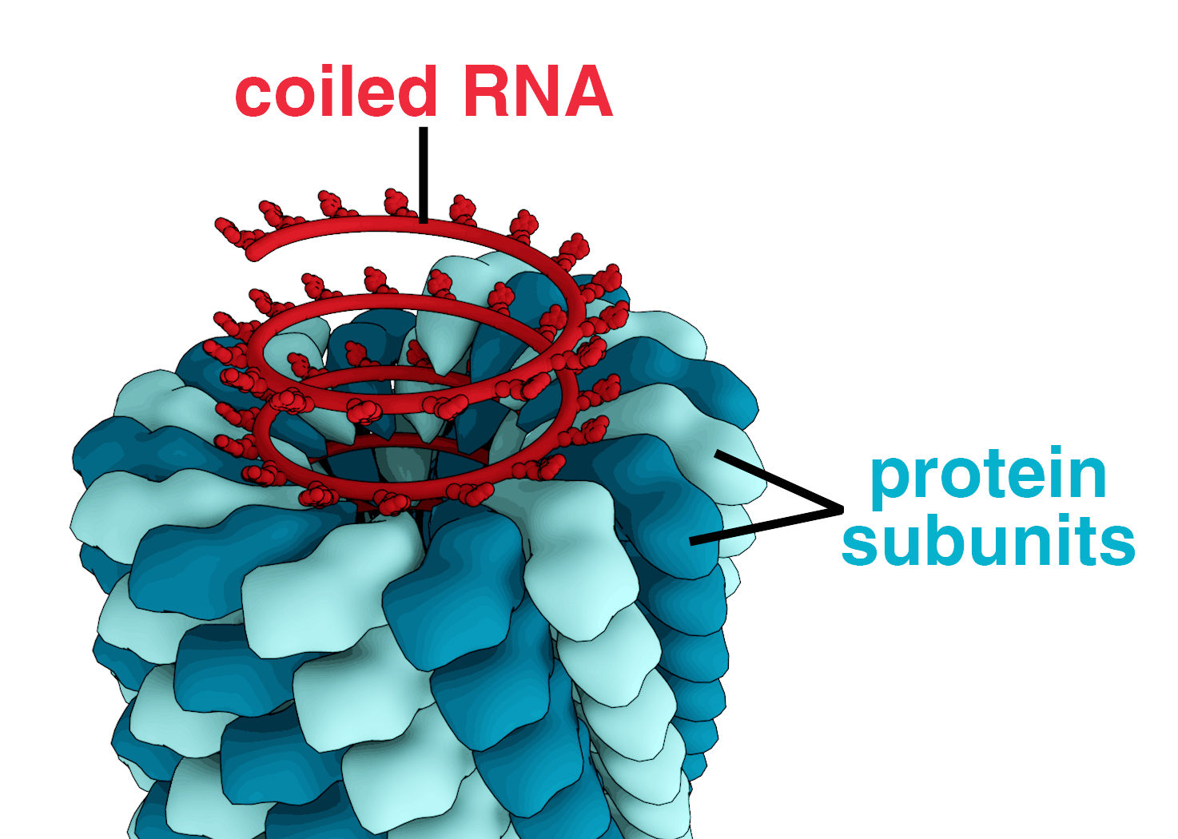

Slide 4
Structure
TMV is made up of a piece of nucleic acid (ribonucleic acid; RNA) and a surrounding protein coat.
The complete virus is a submicroscopic, rigid, rod-shaped particle. Once inside the plant cell, the protein coat falls away and nucleic acid portion directs the plant cell to produce more virus nucleic acid and virus protein by disrupting the normal activity of the plant cell.
Its capsid is made from 2130 molecules of coat protein and one molecule of genomic single strand RNA.
All the capsomeres (coat protein) arranged into a rod like helical structure. It consists of 6.3 – 6.5 kb single stranded RNA genomes.
- The 3’-terminus of the genome of this virus has tRNA (transfer ribonucleic acid) like appearance and 5’-terminus of the genome of this virus has a methylated nucleotide cap.

Slide 5
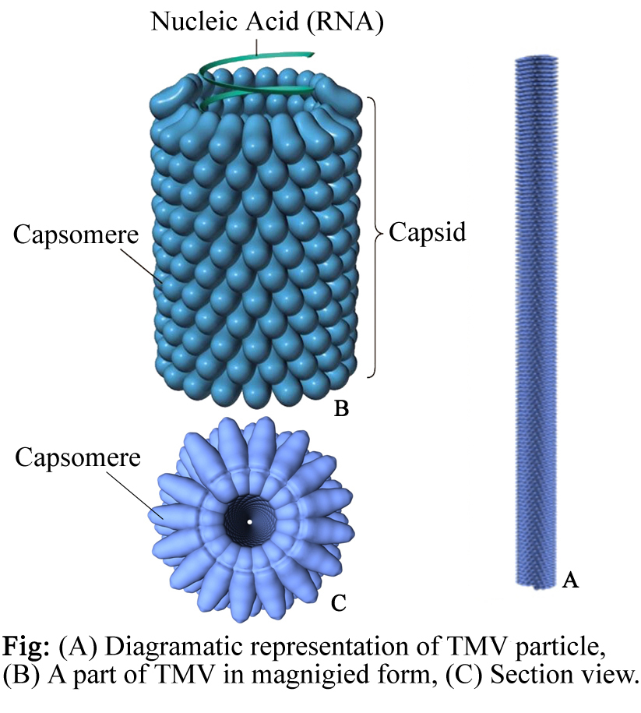

Slide 6
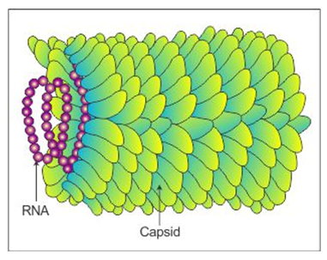
Tobacco mosaic virus also known as TMV is the most extensively studied virus in plants. It was Pathogen Description TMV is a viral plant pathogen and a member of a large group of viruses within the genus Tobamovirus.
Its particles are rigid rods only 300 nanometres long and 18nm wide, and central core diameter of 4nm inside the TMV.
Capsid consist of total 2130 capsomere subunits.

Slide 7
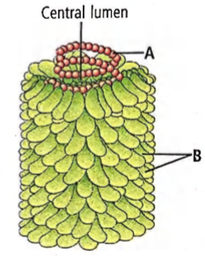
Each capsomere is a grape like structure containing about 158 amino acids and 3 nucleotides in each capsomere.
Each TMV shows 130 turns and each turns consists of 16 capsomeres.
Total nucleotides present in each TMV are approx (2130 ˟3) are 6390.
TMV is a thermostable virus. On a dried leaf, it can withstand up to 50 °C (120 degree Fahrenheit) for 30 minutes

Slide 8
Disease cycle associated with TMV:
TMV infect the tobacco stalks and leaves. First the TMV goes through the infection process and then the replication process.
1. Infection process – After its entry into a particular cell of a plant, it enters the neighbouring cells through plasmodesmata. The infection spreads by direct contact and also by the phloem.
2. Replication process – Following the entry of the virus into the host cell, the virus uncoats itself and releases its genome into the host cell. Then the viral genome replicates itself into the host cell.
After the host coat proteins and genome has been synthesised, they spontaneously assemble into complete TMV virions.

Slide 9
Symptoms in host:-
Light discoloration between the veins of young leaves. - Development of mosaic or mottled pattern of light and dark green areas in the leaves. - Leaves can be crinkled, puckered or elongated.
Treatment and management
One of the common control methods for TMV is sanitation, which includes removing infected plants and washing hands in between each planting
. Crop rotation should also be employed to avoid infected soil/seed beds for at least two years.
As for any plant disease, looking for resistant strains against TMV may also be advised. Furthermore, the cross protection method can be administered, where the stronger strain of TMV infection is inhibited by infecting the host plant with a mild strain of TMV, similar to the effect of a vaccine.

Slide 10
In the past ten years, the application of genetic engineering on a host plant genome has been developed to allow the host plant to produce the TMV coat protein within their cells.
It was hypothesized that the TMV genome will be re-coated rapidly upon entering the host cell, thus it prevents the initiation of TMV replication.
Later it was found that the mechanism that protects the host from viral genome insertion is through gene silencing.
TMV is inhibited by a product of the myxomycete slime mold Physarum polycephalum. Both tobacco and the beans P. vulgaris and V. sinensis suffered almost no lesioning in vitro from TMV when treated with a P. polycephalum extract.

Slide 11
TMV virus can be used to engineer viral vectors. Viral vectors are the tools that are used in recombinant DNA technology in order to transfer the desired genetic material into the host cell.
It is an ideal candidate to be incorporated into the battery electrodes.
The incorporation of TMV into the battery electrodes increases the reactive surface area.

