Slide 1
Hypersensitivity
-Hypersensitivity (allergy) is an inappropriate immune response that may develop in the humoral or cell-mediated responses
-Was first termed anaphylaxis
-can be systematic, which often leads to shock and can be fatal, or localized, which is various atopic reactions

Slide 2
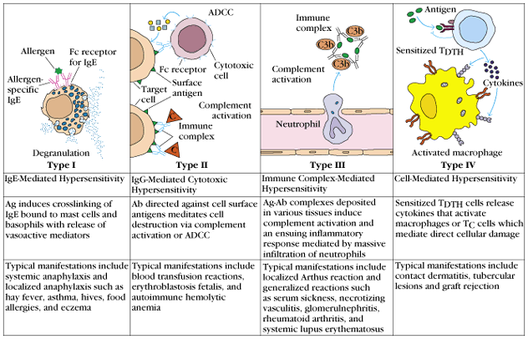
Types of Reactions
There are four types of reactions:
Type I-IgE mediated
Type II-Antibody-Mediated
Type III-Immune Complex-Mediated
Type IV-Delayed-Type Hypersensitivity (DTH)

Slide 3
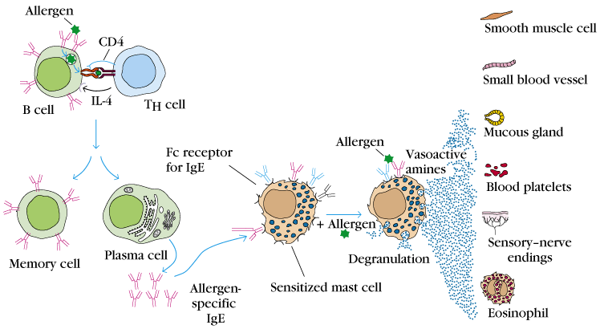
Type I: IgE-Mediated Hypersensitivity
hmm…that sounds bad …aren’t IgE’s supposed to be one of the 5 isotypes of “good guys”?
Of course, the allergen is the true “bad guy” – a non-parasitic antigen capable of stimulating a Type I hypersensitive response.
It’s the secretion and cross-linking of the IgE that causes the problem.
Let’s locate the IgE:

Slide 4
How is a Type I hypersensitive response different from a normal humoral response?
The plasma cell lineage of the B cell that exogenously processed the allergen secretes IgE, not any of the other isotypes.

Slide 5
What is the sequence of events in an IgE-mediated hypersensitive response?
The plasma cells secrete IgE.
These IgE bind to Fc receptors on sensitized mast cells and blood basophils.
When the allergen appears again (usually a few weeks after the first exposure), it cross-links the mIgEs and causes degranulation, releasing granules.
Mediators within these granules act on the surrounding tissues such as smooth muscle, small blood vessels, and mucous glands.

Slide 6
A little background on these mast cells:
Located in nearly all vascularized peripheral tissues
Contain many packets of membrane-bound granule “ammunition”, ready for release upon activation by an allergen
Can also release cytokines (thus they wear multiple immunological hats)

Slide 7
…and their Fc receptors…
High affinity receptor Fc,RI binds to IgE at extremely low serum concentrations (1 X 10⁻⁷). This receptor has ITAM as its cytosolic domain, thus it can initiate the process of degranulation via tyrosine phosphorylation.
Low affinity receptor Fc,RII regulates intensity of IgE response via activating B cells when cross-linked by allergen.
(check Figure 16-4 for structure details)

Slide 8
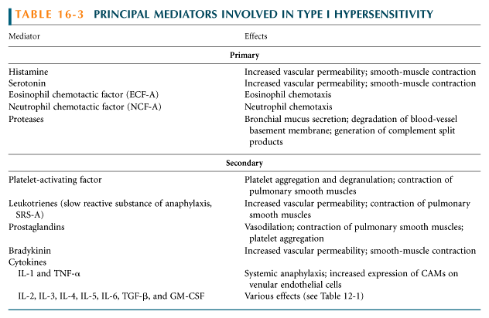
The chemically active effectors within the granules released via degranulation are called mediators. This group includes:
Histamines
Leukotrienes
Prostaglandins
Cytokines

Slide 9
Of course, these effects can be good…
Vasodilation and increased vascular permeability usher in plasma and inflammatory cells (such as esinophils, neutrophils) to attack the pathogen
However, when these effects go overboard, the result is problematic:
Anaphylactic shock – extreme smooth muscle contraction compromises control of the bladder and GI tract and causes bronchiole constriction
Allergic rhinitis – excess mucous is released. More commonly known as hay fever, this ailment affects 10% of the US population
Food allergies – a variety of symptoms
Asthma – bronchoconstriction and excess mucous

Slide 10
Even worse for asthmatics:
They can suffer from a late-phase reaction that develops 4-6 hours after the initial reaction and persists for 1-2 days.
The late-phase reaction is caused by the heavy infiltration of inflammatory cells and the release of cytokines from mast cells, which increases the adhesion of these inflammatory cells to epithelial linings of smooth muscle.
Epithelial damage, bronchoconstriction, and inflamed bronchiole tubes results.

Slide 11
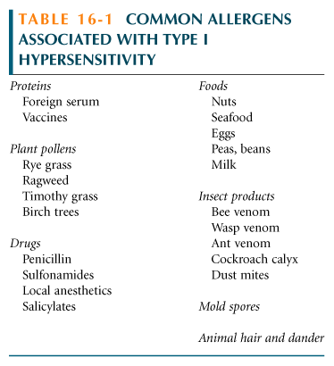
And just look at all these popular allergens!
What’s available in the Western medicine arsenal of drugs?
Antihistamines – block the binding of histamine on target cells
Immunotherapy – treat the patient with increased doses of the allergen (hyposensitization) to reduce severity of the response.
Or, practice better dust control, find another home for Fido, and don’t eat those strawberries!

Slide 12
Type II-Antibody-Mediated Cytotoxic Hypersensitivity
Involves the antibody mediated destruction of cells
Can mediated cell destruction by activating the complement system to create pores in the membrane of the foreign cell
Can also mediated by Antibody-Dependent Cell-Mediated Cytotoxicity (ADCC) where the Fc receptors bind to Fc receptor of antibody on the target cell and promote killing

Slide 13
Transfusion reactions:
Antibodies of the A,B, and O antigens are usually of the IgM class (these antigens are call isohemagglutinins)
For example an A individual produce isohemagglutinins to B-like epitopes but not to A epitopes because they are self
Person who are transfused with the wrong blood type will produce anti-hemmagglutinins causing complement mediated lysis
Antibodies are usually of the IgG class
Transfusion reactions can be delayed or immediate but have different Ig isohemagglutinins
Immediate reactions has a complement-mediated lysis triggered by IgM isohemagglutinins
Delayed reactions induce clonal selection and the productions of IgG which is less effective in activating the complement
    This leads to incomplete complement-mediated lysis
Cross-matching can detect antibodies in the sera to prevent this

Slide 14
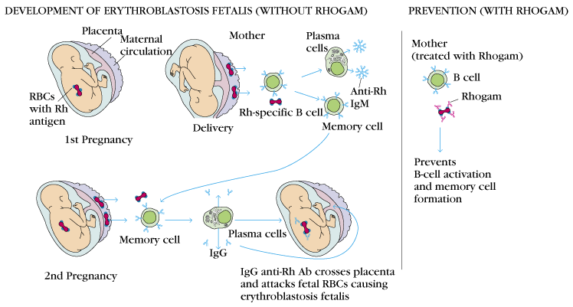
Hemolytic Disease of the Newborn
This is where maternal IgG antibodies specific for fetal blood group antigens cross the placenta and destroy fetal RBC’s
Erythroblastosis fetalis-severe hemolytic disease of newborns
  Most commonly develops when an Rh⁺ fetus expresses an Rh antigen on it’s blood that and Rh⁻ mother doesn’t recognize

Slide 15
Erythroblastosis fetalis
During the 1st pregnancy small amounts of fetal blood pass through the placenta but not enough to induce a responses
During delivery larger amounts of fetal blood cross the placenta causing an activation of B-cells that are Rh specific thus leading to memory B-cells (anti-Rh antibodies)
The IgM antibody clears the Rh⁺ cells from the mother
In subsequent pregnancies with an Rh⁺ fetus, the Rh⁺ RBC cross the placenta activating the memory B-cells
These in turn cross the placenta and damage the fetal RBC because they are seen as “foreign”
This type of reaction can be prevented by administering antibodies against the Rh antigen within 25-48 hours after the 1st delivery
Rhogam-is the antibody that is injected
  it will bind to the fetal RBC that enter the mother’s circulation and facilitate the clearance of them before B-cell activation
  In subsequent pregnancies the mother is unlikely to produce IgG anti-Rh antibodies
  If the mother doesn’t receive this injection there are other ways to treat this, depending on the severity

Slide 16
Drug-Induced Hemolytic Anemia
This is where certain antibiotics can absorb nonspecifically to the proteins on RBC membranes
Examples: penicillin, streptomycin
Sometimes antibodies form inducing complement-mediated lysis and thus progressive anemia
When drug is withdrawn the hemolytic anemia disappears

Slide 17
Type III-Immune Complex-Mediated Hypersensitivity
Reaction with antibodies create immune complexes
These generally facilitate the clearance of antigen by phagocytosis
Large amounts of immune complexes can lead to tissue damage (Type III reaction)
The magnitude depends on the quantity of immune complexes and their distribution
The complexes get deposited in tissues:
  Localized reaction is when they are deposited near the site of antigen entry
  When formed in the blood reaction can develop where ever they are deposited
Deposition of these complexes initiates a reaction that results in the recruitment of neutrophils
Tissue is injured by the granular release from the neutrophil (attempted phagocytosis release lytic enzymes that cause the damage)

Slide 18
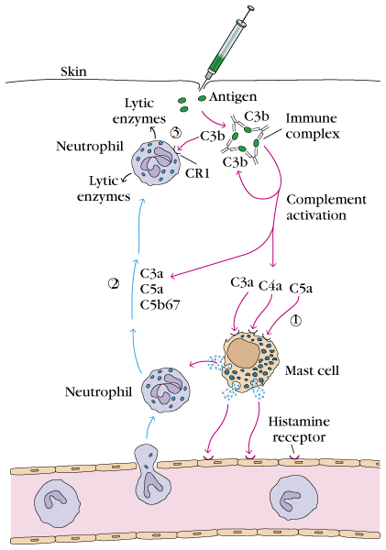
Localized Type III Reactions:
Injection of an Antigen:
  Can lead to an acute Arthus reaction within 4-8 hours
  Localized tissue and vascular damage result from accumulation of fluid (edema) and RBC (erythema)
  Severity can vary from mild swelling to redness to tissue necrosis
Insect bite:
  May first have a rapid type I reaction
  Some 4-8 hours later a typical Arthus reaction develops

Slide 19
Generalized Type III Reactions:
Large amounts of antigens enter the blood stream and bind to antibody, circulation immune complexes can form
These can’t be cleared by phagocytosis and can cause tissue damaging Type III reactions
Serum Sickness-type III hypersensitivity reaction that develops when antigen is intravenously administered resulting in formation of large amounts antigen-antibody complexes and the deposition in tissue
Other conditions caused by Type III-
  Infectious Diseases
    Meningitis
    Hepatitis
    Mononucleosis
  Drug Reactions
    Allergies to penicillin and sulfonamides
  Autoimmune Diseases
    Systematic lupus erythematosus
    Rheumatoid arthritis

Slide 20
Type IV Hypersensitivity
a.k.a. cell mediated hypersensitivity or
delayed type hypersensitivity
What is delayed type hypersensitivity (DTH)?
A hypersensitive response mediated by sensitized T_{DTH} cells, which release various cytokines and chemokines
Generally occurs 2-3 days after T_{DTH} cells interact with antigen
An important part of host defense against intracellular parasites and bacteria

Slide 21
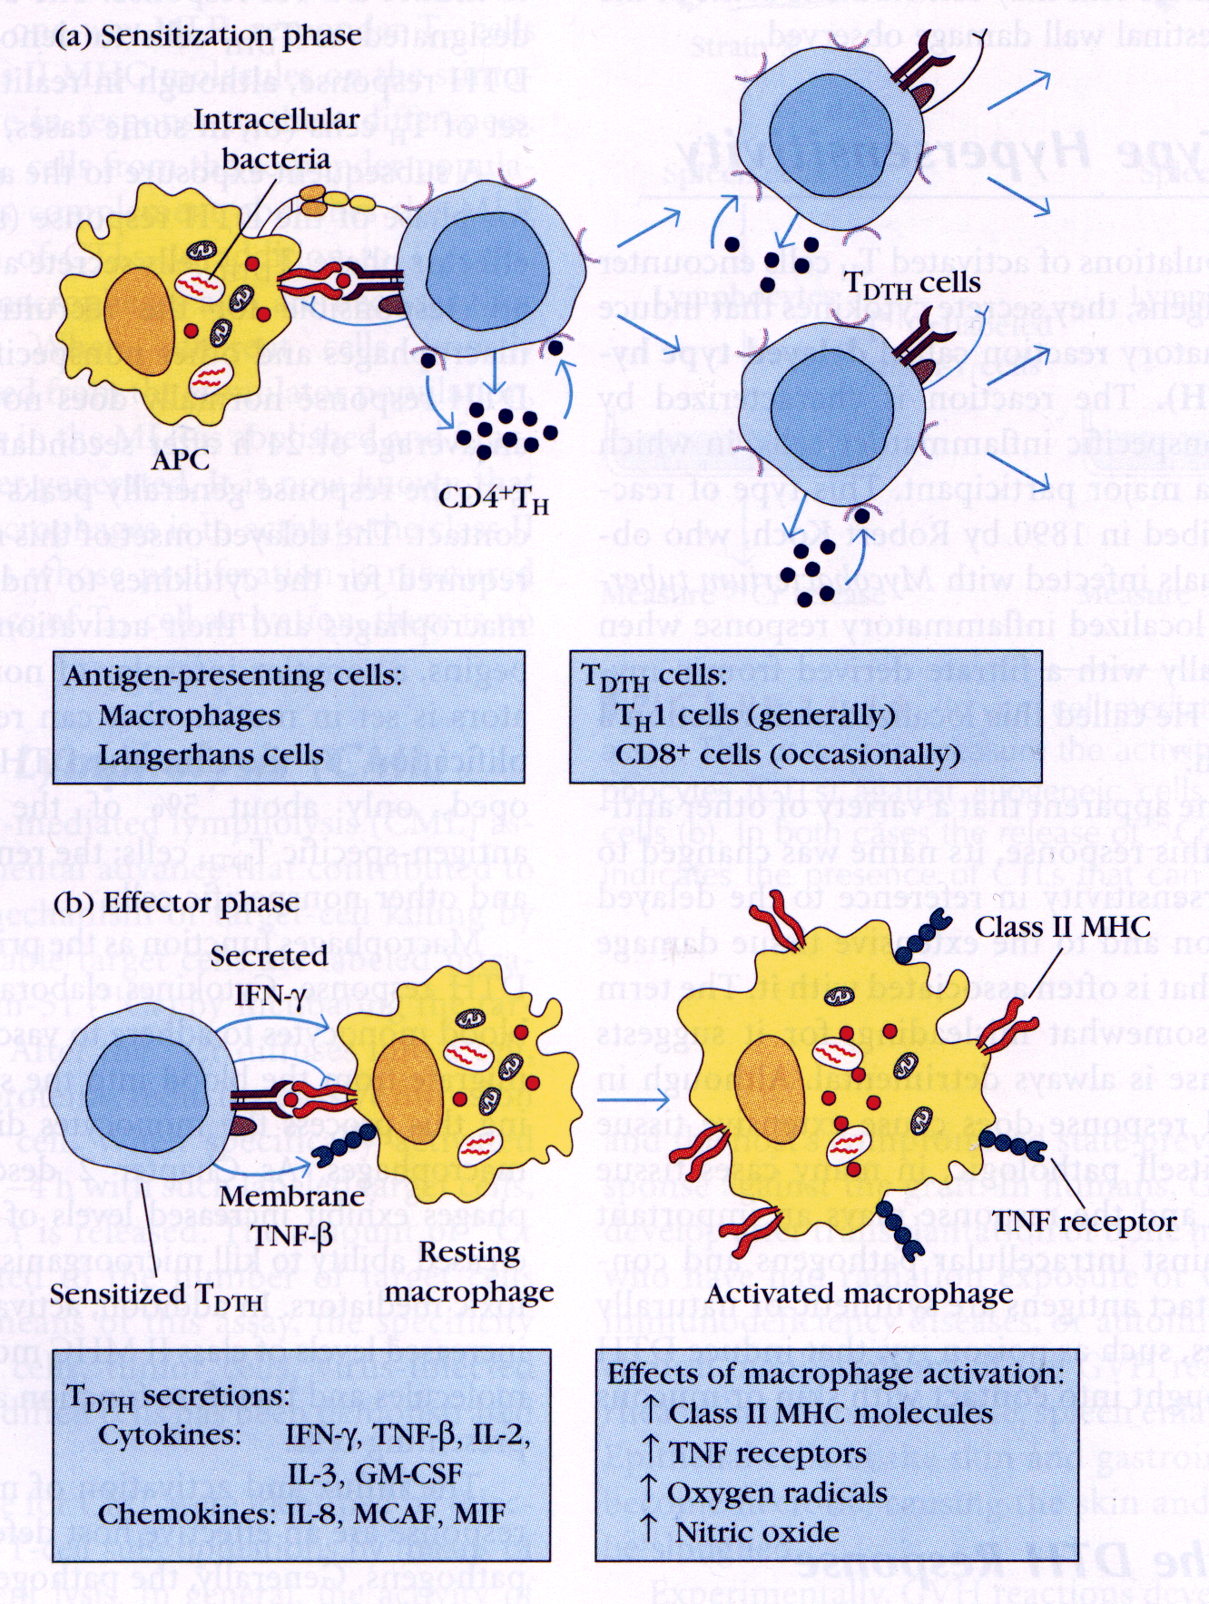
Phases of the DTH Response
Sensitization phase: occurs 1-2 weeks after primary contact with Ag
What happens during this phase?
T_{H} cells are activated and clonally expanded by Ag presented together with class II MHC on an appropriate APC, such as macrophages or Langerhan cell (dendritic epidermal cell)
Generally CD4+ cells of the T_{H}1 subtype are activated during sensitization and designated as T_{DTH} cells

Slide 22
Phases of the DTH Response
Effector phase: occurs upon subsequent exposure to the Ag
What happens during this phase?
T_{DTH} cells secrete a variety of cytokines and chemokines, which recruit and activate macrophages
Macrophage activation promotes phagocytic activity and increased concentration of lytic enzymes for more effective killing
Activated macrophages are also more effective in presenting Ag and function as the primary effector cell

Slide 23
What happens if the DTH response is prolonged?
A granuloma develops…
Continuous activation of macrophages induces the macrophages to adhere closely to one another, assuming an epithelioid shape and sometimes fusing together to form giant, multinucleated cells.

Slide 24
Protective Role of DTH Response
Intracellular bacteria | Intracellular viruses | Contact Antigens
Mycobacterium tuberculosis | Herpes simplex virus | Hair dyes
Mycobacterium leprae | Measles virus | Poison ivy
A variety of intracellular pathogens and contact antigens can induce a DTH response.
Cells harboring intracellular pathogens are rapidly destroyed by lytic enzymes released by activated macrophages

Slide 25
Detrimental Effects of DTH Response
The initial response of the DTH is nonspecific and often results in significant damage to healthy tissue
In some cases, a DTH response can cause such extensive tissue damage that the response itself is pathogenic
Example: Mycobacterium tuberculosis – an accumulation of activated macrophages whose lysosomal enzymes destroy healthy lung tissue
In this case, tissue damage far outweighs any beneficial effects.

Slide 26
How Important is the DTH Response?
The AIDS virus illustrates the vitally important role of the DTH response in protecting against various intracellular pathogens.
The disease cause severe depletion of CD4+ T cells, which results in a loss of the DTH response.
AIDS patients develop life-threatening infections from intracellular pathogens that normally would not occur in individuals with intact DTH responses.

