Slide 1

Presentation
NETWORK SECURITY

Slide 2
presentation
NETWORK SECURITY

Slide 3
Policies
What are the policies and what are purpose of policies???

Slide 4
The Purpose
Provide a framework for the management of security across the enterprise

Slide 5
Definitions
Policies
  High level statements that provide guidance to workers who must make present and future decision
Standards
  Requirement statements that provide specific technical specifications
Guidelines
  Optional but recommended specifications

Slide 6
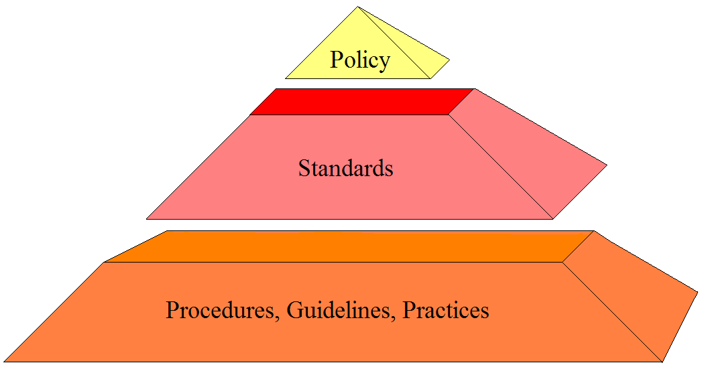
Security Policy
Passwords will be 8 characters long
Access to network resource will be granted through a unique user ID and password
Passwords should include one non-alpha and not found in dictionary

Slide 7
Elements of Policies
Set the tone of Management
Establish roles and responsibility
Define asset classifications
Provide direction for decisions
Establish the scope of authority
Provide a basis for guidelines and procedures
Establish accountability
Describe appropriate use of assets
Establish relationships to legal requirements

Slide 8
Policies should……
Clearly identify and define the information
security goals and the goals of the university.

Slide 9
Policy Lifecycle
IS Goals
Cabinet Goals
Policy
Standards
Procedures
Guidelines
Awareness
Actions Info Security

Slide 10
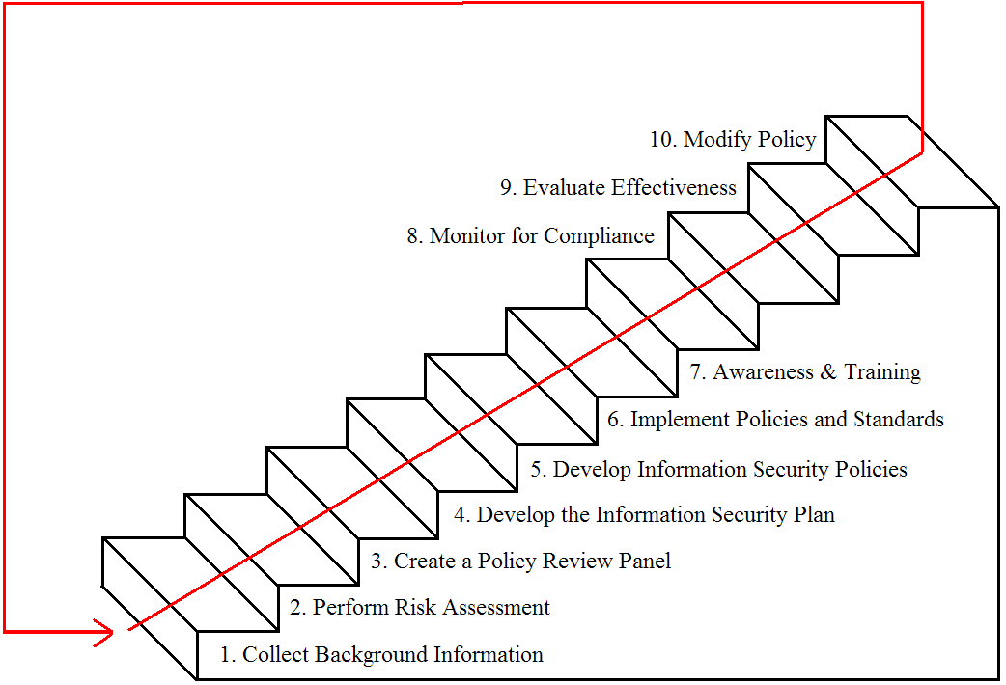
The Ten-Step Approach

Slide 11
Step 1 – Collect Background Information
Obtain existing policies
  Creighton's
  Others
Identify what levels of control are needed
Identify who should write the policies

Slide 12
Step 2 – Perform Risk Assessment
Justify the Policies with Risk Assessment
  Identify the critical functions
  Identify the critical processes
  Identify the critical data
  Assess the vulnerabilities

Slide 13
Step 3 – Create a Policy Review Board
The Policy Development Process
  Write the initial “Draft”
  Send to the Review Board for Comments
  Incorporate Comments
  Resolve Issues Face-to-Face
  Submit “Draft” Policy to Cabinet for Approval

Slide 14
Step 4 – Develop the Information Security Plan
Establish goals
Define roles
Define responsibilities
Notify the User community as to the direction
Establish a basis for compliance, risk assessment, and audit of information security

Slide 15
Step 5 – Develop Information Security Policies, Standards, and Guidelines
Policies
  High level statements that provide guidance to workers who must make present and future decision
Standards
  Requirement statements that provide specific technical specifications
Guidelines
  Optional but recommended specifications

Slide 16
Step 6 – Implement Policies and Standards
Distribute Policies.
Obtain agreement with policies before accessing Creighton Systems.
Implement controls to meet or enforce policies.

Slide 17
Step 7 – Awareness and Training
Makes users aware of the expected behavior
Teaches users How & When to secure information
Reduces losses & theft
Reduces the need for enforcement

Slide 18
Step 8 – Monitor for Compliance
Management is responsible for establishing controls
Management should REGULARLY review the status of controls
Enforce “User Contracts” (Code of Conduct)
Establish effective authorization approval
Establish an internal review process
Internal Audit Reviews

Slide 19
Step 9 – Evaluate Policy Effectiveness
Evaluate
Document
Report

Slide 20
Step 10 – Modify the Policy
Policies must be modified due to:
New Technology
New Threats
New or changed goals
Organizational changes
Changes in the Law
Ineffectiveness of the existing Policy

Slide 21
HIPAA Security Guidelines
Security Administration
Physical Safeguards
Technical Security Services and Mechanisms

Slide 22
Minimum HIPAA Requirements
•
Security Administration
Certification Policy (§ .308(a)(1))
Chain of Trust Policy (§ .308(a)(2))
Contingency Planning Policy (§ .308(a)(3))
Data Classification Policy (§ .308(a)(4))
Access Control Policy (§ .308(a)(5))
Audit Trail Policy (§ .308(a)(6))
Configuration Management Policy(§ .308(a)(8))
Incident Reporting Policy (§ .308(a)(9))
Security Governance Policy (§ .308(a)(10))
Access Termination Policy (§ .308(a)(11))
Security Awareness & Training Policy(§ .308(a)(12))

Slide 23
Minimum HIPAA Requirements
•
Physical Safeguards
–
–
–
–
–
–
Security Plan (Security Roles and Responsibilities) (§ .308(b)(1)) Media Control Policy (§ .308(b)(2))
Physical Access Policy (§ .308(b)(3)) Workstation Use Policy (§ .308(b)(4)) Workstation Safeguard Policy (§ .308(b)(5))
Security Awareness & Training Policy (§ .308(b)(6))

Slide 24
Minimum HIPAA Requirements
•
Technical Security Services and Mechanisms
Mechanism for controlling system access (§ .308(c)(1)(i))
  “Need-to-know”
–
–
Employ event logging on systems that process or store PHI (§ .308(c)(1)(ii)) Mechanism to authorize the privileged use of PHI (§ .308(c)(3))
Employ a system or application-based mechanism to authorize activities within system resources in accordance with the Least Privilege Principle.
Provide corroboration that PHI has not been altered or destroyed in an unauthorized manner (§ .308(c)(4))
checksums, double keying, message authentication codes, and digital signatures.
–
–
Users must be authenticated prior to accessing PHI (§ .308(c)(5))
•
•
Uniquely identify each user and authenticate identity
Implement at least one of the following methods to authenticate a user:
Password;
Biometrics;
Physical token;
Call-back or strong authentication for dial-up remote access users.
Implement automatic log-offs to terminate sessions after set periods of inactivity.
– Protection of PHI on networks with connections to external communication systems or public networks (§ .308(d))
•
•
Intrusion detection Encryption

Slide 25
Creighton Specific Policies
Access Control Policy
Contingency Planning Policy
Data Classification Policy
Change Control Policy
Wireless Policy
Incident Response Policy
Termination of Access Policy
Backup Policy
Virus Policy
Retention Policy
Physical Access Policy
Computer Security Policy
Security Awareness Policy
Audit Trail Policy
Firewall Policy
Network Security Policy
Encryption Policy

Slide 26
Policy Hierarchy
Governance Policy
Access Control Policy
 | User ID Policy
User ID Naming Standard
Access Control Authentication Standard
Password Construction Standard
Strong
Password Construction Guidelines

