Slide 1

CLASSICAL ENCRYPTION TECHNIQUES

Slide 2
INTRODUCTION
Plaintext: original message
Cipher text: coded message
Enciphering or encryption: the process of converting from plaintext to cipher text
Deciphering or decryption: the process of restoring the plaintext from the cipher text
The many schemes used for encryption constitute the area of study known as cryptography. Such a scheme is known as a cipher. Techniques used for deciphering a message without any knowledge of the enciphering details fall into the area of cryptanalysis. Cryptanalysis is what the layperson calls "breaking the code". The areas of cryptography and cryptanalysis together are called cryptology.

Slide 3
SYMMETRIC CIPHER MODEL
A symmetric encryption scheme has five ingredients
Plain text
This is the original intelligible message or data that is fed into the algorithm as input.
Encryption Algorithm
The encryption algorithm performs various substitutions and transformations
on the plaintext.

Slide 4
Secret key
The secret key is also input to the encryption algorithm. The algorithm will produce a different output depending on the specific key begin used at the time. The exact substitutions and transformations performed by the algorithm depend on the key.
Cipher text
This is the scrambled message produced as output. It depends on the plaintext and Secret key. Two different keys will produce two different cipher texts. The cipher text is an apparently random stream of data.
Decryption Algorithm
This is essentially the encryption algorithm run is reverse. It takes the cipher text and the secret key and produces the original plain text.

Slide 5
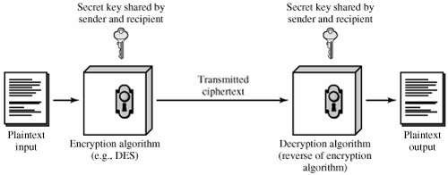
SIMPLIFIED MODEL OF CONVENTIONAL MODEL

Slide 6
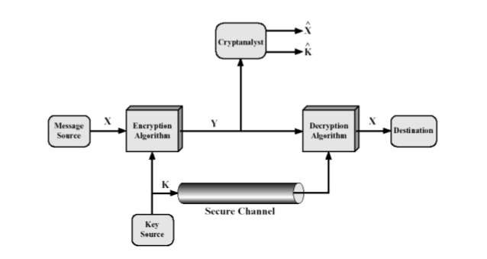
MODEL OF CONVENTIONAL CRYPTOSYSTEM

Slide 7
Symmetric cipher model has two types. There
are:
Cryptography
Cryptanalysis

Slide 8
CRYPTOGRAPHY
Cryptographic system are characterized along three independent dimensions:
The type of operations used for transforming plaintext to cipher text All encryption algorithms based on two principles: substitution , in which each element in the plaintext (bit , letter , group of bits or letters) is mapped into another element and transposition , in which elements in the plain text are rearranged. Most systems , referred to as product systems multiple stages of substitutions and transpositions.

Slide 9
The number of keys used
If both sender and receiver use the same key , the system is referred to as
symmetric , single-key , secret-key or conventional encryption. If the sender
and receiver use different keys , the system is referred to as asymmetric , two- key or public-key encryption.
The way in which the plaintext is processed
A block cipher processes the input one block of elements at a time , producing an output block for each input block. A stream cipher processes the input elements continuously , producing output one element at a time.

Slide 10
CRYPTANALYSIS
There are two general approaches to attacking a conventional encryption scheme:
Cryptanalysis
Cryptanalysis attack rely on the nature of the algorithm plus perhaps some knowledge of the general characteristics of the plaintext or even some sample plaintext-cipher text pairs.
Brute-force attack
The attacker tries every possible key on a piece of cipher-text until an intelligible translation into plaintext is obtained. All possible keys must be tried to achieve success.

Slide 11
SUBSTITUTION TECHNIQUES
A substitution technique is one in which the letters of plain text are replaced by other letters or by numbers or symbols. The plaintext is viewed as a sequence of bits , then substitution involves replacing plaintext bit patterns with cipher text bit patterns.
Caesar cipher
Monoalphabetic ciphers
Playfair cipher
Hill cipher
Polyalphabetic cipher
One-Time pad

Slide 12
CAESAR CIPHER
The Caesar cipher involves replacing each letter of the alphabet with the letter standing three places further down the alphabet. For example:
Plaintext: meet me after the toga party
Cipher text: PHHW PH DIWHU WKH WRJD SDUWB
Then the algorithm can be expressed as follows. For each plaintext p, substitute the cipher letter C:
C=E(3,p)=(p+3) mod 26
General Caesar algorithm is C=E(k , p)= (p + k) mod 26
Decryption algorithm is
p=D (k , C)=(C - k) mod 26

Slide 13
MONOALPHABETIC CIPHERS
Only 25 possible keys , the Caesar cipher is secure. Recall the assignment for the Caesar cipher:
Plain: a b c d e f g h i j k l m n o p q r s t u v w x y z
Cipher: D E F G H I J K L M N O P Q R S T U V W X Y Z A B C
There are 26! or greater than 4 X 1026 possible keys. This is 10 orders of magnitude greater than the key space for DES and would seem to eliminate brute-force techniques for cryptanalysis. Such an approach is referred to as a monoalphabetic substitution cipher , because a single cipher alphabet is used per message.

Slide 14
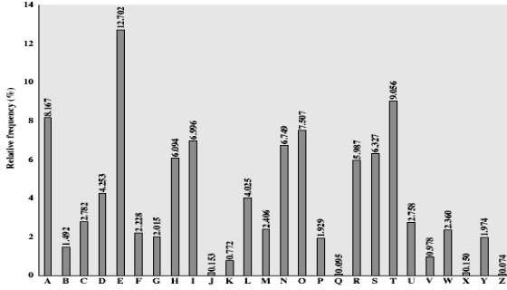
RELATIVE FREQUENCY OF ENGLISH TEXT

Slide 15
PLAYFAIR CIPHER
The playfair algorithm is based on the use of a 5 X 5 matrix of letters constructed using a keyword is monarchy. The matrix is constructed by filling in the letter of the keyword from left to right and from top to bottom , and then filling in the remainder of the matrix with the remaining letters in alphabetic order. The letters I and J count as one letter.
M | O | N | A | R
C | H | Y | B | D
E | F | G | I/J | K
L | P | Q | S | T
U | V | W | X | Z

Slide 16
Plaintext is encrypted two letters at a time , according to the following rules:
Repeating plaintext letters that are in the same pair are separated with a filler letter , such as x , so that balloon would be treated as ba lx lo on.
Two plaintext letters that fall in the same row of the matrix are each replaced by the letter to the right , with the first element of the row circularly following the last. For example , ar is encrypted as RM.

Slide 17
Two plaintext letters that fall in the same column are each replaced by the
letter beneath , with the top element of the column circularly following the last. For example , mu is encrypted as CM.
Otherwise , each plaintext letter in a pair is replaced by the letter that lies in its own row and the column occupied by the other plaintext letter. Thus hs becomes BP and ea becomes IM(or JM , as the encipher wishes).

Slide 18
HILL CIPHER
The encryption algorithm takes m successive plaintext letters and
substitutes for them m cipher text letters. The substitution is determined by m linear equations in which each character is assigned a numerical value
(a=0 , b=1 , …….z=25). For m=3 , the system can be described as follows: c1=(k11p1+k12p2+k13p3) mod 26
c2=(k21p1+k22p2+k23p3) mod 26
c3=(k31p1+k32p2+k33p3) mod 26

Slide 19
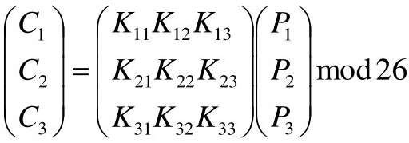
THIS CAN BE EXPRESSED IN TERM OF COLUMN VECTORS AND MATRICES:
Or
C =KP mod 26

Slide 20
POLYALHABETIC CIPHERS
Another way to improve on the simple monoalphabetic technique is to use different monoalphabetic substitutions as one proceeds through the plaintext message. The general name for this approach is polyalphabetic substitution cipher. All these techniques have the following features in common:
A set of related monoalphabetic substitution rules is used.
A key determined which particular rule is chosen for a given transformation

Slide 21
For example , if the keyword is deceptive , the message “we are
discovered save yourself” is encrypted as follows:
Key:
Plaintext:
Cipher text:
mono
poly
bcym
The system can be expressed as follows:
ci=pi ⊕ ki
Where
pi =ith binary digit of plaintext
ki = ith binary digit of key
ci = ith binary digit of cipher text
⊕ = exclusive-or (XOR) operation

Slide 22
ONE-TIME PAD
It is a random key as long as the message , so that the key need not be repeated. The key is to be used to encrypt and decrypt a single message , and then is discarded. Each new message requires a new key of the same length as the new message. Such a scheme , known as one-time pad.
Two fundamental difficulties:
There is the practical problem of making large quantities of random keys.
Every more daunting is the problem of key distribution and
protection.

