Slide 1
BIOSENSOR
(General principles and applications)
Jayanti Tokas, PhD¹; Rubina Begum PhD¹; Shalini Jain, PhD² and Hariom Yadav, PhD^{2*}
¹Department of Biotechnology, JMIT, Radaur, India; ²NIDDK, National Institute of Health, Bethesda, MD 20892, USA
Email: yadavhariom@gmail.com

Slide 2
What is a Biosensor?

Slide 3
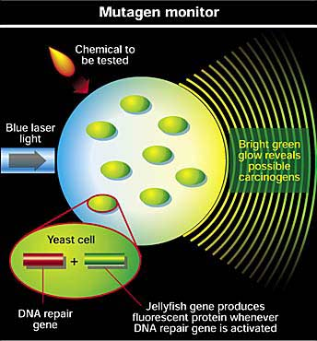
“Biosensor” – Any device that uses specific biochemical reactions to detect chemical compounds in biological samples.
Notes:
The first is much too broad
http://www.gentronix.co.uk/images/newscientist.jpg

Slide 4
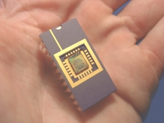
Current Definition
A sensor that integrates a biological element with a physiochemical transducer to produce an electronic signal proportional to a single analyte which is then conveyed to a detector.
Notes:
Can also be to detect a single group of analytes
www.imec.be/ovinter/static_research/BioHome.shtml

Slide 5
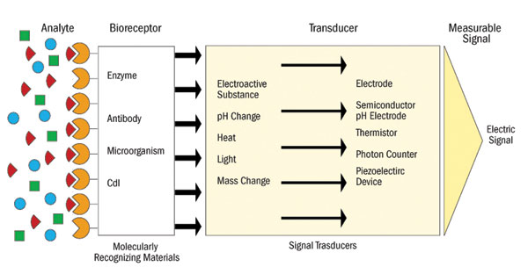
Components of a Biosensor
Detector
Notes:
http://www.dddmag.com/images/0409/HTS1_lrg.jpg

Slide 6
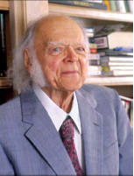
Father of the Biosensor
Professor Leland C Clark Jnr 1918–2005

Slide 7
History of Biosensors
1916 First report on immobilization of proteins : adsorption of invertase on activated charcoal
1922 First glass pH electrode
1956 Clark published his definitive paper on the oxygen electrode.
1962 First description of a biosensor: an amperometric enzyme electrodre for glucose (Clark)
1969 Guilbault and Montalvo – First potentiometric biosensor:urease immobilized on an ammonia electrode to detect urea
1970 Bergveld – ion selective Field Effect Transistor (ISFET)
1975 Lubbers and Opitz described a fibre-optic sensor with immobilised indicator to measure carbon dioxide or oxygen.

Slide 8
History of Biosensors
1975 First commercial biosensor ( Yellow springs
Instruments glucose biosensor)
1975 First microbe based biosensor, First immunosensor
1976 First bedside artificial pancreas (Miles)
1980 First fibre optic pH sensor for in vivo blood gases (Peterson)
1982 First fibre optic-based biosensor for glucose
1983 First surface plasmon resonance (SPR) immunosensor
1984 First mediated amperometric biosensor: ferrocene used with glucose oxidase for glucose detection

Slide 9
History of Biosensors
1987 Blood-glucose biosensor launched by MediSense ExacTech
1990 SPR based biosensor by Pharmacia BIACore
1992 Hand held blood biosensor by i-STAT
1996 Launching of Glucocard
1998 Blood glucose biosensor launch by LifeScan FastTake
1998 Roche Diagnostics by Merger of Roche and Boehringer mannheim
Current Quantom dots, nanoparicles, nanowire, nanotube, etc

Slide 10
Basic Characteristics of a Biosensor
1. LINEARITY Linearity of the sensor should be high forthe detection of high substrate concentration.
2. SENSITIVITY Value of the electrode response per substrate concentration.
3. SELECTIVITY Chemicals Interference must be minimised for obtaining the correct result.
4.RESPONSE TIME Time necessary for having 95% of the response.

Slide 11
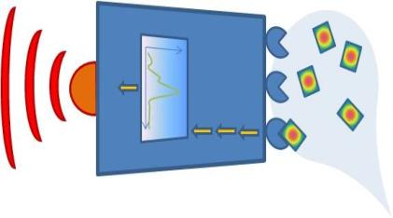
Biosensor
Analyte
Response
Detection
Sample handling/
preparation
Analysis
Signal

Slide 12
1. The Analyte (What do you want to detect)
Molecule - Protein, toxin, peptide, vitamin, sugar, metal ion
Biosensor
2. Sample handling (How to deliver the analyte to the sensitive region?)
(Micro) fluidics - Concentration increase/decrease), Filtration/selection

Slide 13
Biosensor
3. Detection/Recognition
(How do you specifically recognize the analyte?)
4. Signal
(How do you know there was a detection)

Slide 14

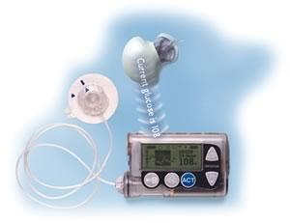
Example of biosensors
Pregnancy test
Detects the hCG protein in urine.
Glucose monitoring device (for diabetes patients)
Monitors the glucose level in the blood.

Slide 15
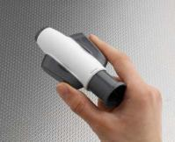
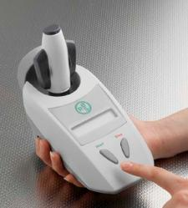
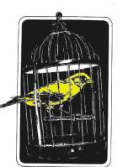
Example of biosensors
Infectous disease biosensor from RBS
Old time coal miners’ biosensor

Slide 16
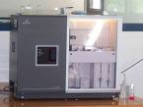
Research Biosensors
Biacore Biosensor platform

Slide 17
Typical Sensing Techniques
for Biosensors
Fluorescence
DNA Microarray
SPR Surface plasmon resonance
Impedance spectroscopy
SPM (Scanning probe microscopy, AFM,
STM)
QCM (Quartz crystal microbalance)
SERS (Surface Enhanced Raman Spectroscopy)
Electrochemical

Slide 18
Types of Biosensors
Calorimetric Biosensor
Potentiometric Biosensor
Amperometric Biosensor
Optical Biosensor
Piezo-electric Biosensor

Slide 19
Piezo-Electric Biosensors
Piezo-electric devices use gold to detect the specific angle at which electron waves are emitted when the substance is exposed to laser light or crystals, such as quartz, which vibrate under the influence of an electric field.
The change in frequency is proportional to the mass of absorbed material.

Slide 20
Electrochemical Biosensors
  For applied current: Movement of e- in redox reactions detected when a potential is applied between two electrodes.

Slide 21
Potentiometric Biosensor
  For voltage: Change in distribution of charge is detected using ion-selective electrodes, such as pH-meters.

Slide 22
Optical Biosensors
  Colorimetric for color
  Measure change in light adsorption
  Photometric for light intensity
  Photon output for a luminescent or fluorescent process can be detected with photomultiplier tubes or photodiode systems.
Notes:
Cellulose pads can be impregnated with enzyme and reagents.

Slide 23
Calorimetric Biosensors
  If the enzyme catalyzed reaction is exothermic,
  two thermistors may be used to
  measure the difference in resistance
  between reactant and product and, hence,
  the analyte concentration.

Slide 24
Electrochemical DNA Biosensor
Steps involved in electrochemical DNA hybridization biosensors:
  Formation of the DNA recognition layer
  Actual hybridization event
  Transformation of the hybridization event into an electrical signal

Slide 25
Types DNA Biosensors
DNA biosensor
Motivated by the application to clinical diagnosis and genome mutation detection
Electrodes
Chips
Crystals

Slide 26
Wearable Biosensors
Ring Sensor
Smart Shirt

Slide 27
Biosensors on the Nanoscale
Molecular sheaths around the nanotube are developed that respond to a particular chemical and modulate the nanotube's optical properties.
A layer of olfactory proteins on a nanoelectrode react with low-concentration odorants (SPOT-NOSED Project). Doctors can use to diagnose diseases at earlier stages.
Nanosphere lithography (NSL) derived triangular Ag nanoparticles are used to detect streptavidin down to one picomolar concentrations.
The School of Biomedical Engineering has developed an anti- body based piezoelectric nanobiosensor to be used for anthrax,HIV hepatitis detection.

Slide 28
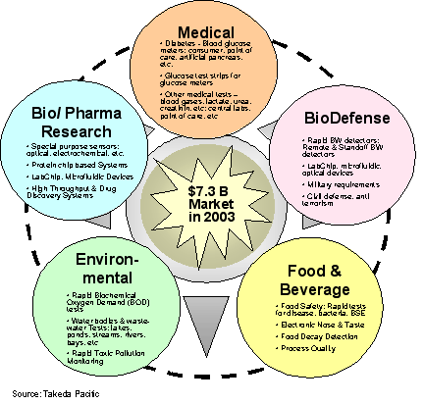
Potential Applications
Clinical diagnostics
Food and agricultural processes
Environmental (air, soil, and water) monitoring
Detection of warfare agents.
Notes:
www.fuji-keizai.com/e/report/biosensor2004_e.html

Slide 29
Application of Biosensor
Food Analysis
Study of biomolecules and their interaction
Drug Development
Crime detection
Medical diagnosis (both clinical and laboratory use)
Environmental field monitoring
Quality control
Industrial Process Control
Detection systems for biological warfare agents
Manufacturing of pharmaceuticals and replacement
organs

Slide 30
Biosensors play a part in the field of environmental quality, medicine and industry mainly by identifying material and the degree of concentration present

Slide 31


