Slide 1
Immunology
Study of immunity

Slide 2
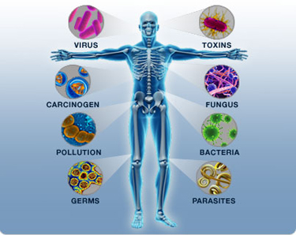
Immunity
Immunity is body's ability to resist or eliminate potentially harmful foreign materials or abnormal cells

Slide 3
Immunity
Immunity (immunis- Latin-exempt, state of protection from infectious diseases)
Immunity is body's ability to resist or eliminate potentially harmful foreign materials or abnormal cells
consists of following activities:
  Defense against invading pathogens (viruses & bacteria)
  Removal of 'worn-out' cells (e.g., old RBCs) & tissue debris (e.g., from injury or disease)
  Identification & destruction of abnormal or mutant cells (primary defense against cancer)
  Rejection of 'foreign' cells (e.g., organ transplant)
  Inappropriate responses:
    Allergies - response to normally harmless substances
    Autoimmune diseases

Slide 4

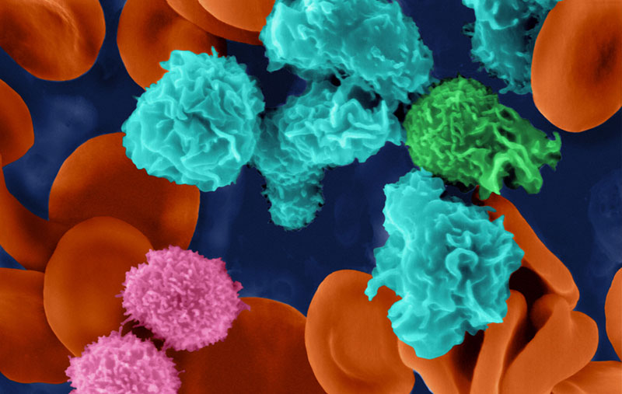
Body Defenses

Slide 5
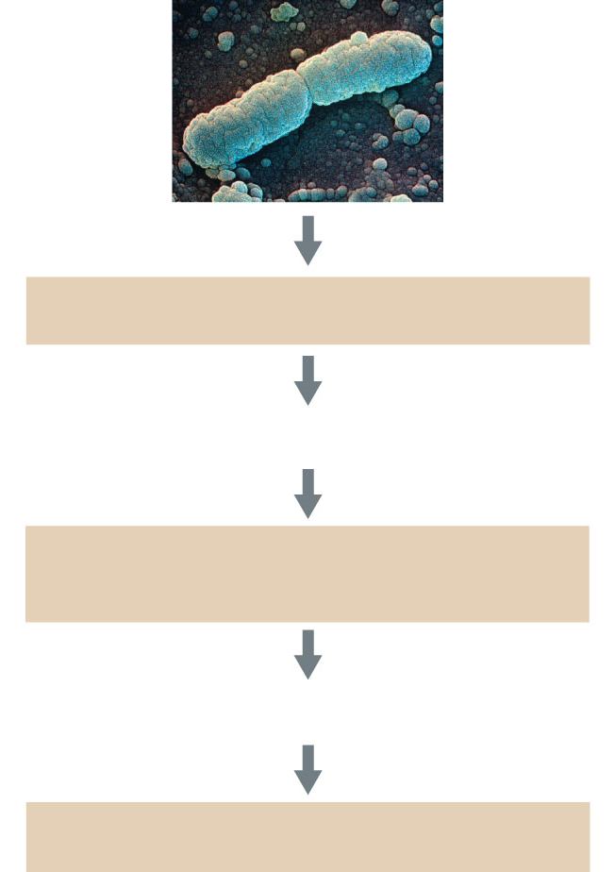
Defense Against Disease
Nonspecific External Barriers
skin, mucous membranes
If these barriers are penetrated,
the body responds with
Innate Immune Response
phagocytic and natural killer cells,
inflammation, fever
If the innate immune response is insufficient,
the body responds with
Adaptive Immune Response
cell-mediated immunity, humoral immunity

Slide 6
Types of immunity
Natural innate immunity
1.species immunity
2.racial immunity
3.indivdual immunity

Slide 7
Types of innate immunity
1 species immunity it is immunity in the membrane of particular species.
Ex many human pathogen do not infect animal
The physiological and biochemical difference bet. tissue of diff.species may be responsible for species specific immunity

Slide 8
Types
2 racial immunity In which various race within
the same species show marked diff. in the degree of resistance to infection.
3Individual immunity Recovering from an infection or through vaccination
resistance to infection varies from individual to individual

Slide 9
Innate immunity
It is comes because of genetic and constitutional
make up.
It has no relation ship with previous bacterial
infection and immunisation.
It acts as first line of defence against infections,
micro organisms, their products before they cause

Slide 10
Overview of the Immune System
Immune System
Innate
(Nonspecific)
1º line of defense
Adaptive
(Specific)
2º line of defense
Interactions between the two systems
Notes:
Two arms of the immune system

Slide 11
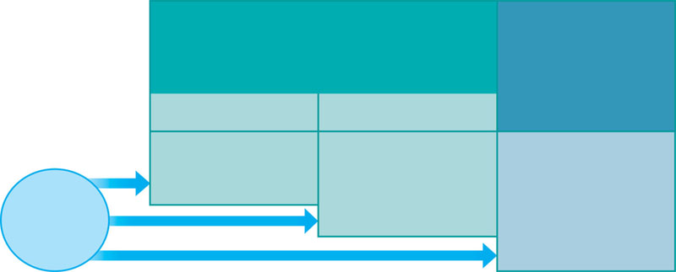
A typical immune response
INNATE IMMUNITY
Rapid responses to a
broad range of microbes
ACQUIRED IMMUNITY
Slower responses to
specific microbes
External defenses
Internal defenses
Skin
Phagocytic cells
Humoral response
(antibodies)
Mucous membranes
Antimicrobial proteins
Secretions
Inflammatory response
Invading
microbes
(pathogens)
Natural killer cells
Cell-mediated response
(cytotoxic
lymphocytes)
Complement

Slide 12
Mechanism of innate immunity some defensive barriers
1 physical barriers
2physiological barriers
3cellular barriers
4chemical barriers

Slide 13
Physical barriers
Theses mechanism include such as skin,mucosa.
Skin To prevent entry of pathogen are an organism 1 line defence mechanism
Mucosa mucosa membrane secreat mucosa
Which is protective barriers that protect
cover internal surface

Slide 14
Body Coverings: The Skin
epidermis
sebaceous glands
sweat gland

Slide 15
Body Coverings:
Mucous Membranes
mucus
cilia
columnar epithelium

Slide 16
Physiological barriers
Human milk: this is very rich in anti bacterial substances.
Ex:IgA, lacto feritin, neuraminic acid etc. they fight against
E.coli and stephylococci.
• Secrition of the digestiv tract: stomach as microbicidal effect.
This isdue to the presence of Hcl in the gastric juice. This Hcl is secreted by oxyntic cell lining stomach
Tem of body normal body tem inhibit growth some pathogen

Slide 17
Cellular barriers
Phagocytic cells (WBCs)
  Ex neutrophils, monocytes,macrophages
  Natural Killer (NK) Cells: attack virus infected cells

Slide 18
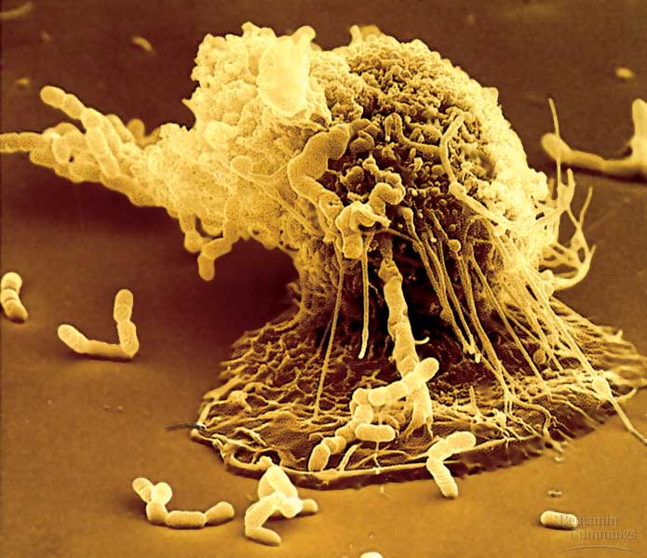
Nonspecific Phagocytosis
Neutrophils
Monocytes
Eosinophils

Slide 19
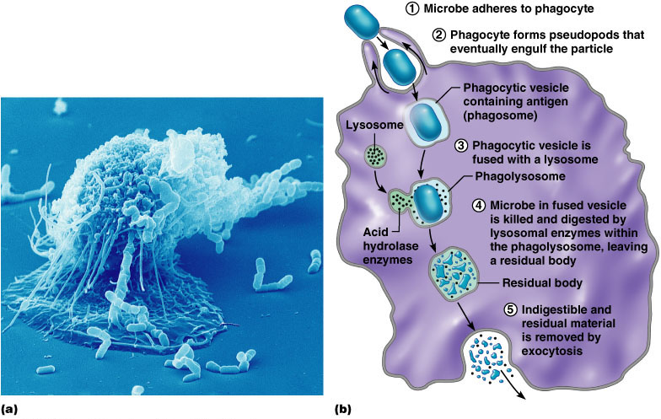
Mechanism of Phagocytosis
Mechanism of Phagocytosis
Macrophage

Slide 20
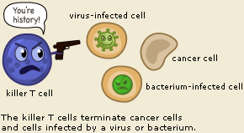
Natural killer cells
Not B-lymphocytes / T-lymphocytes
Important part of the innate immune system
Kill virus /bacteria infected cells (Intracellular pathogens)
Kills cancer cells
Notes:
are defined as large granular lymphocytes (LGL)

Slide 21
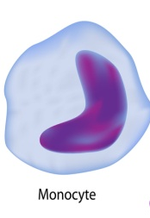
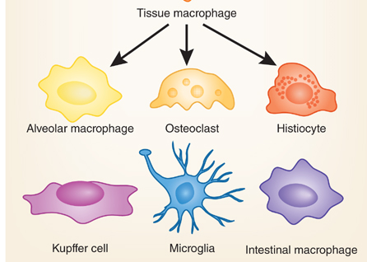
Monocytes
Monocytes (~5% of WBCs)
Migrate into the tissues and become Macrophages
Lung Bone
Liver Brain intestine

Slide 22
Macrophages
“Big eaters”
Phagocytosis of microbes in tissue
(neutrophils are present only in blood)
Antigen presentation
Notes:
Increased number of adipose tissue macrophages correlates with increased adipose tissue production of proinflammatory molecules.

Slide 23
Inflammtary barriers
Inflammation of imp tissue damage is an a
1 imp. Immune response towards antigen
2 imp.defence mecanism of host to prevent
infection.

Slide 24
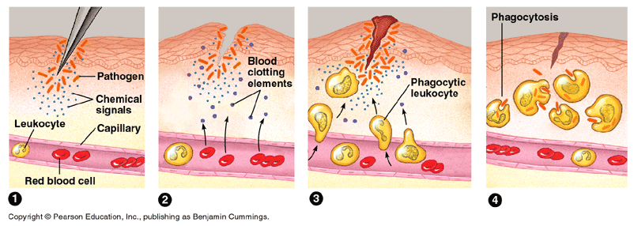
Inflammatory Response
Histamine & prostaglandins released
Capillaries dilate
Clotting begins
Chemotactic factors attract phagocytic cells
Phagocytes consume pathogens & cell debris

Slide 25
Chemical barriers
1 body secreation -To secreat various fluids
play an imp role in defence mechanism
a] skin secreat sweat ,sebum contain bactericidal substance.
b] Tears contain lysozyme
c] Interferon

Slide 26
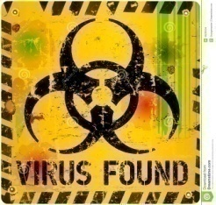
Interferons (IFN)
Signalling proteins produced by by virus infected monocytes and lymphocytes
Secreted proteins – Key anti-viral proteins
“Interfere” with virus replication
Warn the neighbouring cells that a virus is around...
If we did not have IFNs – most of us may die of influenza virus infection

Slide 27
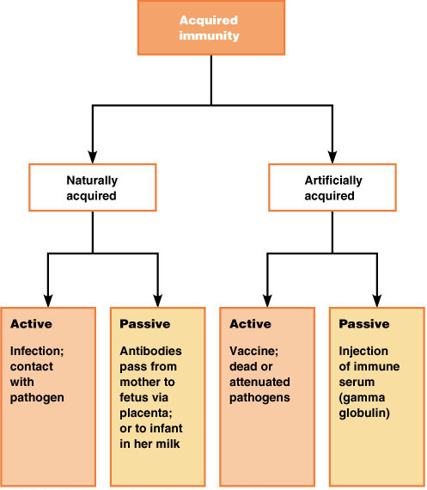
Types of Acquired Immunity

Slide 28
Acquired/specific immunity
Immunity secific for particular disease which an indivdual acquir during course of his life.
Specific for particular disease so called specific immunity

Slide 29
Active Immunity
The production of antibodies against a specific disease by the immune system.
Naturally acquired through disease
Artificially acquired through vaccination
  Vaccines include inactivated toxins, killed microbes, parts of microbes, and viable but weakened microbes.
Active immunity is usually permanent

Slide 30
A vaccinated person has a secondary response based on memory cells when encountering the specific pathogen.
  Routine immunization against infectious diseases such as measles and whooping cough, and has led to the eradication of smallpox, a viral disease.
  Unfortunately, not all infectious agents are easily managed by vaccination.
    HIV vaccine in the works

Slide 31
Passive Immunity
Passive Immunity- Protection against disease through antibodies produced by another human being or animal.
Effective, but temporary
Ex. Maternal antibodies
Colostrum.

Slide 32
Passive immunity can be transferred artificially by injecting antibodies from an animal that is already immune to a disease into another animal.
  Rabies treatment: injection with antibodies against rabies virus that are both passive immunizations (the immediate fight) and active immunizations (longer term defense).

Slide 33
Other type of immunity
1 adoptive immunity – immunity produced by Tranferring lymphoid cell from an immune doner to genitically identical recipient
the treament of certain diseses like lepromatous leprosy
2 combined immunity it is combination of active and passive method of immunization

Slide 34
Local and herd
Local immunity certain microbes infect only
Certain groups of cell and selective tissue
Herd immunity means not everyone in a community need to be immune to prevent
spread disease.
Herd immunity is low an infectious disease may
Spread rapiadly.
Ex polio

