Slide 1
Substrate Level Phosphorylation
Dr. Rahul. A. More

Slide 2
Introduction
Substrate-level phosphorylation is a process in which ATP is synthesized as a result of the oxidation of an organic compound, the substrate, without the participation of any external electron donor (e.g., NADH) or external electron acceptor (e.g., O₂).
That is, in substrate-level phosphorylation the involved organic compound itself serves as both electron donor (becomes oxidized) and electron acceptor (becomes reduced) and its high energy phosphate bonds are transferred to ADP to form ATP

Slide 3
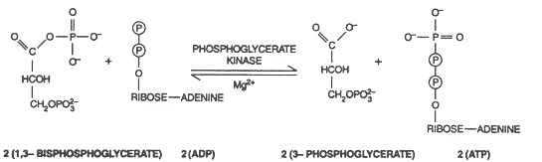
Following are the steps of aerobic respiration during which ATP molecules are synthesized involving substrate-level phosphorylation:
(1) During glycolysis, the enzyme phosphoglycerate kinase transfers the high energy phosphoryal group from the carboxyl group of 1, 3- bisphosphoglycerate to ADP, forming ATP and 3-phosphoglycerate.

Slide 4
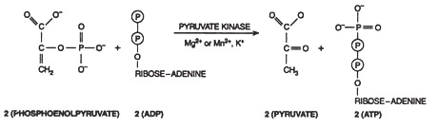
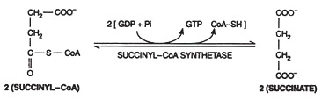
2) During glycolysis, the enzyme pyruvate kinase transfers the high energy phosphoryl group from phosphoenolpyruvate to ADP, forming ATP and pyruvate.
(3) During TCA cycle (Citric acid cycle; Kreb’s cycle), the enzyme succinyl-CoA synthetase breaks the thioester bond of succinyl-CoA and the energy released in this breakage is used to drive the synthesis of a phosphoanhydride bond in GTP or ATP. Succinate is the product in the process.

Slide 5
4) Fermentation:
The simplest mode of ATP generation is fermentation. It can be defined as an ATP generating metabolic process in which organic compounds serve both as electro donors and electron acceptors
Features:
Substrate level phosphorylation is only the mode of ATP synthesis in fermentation.
In fermentations, electron donors and electron acceptors are usually obtained from single fermentable substrate such as sugar.
Fermentation always maintains a strict oxidation reduction balance. The organic substrates undergo a balanced series of oxidative and reductive reactions; pyridine nucleotide (NADH+H+) reduced in one step of fermentation is oxidized in another. This general principal is illustrated in homolactic acid fermentation .

Slide 6
Oxidative Phosphorylation
Oxidative phosphorylation is a mode of ATP generation in which synthesis of ATP from ADP and inorganic phosphate occurs by using energy released by electron transport from substrate to O2, NO3 SO4 or CO3.

Slide 7
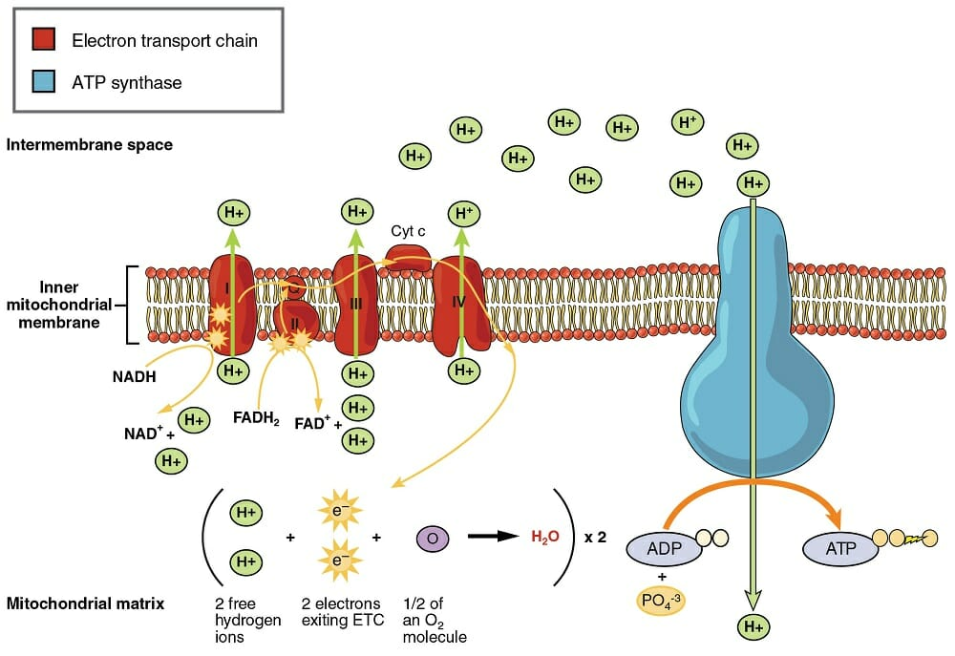
Respiratory electron transport chain

Slide 8
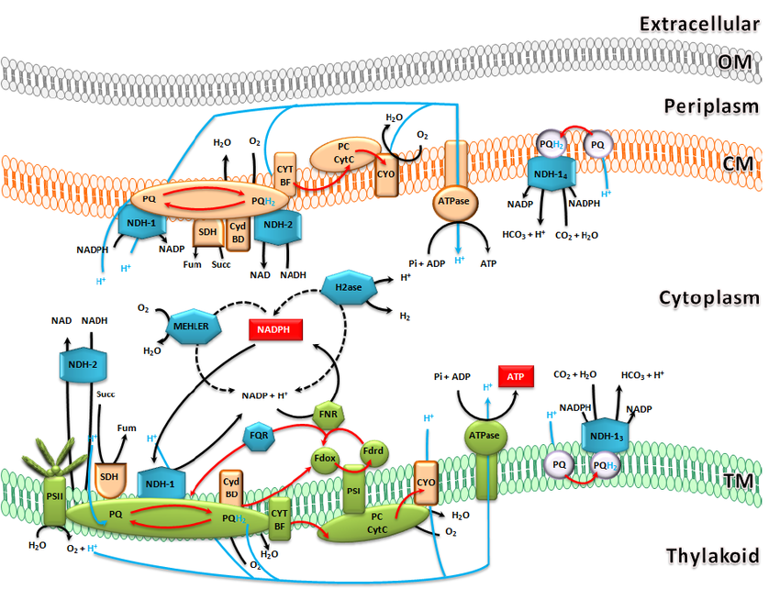

Slide 9
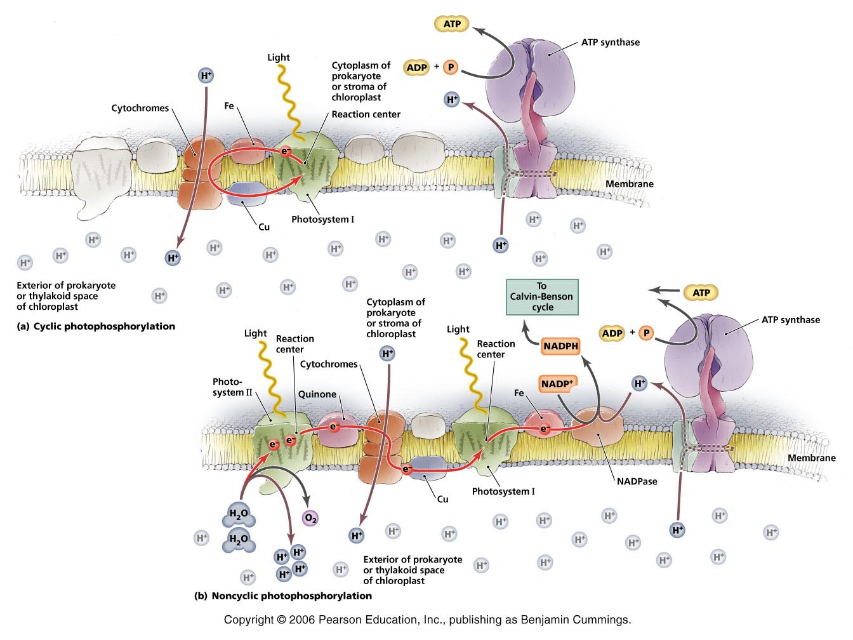
Photophosphorylation in bacteria

Slide 10
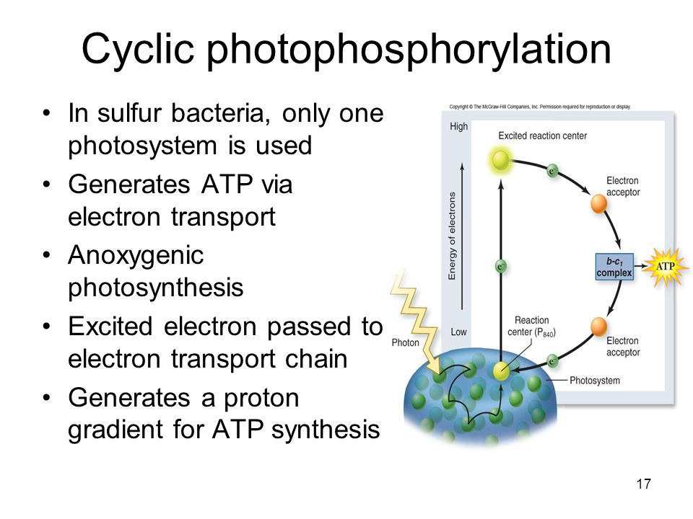

Slide 11
