Slide 1
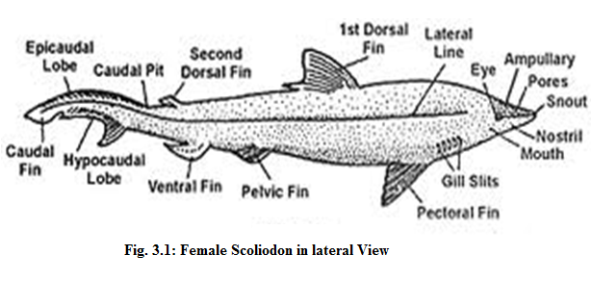
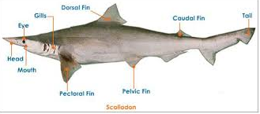
Scoliodon External Characters

Slide 2
Scoliodon External Characters
The Scoliodon has a long, laterally compressed spindle-shaped body tapering at the both ends.
Body - placoid scales. heterocercal tail. Body divisible- head, trunk and tail.

Slide 3
Scoliodon External Characters
Trunk contains median unpaired fins and paired lateral fins.
in male, each pelvic fin bears along its inner edge a stiff, rod-like copulatory organ called the clasper

Slide 4
Scoliodon: Claspers

Slide 6
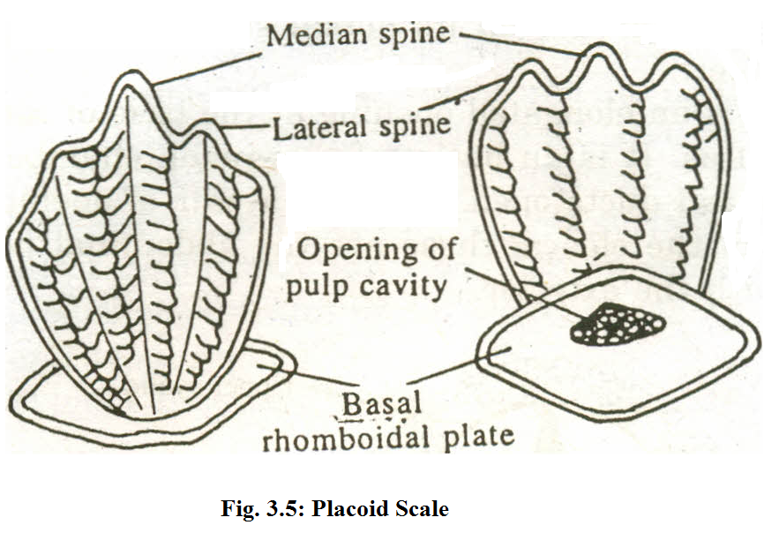
Ventral View
Dorsal View
Placoid scales are derived from both epidermis and dermis of skin.
A typical placoid scale is distinguished into the basal plate and spine.
Basal plate: It is a diamond-shaped or rhomboidal plate formed of cement like material. It lies embedded in the dermis and is firmly attached to it by strong fibres of connective tissue.
The Spine: It is a flat, backwardly directed trident structure projecting out of the skin and giving it roughness.

Slide 9
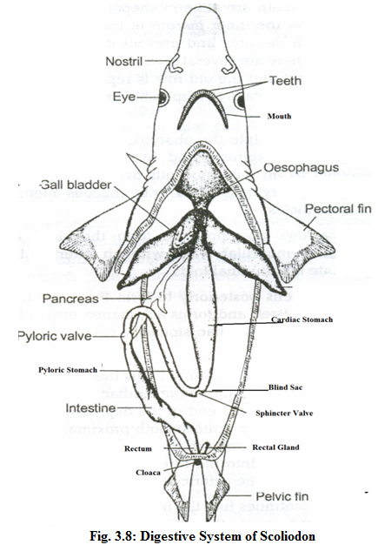
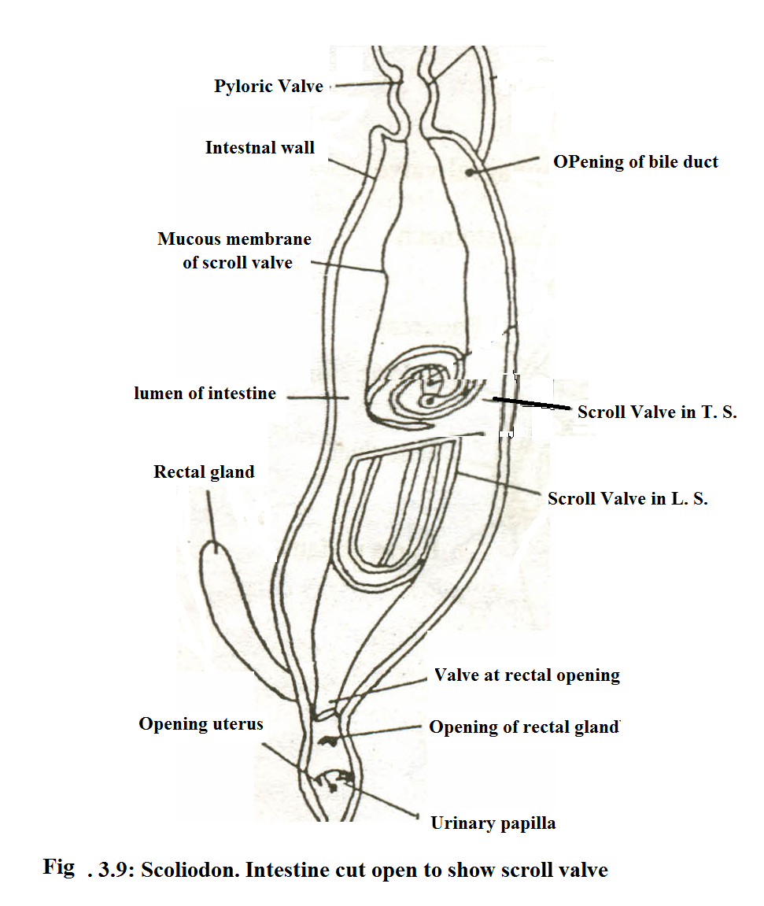

Slide 10
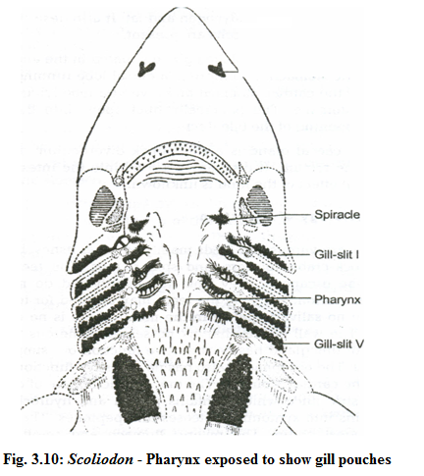

Slide 11
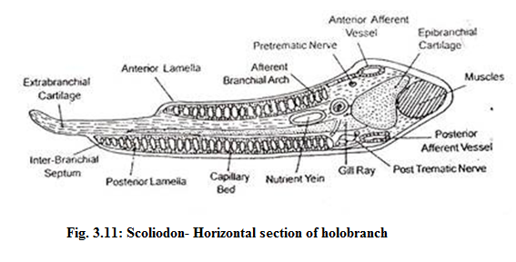

Slide 12
Scoliodon: Heart
The heart consisting of the following chambers:
The sinus venosus: thin-walled triangular chamber, Two large veins, the ducti Cuvieri and e two hepatic sinuses open. Sinus venosus opens into the auricle through the sinu-auricular aperture, guarded by a pair of membranous valves.
The auricle: large triangular sac, walls thicker. It communicates with the ventricle by the auriculo-ventricular aperture guarded by a bilabiate valve.

Slide 13
Scoliodon: Heart
3. The ventricle: most prominent part of the heart and very thick muscular walls, the inner lining of which is traversed numerous muscular strands that give ventricle and spongy texture. The ventricle opens in the conus arteiosus and opening is guarded by cuspid valves.
4. The conus arteriosus: stout; muscular tube and interiorly provided with two transverse rows of semi-lunar valves. The conus arteriosus is continued forwards through the wall of the pericardium as the ventral or cardiac aorta.

Slide 14
Scoliodon: Heart Internal Structure
Working of Heart: Pump the blood to the different parts of the body. This is effected by the rhythmic contraction of the different parts of the heart in a definite Succession and at regular intervals. The heart-beat or contraction starts in the sinus venosus, atrium or auricle ventricle and conus arteriosus. Thus, only the venous blood (Deoxygenated) passes through the heart in Scoliodon. This is known as the single type of circulation and the heart is called venous or branchial heart. sinus venosus to form a sinuauricular node where the heart-beat starts.

Slide 15
Scoliodon:Arterial system
1. The ventral aorta and afferent branchial arteries
2. The efferent branchial & epibranchial arteries
3. Arteries of dorsal aorta
4. The Arteries of the head
5. The hypobranchial blood plexus

Slide 16
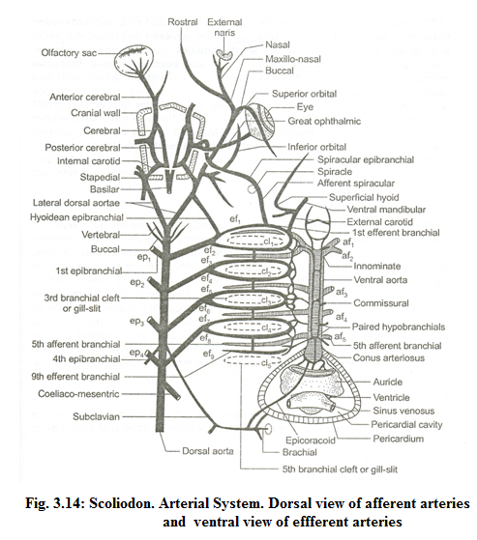

Slide 17
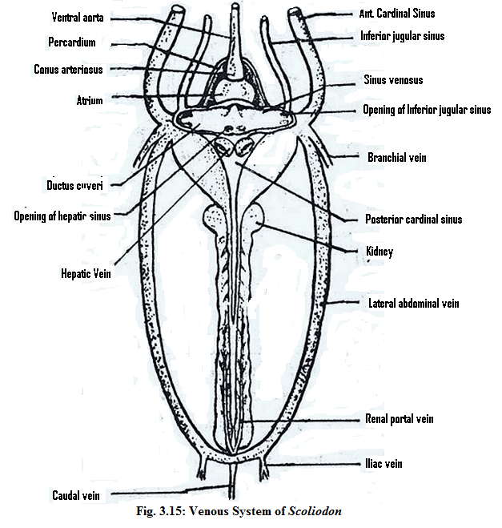
Anterior cardinal system
2. Posterior cardinal system
3. Lateral abdominal system
4. Portal system
5. Cutaneous system

Slide 18
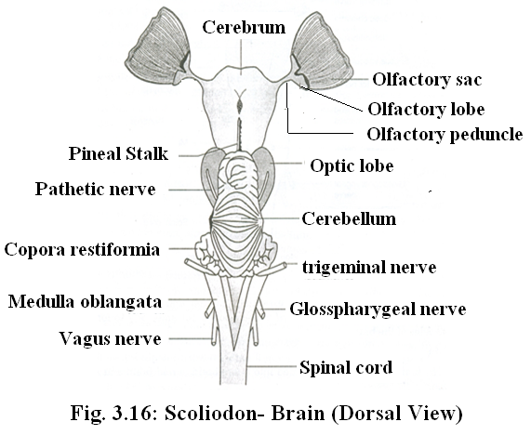
Brain: The brain is divided into three parts: fore-brain, mid-brain and hind-brain. a).Fore-brain: includes olfactory lobes, cerebrum and the diencephalon.
The olfactory lobe consists of pair of stout stalks, the olfactory peduncles extending forwards and outwards from the antero lateral angle of the cerebrum.
Olfactory peduncles end in a bilobed mass called olfactory bulb or lobe, closley applied to the olfactory sac of its own side. The olfactory tract and bulbs enclose narrow cavities, the olfactory ventricles or rhinocoels.

Slide 19
The cerebrum is undivided massive structure with no median groove to separate it into right and left cerebral hemispheres. It contains pair of cavities called lateral ventricles or paracoels separated by median partition and they are continued with foramen of Monro. The dorsal surface of cerebrum is quite smooth but on mid ventral surface, there is small opening, called neuropore through which emerge a pair of delicate nerves, the terminal or pre-olfactory nerves. Each of these nerves bears a ganglion along its course and runs along side the olfactory tract of its own side to innervate the mucous membrane of the olfactory sac.

Slide 20
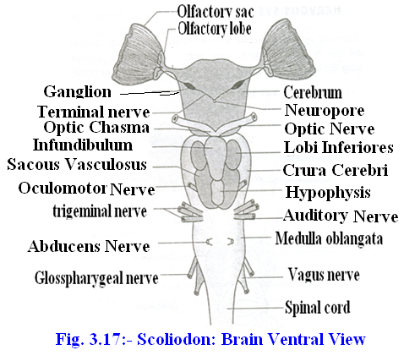
The cerebrum is continued behind into the narrow diencephalon which is very short and is completely hidden by the forward prolongation of the cerebellum. The roof of the diencephalon is extremely thin and membranous, being non-nervous in character, but it contains numerous blood vessels forming the anterior choroid plexus. Ventrally its anterior margin bears optic chiasma of two optic nerves. Just behind the chiasma a hollow projection called infundibulum is situated on the floor. Attached posteriorly to infundibulum is a sac like hypophysis and both make up the pituitary body. Close to the lateral sides of infundibulum lie two thick walled oval sacs called the lobi inferiors, the distalend which are continued into a pair of glandular sacs, the sacci vasculosi with thin walls.

Slide 21
(b) Mid brain:
It is not a prominent part and remains closely concealed dorsally by cerebellum and ventrally by the infundibullar outgrowths. It consists mainly of a pair of large, rounded dorsal swellings the optic lobes or carpora bigemina, which are the centres of sight and hearing. Each optic lobe has a cavity called optocoel. Ill and IV cranial nerves arise from midbrain.

Slide 22
(c) Hind brain: It consists of two parts cerebellum and medulla oblongata.
Cerebellum is large, elongated and rhomboidal structure overhanging the optic lobes in front and part of medulla behind. Its dorsal surface is irregularly folded and divided into three lobes by two transverse furrows. It has a cavity called metacoel. Anterior end of hind brain arises, a pair of hollow outgrowths, the carpora restiformia or auricular lobes.
Medulla oblongata, the last part of the brain is a triangular structure and continues posteriorly into the spinal cord. Medulla is roofed over by a thin, non-glandular and vascular membrane, the posterior choroid plexus. It has a wide cavity called fourth ventricle
Spinal Cord: It is the extension of medulla oblongata up to the end of tail, within the neural canals of vertebral column. It encloses a central canal and inner grey matter covered by outer white matter.
o

Slide 24
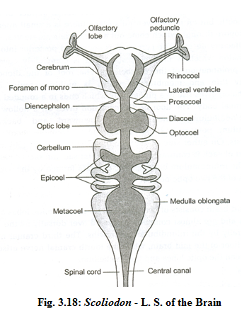

Slide 25
Functions of Brain:
1. Olfactory lobes and cerebrum are useful for sense of smell
2. The cerebellum is the seat of regulation of balance and muscular control.
3. The lobi inferiors and sacci vasculosi are centres for smell and taste.
4. Optic lobe has optic, olfactory, gustatory and acoustic-lateral sensory centres
5. The medulla oblongata contains the respiratory centres.

Slide 26
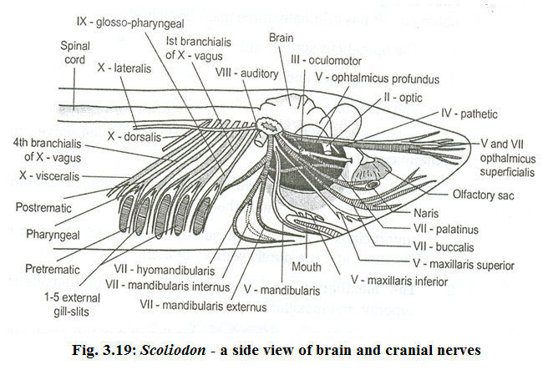

Slide 27
A) The Cranial Nerves: There are 10 pairs of cranial nerves recognized by their serial Roman numbers as well as the names. The serial numbers, names, origin and distribution of cranial nerves are as follows:-
Nerve “0″ Terminal or Pre-olfactory: These are sensory arising through neuropore of cerebrum and innervating the olfactory region.
Nerve I Olfactory: These are sensory, serves for smelling. Arise from olfactory lobe supply to olfactory sac.
Nerve II Optic: These are sensory in relation to light. Thick and short nerves arise from ventral side of diencephalon form optic chiasma and innervate retina of eye.
Nerve III Oculomotor: These are motor, controlling movements of eyeball, iris and lens. They are slender, arise from ventral surface of midbrain.
Nerve IV Trochlear or Pathetic: These are motor, help in rotation of eye ball. They arise dorso-ventrally from midbrain and supply the superior oblique muscle of eye.
Nerve V Trigeminal: They are mixed nerves arise from antero-lateral sides of medulla. Innervate to skin of snout and upper and lower jaw.

Slide 28
Nerve VI Abducens: It is a small slender and motor nerve arising mid ventrally from medulla to innervate the posterior rectus muscle of eye.
Nerve VII Facial: It is a mixed large nerve arising from the side of the medulla and supplies to the ampullae of lorenzini and buccal cavity.
Nerve VIII Auditory: It is sensory and helps in audition. It passes into auditory capsule to innervate the membranous labyrinth.
Nerve IX Glossopharyngeal: It is a mixed nerve and nerve and innervating to gill pouch and pharynx..
Nerve X Vagus or pneumogastric: It is the largest and mixed nerve and innervating to neuromast organs and heart

Slide 29
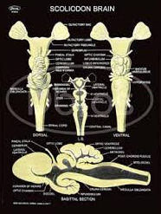

Slide 30
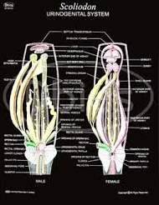

Slide 31
Scoliodon: Male Urinogenital System
Testes: two elongated testes, each running from the liver to the rectal gland. They are attached to the abdominal wall by a double fold of peritoneum called mesorchium. Each testis is composed of numerous seminiferous
Vasa efferentia: From each testis arise several thin tubular vasa efferantia which open into the anterior and of that vas deferens. These ducts are convoluted called as epididymis. The vas deferens which passes back to form a broad seminal vesicle
Spem sac: On either side of the urinogenital sinus lies a club shaped sperm sac. The function sperm sac is unknown.
Siphons: A pair of elongated siphons lies on the ventral side of the body between the skin and muscles.
Claspers (Myxopterygium): These are paired stiff, rod like copulatory organs which are modified pelvic fin. Each claspers is a tube partially open on the dorsal side forming a triangular groove which open into cloaca.

Slide 32
Scoliodon: Female Urinogenital System
Ovary: yellowish, lobulated, saccular bodies and located in the abdominal cavity-and attached to the anterior abdominal wall middorsally by a fold of peritoneum called mesovariumThey extend back from the base of liver and merge into the epigonal organ.
Oviducts: large tubes extending along Anteriorly they are narrow and unite mid ventrally below the oesophagus. They open into the coelom by zigzag slit like aperture, the ostium or oviducal funnel lying ventral to the oesophagus and posterior' to transverse septum
Shell gland: (oviducal or nidamental gland) which is heart shaped and shows narrow middle mucus secreting zone and posterior large shell secreting zone
Uterus: Towards the posterior region, the oviduct dilates to form a uterus. The two uteri unite to form a short vagina, which opens into cloaca.

Slide 33
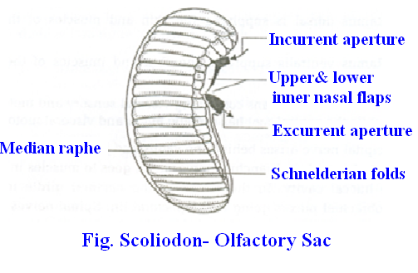
1. Olfactory organs: a pair of blind sacs lying on the ventral side of the head in front of the mouth. It is covered externally by a thin membrane and muscous membrane lining the inner wall which form double series of folds. The schneiderian folds are many medial raphes. Two types of cells, the olfactory receptors cells and supporting cells. The olfactory cells are connected with the fibres of the olfactory nerve which passes from each olfactory sac with olfactory lobe of its side of the brain. Each external nostril is more or less completely divided into two, a lateral incurrent siphon and a medial excurrent siphon by three nasal flaps. The highly developed sense of smell enables them to detect food.

Slide 34
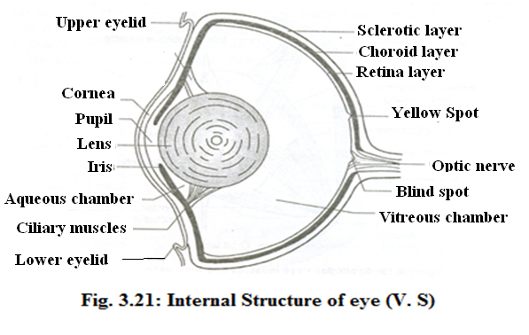
2. Eyes (Photoreceptors): eye-ball consists of three concentric layers,
1. Sclerotic layer: is cartilaginous and opaque and forms the outer protective layer and exposed part is transparent and is known as cornea through which the light enters. 2. Choroid layer: richly supplied with blood vessels and is pigmented. It is continued in front as strongly circular curtain, the iris, with a median vertical slit, as strongly circular curtain, the iris, with a median vertical slit, the pupil.
3. Retina layer: innermost layer and made up of special nerve cells called rods cells but no cone cells. The spherical crystalline lens which divides the eye into two unequal chambers, each filled with a saline liquid, the aqueous humour, while the chamber behind the lens contains a denser fluid, the vitreous humour. The lens is kept in place by a suspensory ligament.

Slide 35
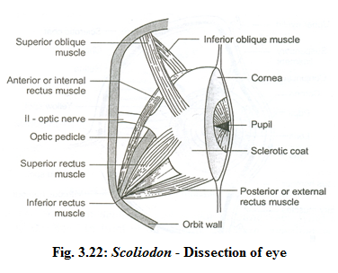
The eye-muscles: The eye-ball is lodged in the orbit and is held in position by six eye-muscles. The first group comprises four recti muscles
1. Superior rectus is inserted on the dorsal surface of the eye-ball.
2. Inferior rectus is inserted on the ventral surface of the eye-ball.
3. Anterior rectus is inserted on the anterior surface of the eye-ball.
4. Posterior rectus muscles is inserted on the posterior surface of the eye-ball.
The second group comprise two oblique muscles
1. Superior oblique is inserted on the dorsal surface of the eye ball in front of the place of insertion of the superior rectus.
2. inferior oblique is inserted in the ventral surface of the eye ball in front of the inferior rectus.

Slide 36
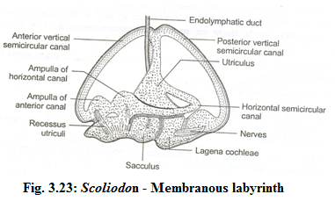
3. The Stato-acoustic Organs (Organs of equilibrium and Hearing): The pair of internal ears or membranous labyrinth serves the function o equilibrium and Hearing in the Scoliodon
1. Utriculus: medial, vertical, somewhat flattened structure placed dorsally. Three semicircular canals also arise from the utriculus and these are anterior vertical, posterior vertical and horizontal semicircular canals All the three canals show swellings at one end called the ampullae.
2. Sacculus: posterior and ventral part and gives out a posterior outpushing called the lagena. The sensory cells in cristae and maculae possess cilia at the free end while the basal ends receive nerve fibres from auditory nerve . The actual receptors of the internal ears are modified neuromasts called cristae and maculae. The cavity of the internal ear is filled with a watery fluid called endolymph

Slide 37
Functions of membranous labyrinth:
1. It mainly acts as a stato acoustic organ.
2. It controls the equilibrium and balance of the body.
3. It also controls change in direction during swimming and maintains muscular tone and is a gravity receptors.

Slide 38
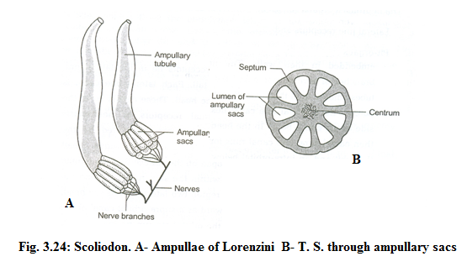
4. Ampullae of Lorenzini: unbranched tubes found in definitely located groups on the upper and lower surfaces of the head. In all sharks, that are habitually active, hundreds of pores open to the exterior. Each pore leads into a duct od canal of Lorenzini filled with mucus. The proximal portion of the ampulla consists of about eight or nine dilated sacs. Two types of cells are present in the ampulla, pear shaped mucous gland cells and sensory cells. The mucous gland cells secrete mucus. The sensory cells are hair like structure. Function: - They detect changes of temperature so they are also called as thermoreceptors

Slide 39
5. The Neuromast Organs (Rheoreceptors): The neuromast organs consist of: (1) lateral line receptors and (2) pit organs.
The lateral line receptors lie in the lateral line canal on each side of the trunk and tail, each of which is continued into the cephalic canals on the head. The canals lie in the dermis and have a group of epidermal receptors or neuromasts embedded in their walls. The neuromasts are innervated by vagus nerve.
Function: - The lateral line receptors are current receptors (rheoreceptors), detecting movement and vibration in the surrounding water.

Slide 40
