Slide 1
LIPIDS
- Lipids are naturally occuring hydrophobic molecules.
They are heterogenous group of compounds related to fatty
acids.
They include cooking oil, butter, ghee, waxes, cholesterol,
rubber, etc. belong to this category.
Lipids are widely present in plants and animals.
Term lipid – Bloor (1943) – “Lipids are naturally occuring
compounds, which are insoluble in water and soluble in one or
more org. solvents, such as benzene, chloroform. Ether, etc.”
Lipids contain fatty acids. Fatty acids are organic hydrocarbon
chain ending in –COOH group.

Slide 2
General characters of lipids:
Lipids are insoluble in water and hence hydrophobic.
They are soluble in non-polar solvents, such as benzene,
chloroform, ether, etc.
Lipids have high energy content and metabolized to release
calories.
Fats are bad conductors of heat.
They are hydrolyzed by the enzyme lipase to yield fatty acids
and glycerol.
The hydrolysis of fats by alkali is called as saponification. It
results in the formation of glycerol and salts of fatty acids
called soaps.
Pure fats are colorless and extremely bland in taste.
The melting point of fats depends upon length of chain of
fatty acids and the degree of unsaturation.

Slide 3
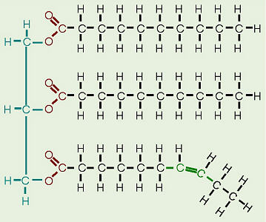
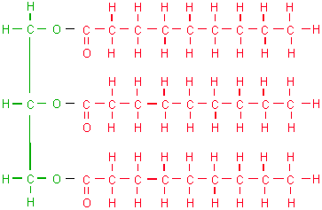
Structure of lipids:
- Lipid has no single common structure.
- The most commonly occurring lipids are triglycerides and
phospholipids.
Triglycerides :
These are fats and oils.
They have glycerol bonded to 3 fatty acids.
If fatty acids are similar – simple triglyceride.
If fatty acids are dissimilar – mixed triglyceride.

Slide 4
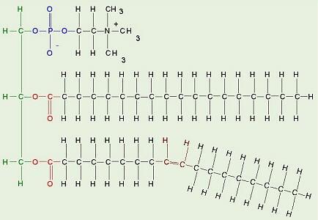
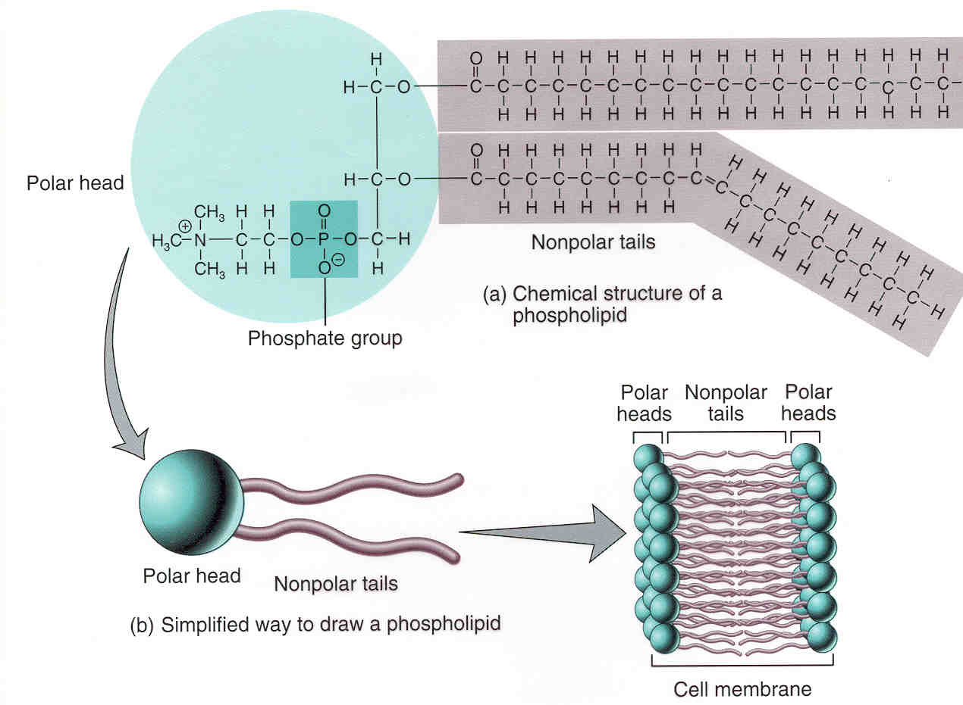
Phospholipids:
These are found in membranes of plant and animals.
They are lecithins and cephalins.
Phospholipids contain glycerol and fatty acid and also contain
phosphoric acids and a low mol. wt. alcohol.

Slide 5
Functions of lipids:
Lipids are more important source of energy and provide more energy than carbohydrates & proteins.
Triglycerides serve as reserve energy of the body.
Lipids are important component of cell-membrane structure in eukaryotes.
Layers of fat in sub-cutaneous layer provides insulation & protection from external heat.
Some lipids are important as vitamins.
Lipids are components of some enzymes systems.
Some hormones are lipids (eg: steroids).
Some lipids like waxes give a protective covering on the surface of leaves, stems & fruits.

