Slide 1
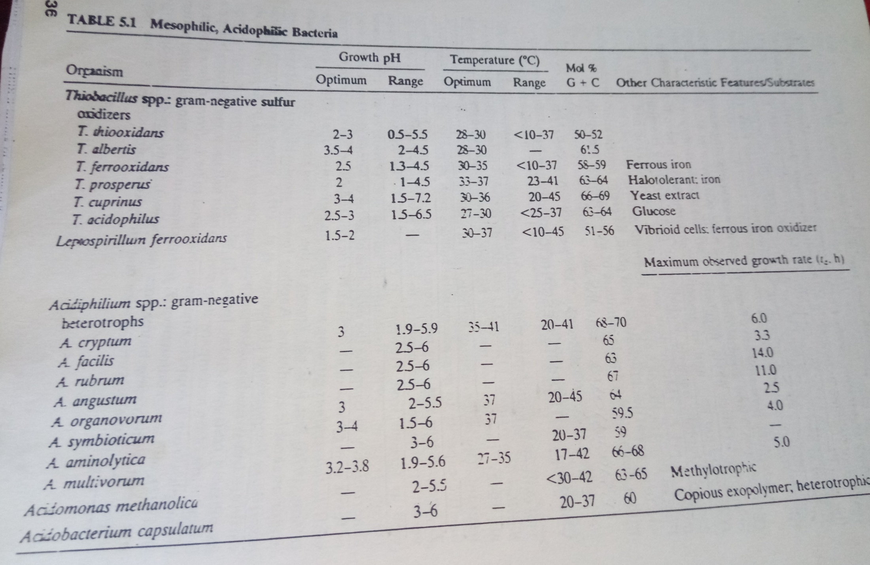
Acidophiles

Slide 2
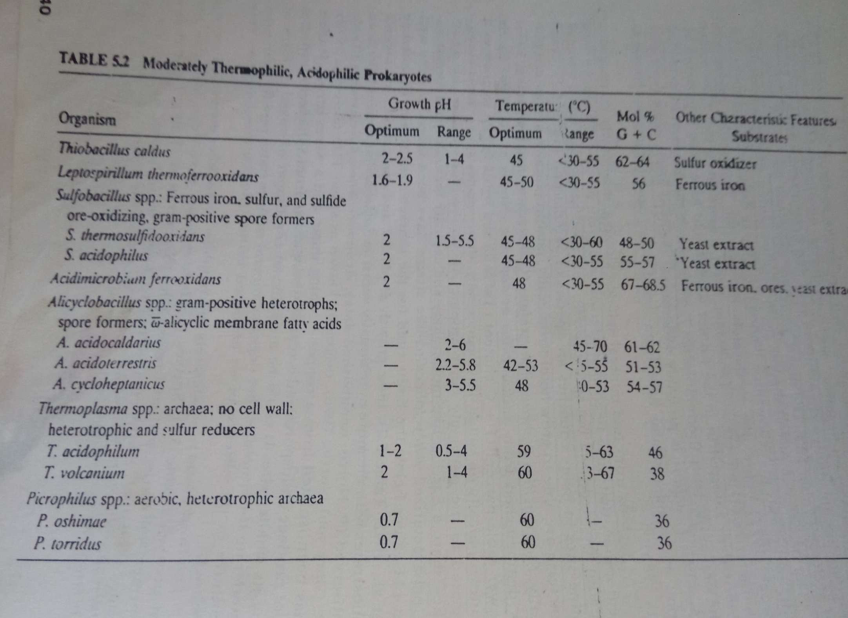

Slide 3
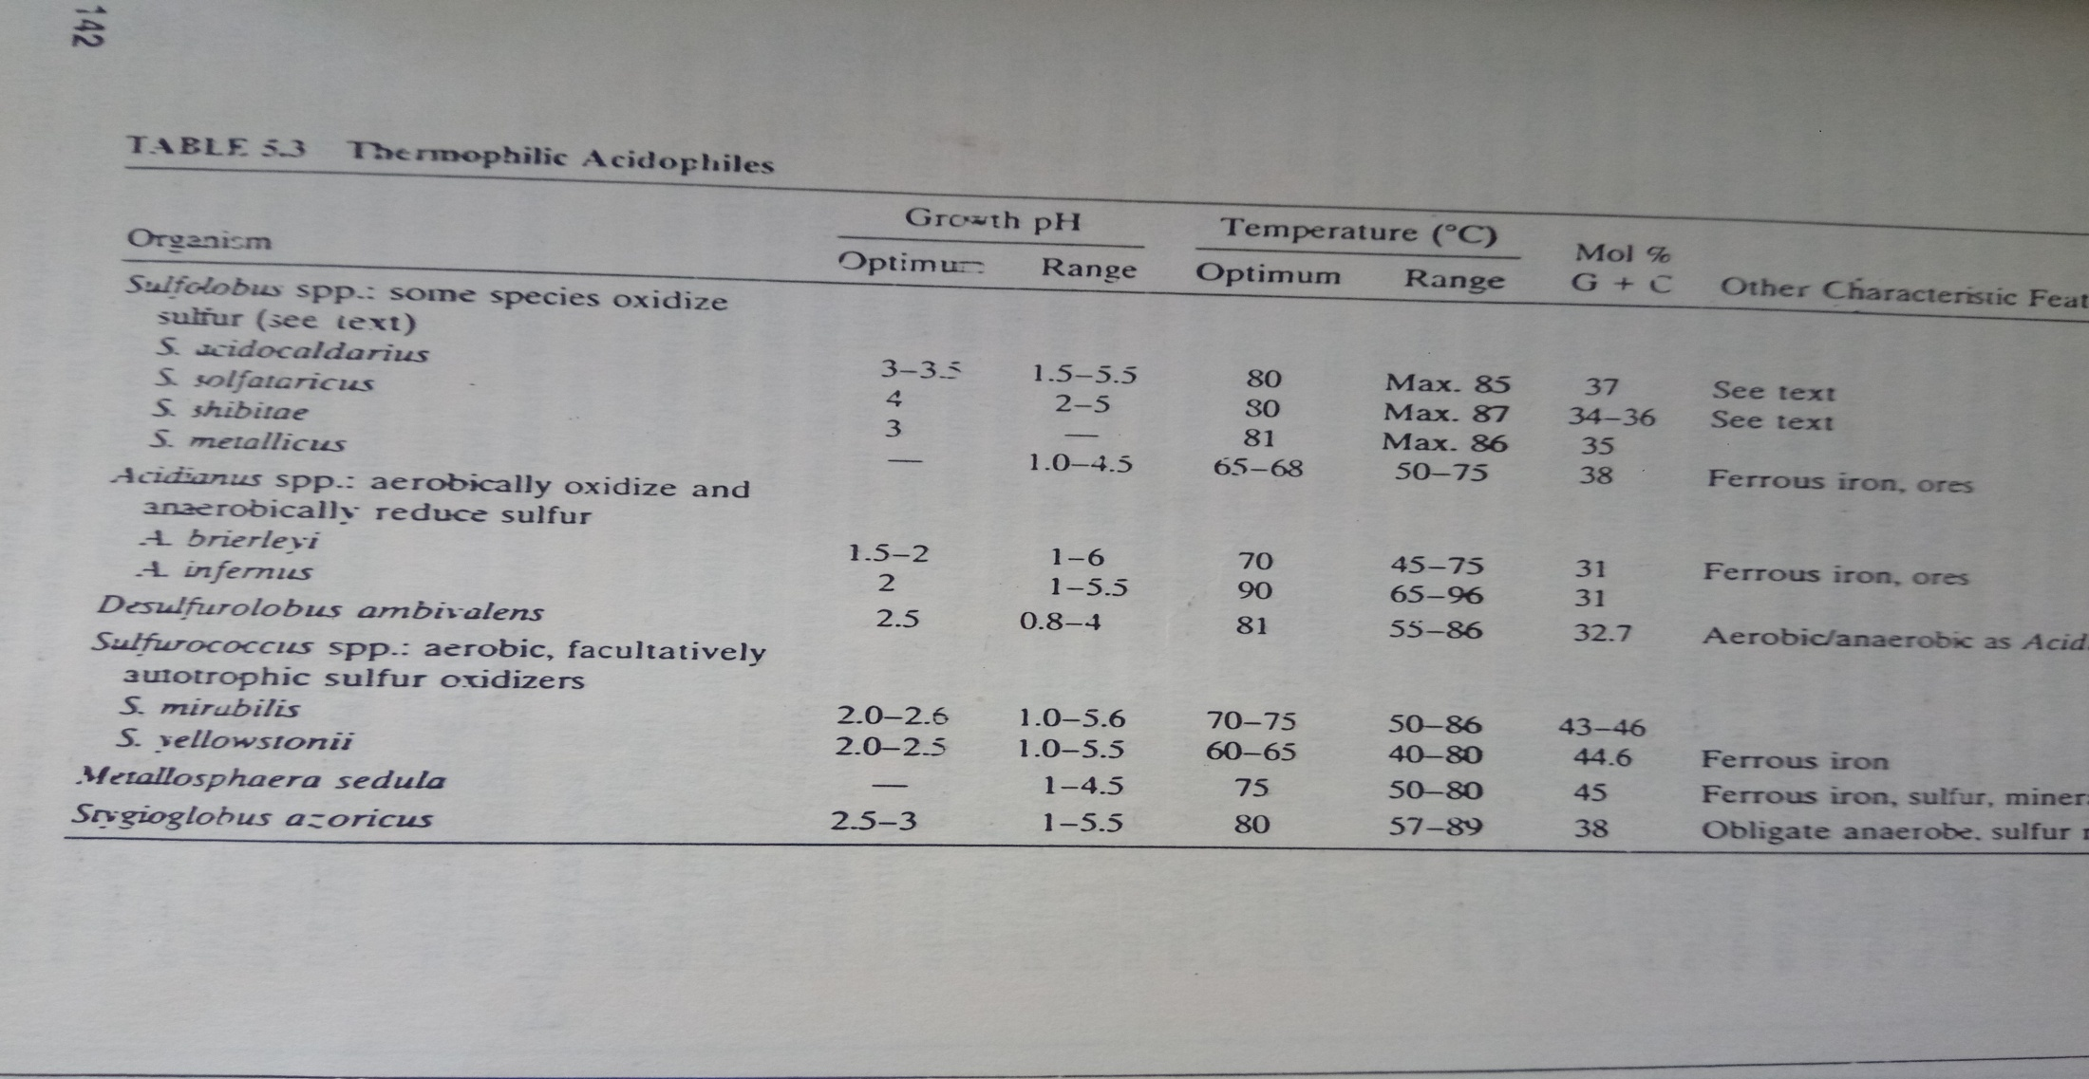

Slide 4
Physiological Adaptations
Acidophiles are believed to use a combination of mechanisms such as a proton impermeable cell membrane,
Reversed membrane potential and cytoplasmic buffering.
The cell membrane acts as the primary defense against low pH for acidophiles thriving in acidic environments.
The cell membranes of acidophiles differ greatly from neutrophiles in fatty acid and lipid composition.
The relatively high proportion of archaea among acidophiles is partially attributable to the low permeability of archaeal membranes to protons
Archaeal membranes are characterized by the presence of tetraether lipids. These ether linkages are less susceptible to acid hydrolysis as compared to the ester linkages found in bacterial and eukaryotic membrane Lipids .
Studies on liposomes derived from P. oshimae membrane lipids indicate that the impermeability to protons might also be due to the presence of rigid monolayer preventing splitting of the membrane and the
bulky isoprenoid core.

Slide 5
Some archaea such as Ferroplasma and Thermoplasma are cell wall less microbes.The cell membrane of Thermoplasma spp. does not have sterols, glycoproteins and lipoglycans.
The detailed analysis of membrane structure of archaea revealed the
important role of membrane lipids in maintaining constant pH inside the cell, membrane, proton gradient and proper functioning of membrane ATP synthase.
Acidophiles use a reverse membrane potential (positive ΔΨ) as a pH homeostasismechanism, as opposed to the negative ΔΨ seen in neutrophiles.
This positiveΔΨ is generated in acidophiles by the Donnan potential of positively charged ions, usually potassium, which inhibits the entry of protons into the cell.
The genome analysis of acidophiles such as P. torridus, F. acidarmanus,
S. Solfataricus and Leptospirillum suggested
the presence of disproportionately high number of putative cation transporters, possibly involved in the generation of Donnan potential

Slide 6
In spite of highly impermeable cell membrane of acidophiles, if there is any sudden influx of protons, the buffering capacity of the cytoplasm can sequester those protons and prevent ensuing damage.
All acidophiles contain cytoplasmic buffering molecules which have basic amino acids such as lysine, histidine, arginine and others
that are capable of capturing protons.
A comparison between the cytoplasmic buffering capacity of the extremophile A. acidophilum and neutrophile E. coli suggested that the latter has more buffering capacity.
This suggests that pH homeostasis in acidophiles through cytoplasmic buffering does not imply higher buffering capacity than neutrophiles. Other buffering molecules include dihydrogen phosphate ion and potassium.
Genome sequence analysis of most of the acidophiles like Ferroplasma,
Leptospirillum, Acidithiobacillus ferrooxidans, A. thioxidans, A. caldus confirmed the presence of putative proton efflux system that includes H+ATPases, antiporters and symporters

Slide 7
Abundance of secondary transporters has been reported from acidophiles. Active secondary transporters are membrane proteins that uses transmembrane electrochemical gradient of protons or sodium ions to drive transport.
In P. torridus and T. acidophilum, these secondary transporters are present in huge numbers, representing the adaptation of these acidophiles to low pH.
Generally heterotrophic acidophiles are capable of degrading organic acids such
as acetic and lactic acid .
These acids are deleterious to acidophiles as they act as uncouplers of respiratory chain at acidic
pH. These are protonated acids/conjugated bases which have dissociable protons
that can easily pass across the cell membrane.
Genes encoding the enzymes of organic acid degradation pathways are present in the genomes of extreme acidophiles; its association with low pH is, however,unclear.

Slide 8
Interestingly, all acidophiles capable of growing at extreme acidic pH are heterotrophs and are efficient in degrading organic acids.
Chaperones are proteins that are involved in the proper refolding of other proteins
Interestingly, in acidophiles, a high expression of heat shock proteins/chaperones has been reported. These chaperones enable the rapid and efficient repair of damaged proteins

Slide 9
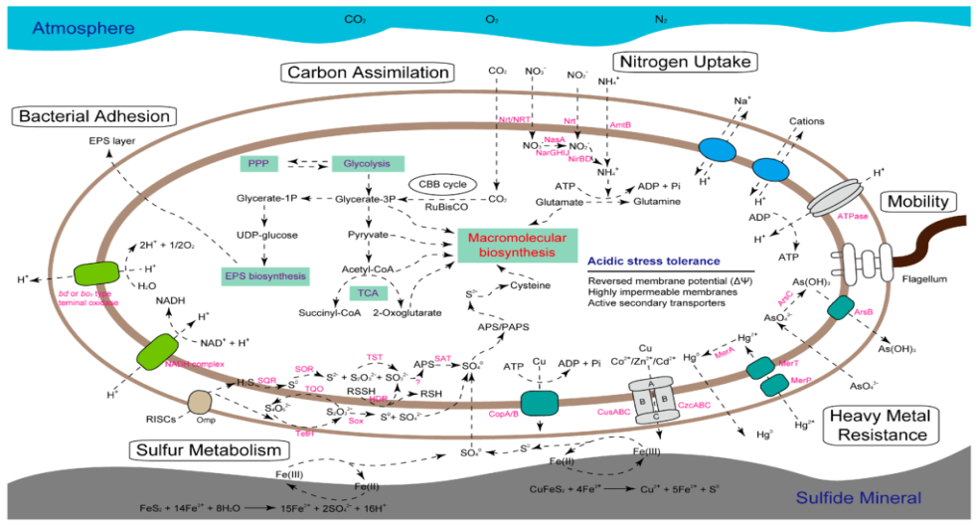

Slide 10
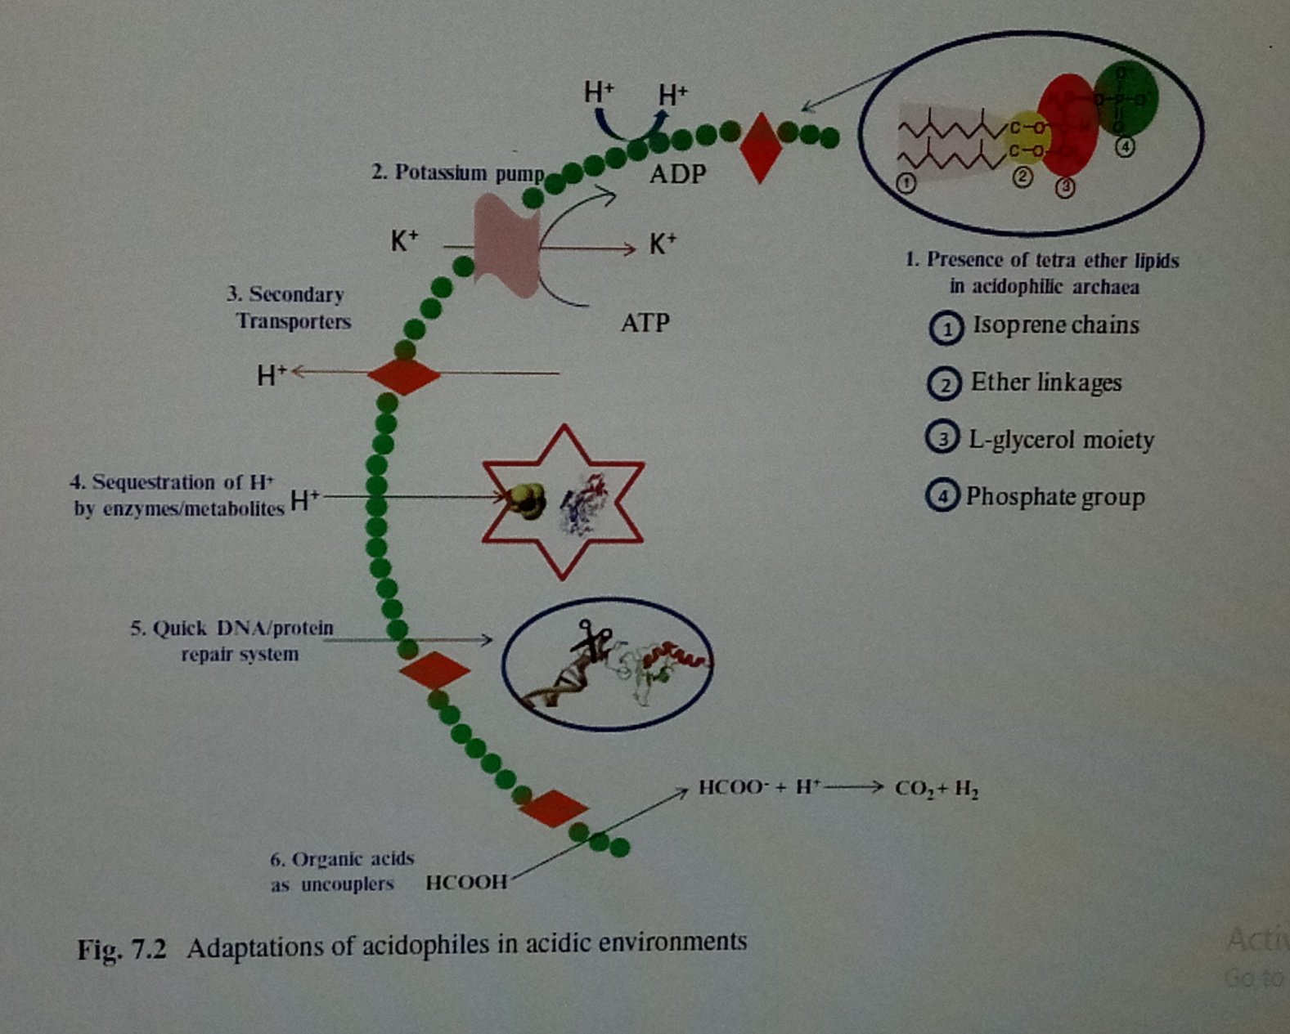

Slide 11
Molecular Adaptations of Acidstable Proteins
Acidophilic enzymes possess properly folded structure and stability in acidic environments and are catalytically active at pH as low as 1.0.
1.Presence of acidic amino acids (negatively charged at a neutral pH) on the surface.Ex. The presence of numerous glutamic and aspartic surface residues on the modeled endo-b -glucanase from S. solfataricus generates a high negative surface charge at neutral pH, a significant
adaptation of acidstable enzymes at low pH.
2. Acidstable α-amylase from A. acidocaldarius possesses a reduced density of both positive and negative charges on the surface of the protein; this avoids the electrostatic repulsion of charged groups at acidic pH and may be considered an adaptation for acid stability.
3.The analysis of several proteins from F. acidiphilum suggested the presence of enzymes active at pH lower than its cytoplasmic pH. This may be due to the intracellular compartmentalization of these enzymes and the pH gradient that exists within the cytoplasm. Another possible reason for this is that these enzymes form multienzyme complexes which increase the pH optima closer to that of cytoplasm.
5 6

Slide 12
The proteome analysis of F. acidiphilum indicated the presence of a high proportion of iron proteins that contributes to the pH stability of enzymes. This iron functions as an ‘iron rivet’ that stabilizes the 3D structure of the protein.
Metagenomic and Metatranscriptomic Analysis of Acidophiles
A total of 56 draft or completely sequenced genomes of acidophiles are reported that includes 30 bacteria and 26 archaea. Availability of multiple genome sequences permits the prediction of metabolic and genetic interactions among the members of the bioleaching microbial community and the analysis of main evolutionary developments
that shape genome architecture and evolution. Chen et al. (2014) studied the comparative metagenomics and metatranscriptomics analysis of microbial collections.
from geochemically distinct AMD sites. The species of Acidithiobacillus,
Leptospirillum and Acidiphilium are predominantly present in the microbial communities and exhibit high transcriptional activities.

Slide 13
The comparative analyses of microbial community of AMD showed that the microorganisms are adapted to various environmental conditions through regulating the expression of genes playing roles in multiple in situ functional activities. such as low pH adaptation, assimilation of carbon, nitrogen and phosphate, energy generation, environmental stress resistance and many other functions.
The comparative analysis of acidophiles revealed diverse strategies employed by Acidithiobacillus ferrivorans and Leptospirillum ferrodiazotrophum in nutrient assimilation and energy generation for survival under different conditions. analyzed the microbial biofilm community of AMD sites and reported the dominance of proteins involved in protein refolding and response to oxidative stress. This suggests that damage to biomolecules is a main challenge in the survival
of microorganisms in the extreme environments.
Acidophilic Bacteria and Archaea in Microbiohydrometallurgy
Most of the extremely acidic environments are the result of human activity such as mining of metals and coal. The microbial dissimilatory oxidation of elemental sulfur, reduced sulfur compounds (RSCs) and ferrous iron generates acidity.

Slide 14
Elemental sulfur is mainly found in geothermal areas where it is formed by the condensation of sulfur dioxide and hydrogen sulfide

