Slide 1
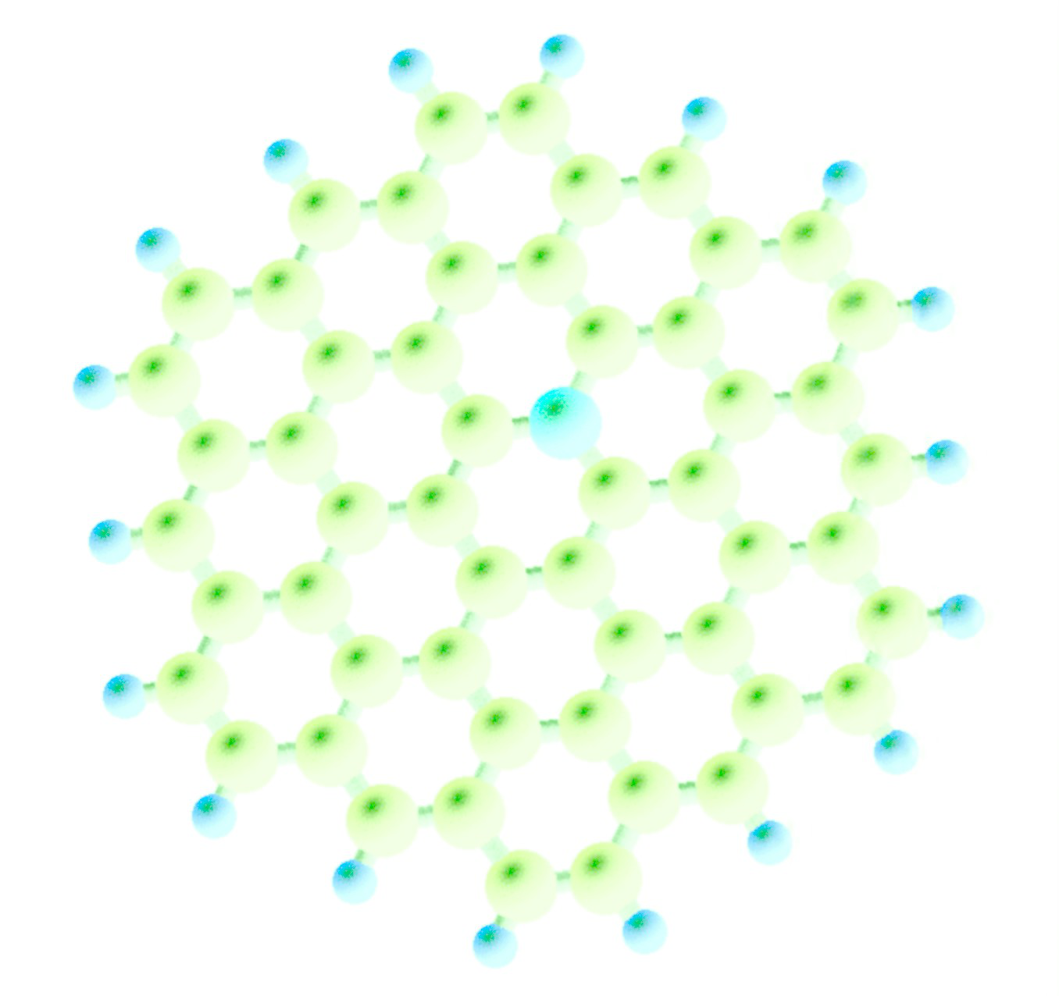
AGA 0316 Aula 14
Sigam o Nitrogênio -2

Slide 2
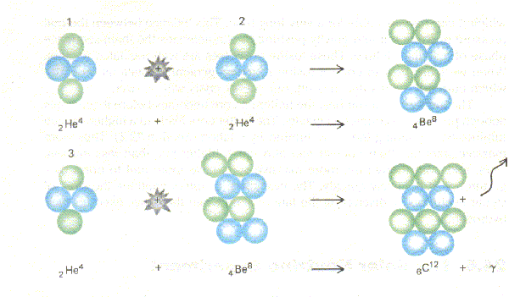

Slide 3
FOLLOW THE LIFE
Solvent
Biogenic elements
Source of Free Energy
⇒
searches for life within our solar system commonly retreat from a search for life to a search for “life as we know it,” meaning life based on liquid water, a suite of so-called “biogenic” elements (most famously carbon), and a usable source of free energy.
(Chyba & Hand, 2005, p. 34)

Slide 4
FOLLOW THE LIFE
Follow the water
Follow the carbon
Follow the nitrogen
Follow the energy
Follow the entropy
Follow the information
⇒

Slide 5
Why Nitrogen?
N is the fourth more abundant chemically active element in the Universe
N is one of the elements (together with C, O and P) entering in the composition of the carrier of biological information in Earth (DNA)
N allows the assembling of a number of complex, heterocyclic, assymmetric compounds
The odd-valence of N compounds introduces asymmetries, which are a necessary condition for information storage
Notes:
5

Slide 6
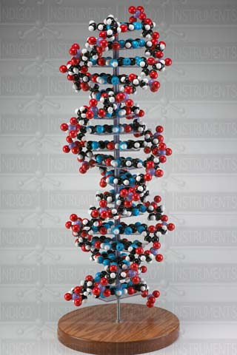
Nucleic acids (DNA/RNA)
The living organisms contain two sorts of nucleic acids: DNA and RNA
Deoxyribonucleic acid (DNA) is the nucleic acid that contains the genetic instructions used in the development and functioning of all known living organisms
Both DNA and RNA are constituted by nucleotides linked together in long polymers

Slide 7
Nucleotide
Each nucleotide:
1) Five-carbon sugar molecule
2) One or more phosphate groups
3) Nitrogen-containing compound – nitrogenous base

Slide 8
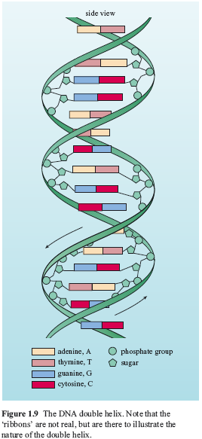
Strand
DNA has a double helix structure.
DNA strand DNA strand
A T
T A
G C
C G
Hydrogen bond
(weak)
A can link only with T
G can link only with C
Two DNA strands are “complimentary”
to each other

Slide 9
RNA World Hypothesis
RNA is an information carrier (like DNA)
RNA molecules can act as catalysts (unlike DNA)
But self-replicating systems of RNA molecules have not been found in nature yet …
Origin of Life
RNA world
DNA/protein
world

Slide 10
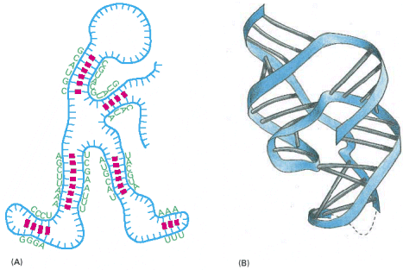
RNA is a single-stranded but not a linear molecule.
The shape is very important for catalytic purposes

Slide 11
DNA vs. RNA
Deoxyribonucleic acid (DNA) – deoxyribose sugar
Ribonucleic acid (RNA) – ribose sugar
Four bases:
DNA RNA
A – adenine – A
G – guanine – G
C – cytosine – C
T – thymine U – uracil

Slide 12
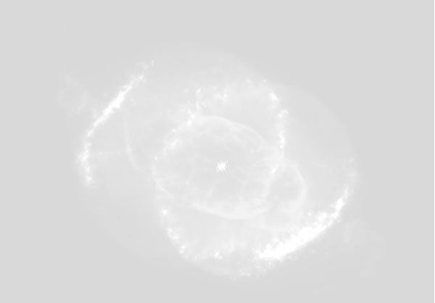
All living Beings are constituted by
CELLS with DNA and RNA inside
Notes:
12

Slide 13
The cell
Nucleic acids, proteins, lipids, carbohydrates are parts of the living organism but not the living organism by themselves.
Cell is the smallest unit of any living organism which can:
Gather raw materials from the environment
Construct out of them a new cell with a new copy of the hereditary information

Slide 14
A small bag of molecules that is separated from the outside world
Bag – membrane and cell wall
There are always DNA, cytosol, ribosomes and enzyme in the bag.

Slide 15
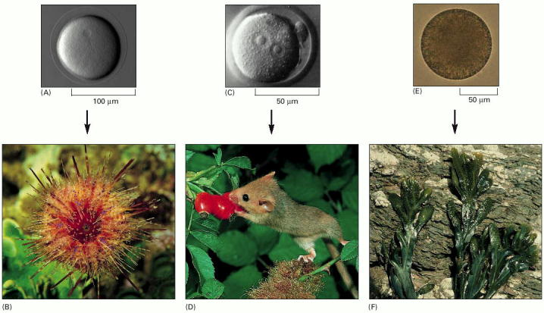
1) Many living organisms are single cells
2) In multicellular organisms (e.g. humans) groups of cells perform specialized functions
3) But in all cases, whether we discuss the solitary bacterium or the aggregate
of more than 10¹³ cells (human body), the whole organism has been
generated by cell divisions from a single cell.

Slide 16
A few common features of all Cells
All Cells store their hereditary information in the DNA
All Cells replicate their hereditary information by templated polymerization
All Cells transcribe portions of their hereditary information into the same intermediary form (RNA)
All Cells use proteins as catalysts

Slide 17
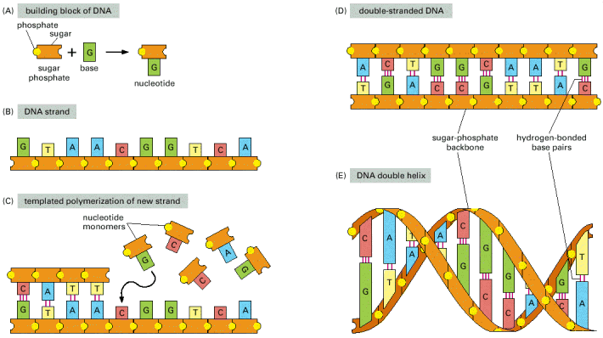
All Cells Replicate Their Hereditary Information by Templated Polymerization

Slide 18
A
G
C
T
DNA is a string of “letters”

Slide 19
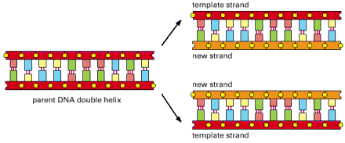
Unzipping DNA
Templated polymerization

Slide 20
RNA types
mRNA messenger RNA (mRNA) RNA molecule that specifies the amino acid sequence of a protein.
rRNA ribosomal RNA (rRNA) Any one of a number of specific RNA molecules that form part of the structure of a ribosome and participate in the synthesis of proteins
tRNA transfer RNA (tRNA) Set of small RNA molecules used in protein synthesis as an interface (adaptor) between messenger RNA and amino acids.

Slide 21
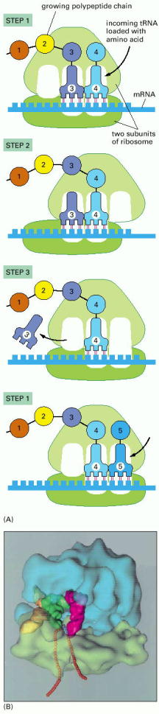
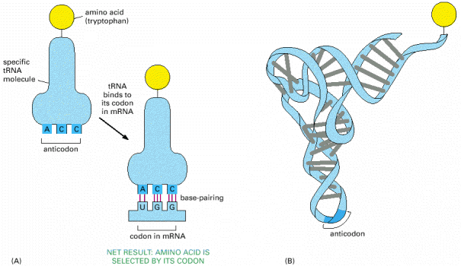
1) Each type of tRNA becomes attached
at one end to a specific amino acid, and displays at
its other end a specific sequence of three nucleotides
2) Ribosome (rRNAs) latches on one end of the mRNA
trundles through it and picks up tRNAs loaded with amino acids
3) In the ribosome tRNAs attach to a matching segment of
the mRNA. The amino acids link together to extend the growing
protein chain. tRNAs, without amino acids, are released

Slide 22
Rational for Darwin’s theory
DNA replication proceeds with high speed – human DNA (3-billion-base sequence) can be copied in several hours
Even though DNA replication proceeds with incredible accuracy, errors do occur (< 1 error per billion bases copied) – mutations.
If cell survives the mutation, it will be copied every time DNA is replicated
Mutations cause diversity within species
Some mutations have no effect, some are lethal and in very rare occasions mutations are useful – basis for evolution

Slide 23
ORIGINS OF LIFE?
Notes:
23

Slide 24
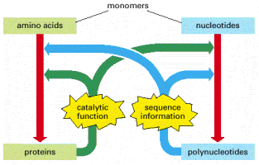
What did come first?
DNA? RNA? Protein?
DNA has information to reproduce itself but needs proteins to catalyse the reaction
Proteins can catalyse reactions but can’t
reproduce by themselves
It is very unlikely that all DNA/RNA/proteins components
would form spontaneously at the same time.

Slide 25
The First Living System Components
DNA/protein system is very complicated.
It is reasonable to assume that there was a simpler system from which DNA/protein evolved.

Slide 26
Evidence of early DNA Life
Stromatolites – accretionary organosedimentary structures produced by communities of marine-dwelling microorganism , principally cyanobacteria.
Oldest Stromatolites are from 3.556 +- 0.032 billion years ago.
They have close structural homology to recent Stromatolites.
Oldest micro fossils of cyanobacteria-like were found nearby from 3.5 years ago. => oldest DNA life.

Slide 27
Who Was First ? Proteins or Nucleic Acids?
Proteins
It is easier to polymerize proteins than nucleotides
Nucleic acids
special conditions in the soup enabled replication without proteins
Both
relation from the start:
proteins-nucleotids
Amino acids -codons

Slide 28
The Chain to Life
Inorganic materials
The creation of primordial soup (simple organic compounds were created from inorganic materials)
Polymerization
Creation of a simple system that can replicate itself: knowledge and enzymatic/synthesis functions
DNA/proteins mechanism

Slide 29
RNA World Hypothesis
RNA is an information carrier (like DNA)
RNA molecules can act as catalysts (unlike DNA)
The firsts living being were CELLs with only RNA inside (DNA and proteins came later)
Origin of Life
RNA world
DNA/protein
world

Slide 30
The Path to DNA/proteins System
stability
Abiotic world
catalytic
RNA-World
replication
DNA /proteins
flexibility

Slide 31
Concept of the RNA world
Short strands of RNA-like molecules were produced spontaneously (with the help of minerals)
Eventually some of the RNA-like molecules were able to catalyze their own replication
Copying errors introduced mutations and therefore Darwinian-like evolution

Slide 32
Concept of the RNA world
C
A
G
G
C
U
G
U
A
A
G
G
C
U
A
G
G
C
U
C
C
U
U
C
C
G
A
G

Slide 33
RNA World Model:
Evolution from RNA to DNA
Emerging of RNA as an outcome of polymerization
2. Catalytic function ?
RNA self replicating without enzymes
1. How ?
Who/Which?
RNA - proteins system
3. The path? mechanism to path ?
DNA-RNA-proteins system

Slide 34
Organic From Inorganic
(Miller, Urey, Eigen) : Put together a blend of particular gases and water, then by the help of electric stream, spontaneous simple organic compounds as purines, pyrimidines and others that exist in living organisms, are created.
Conclusion: simple organic compounds (amino acids, nucleotides, ATP-like) were created from inorganic materials.
Notes:
34
gyyyyyyyyyyyyyyyyyyyyyy

Slide 35
Biochemical Molecules of the Prebiotic Earth
Prebiotic synthesis of Purines

Slide 36
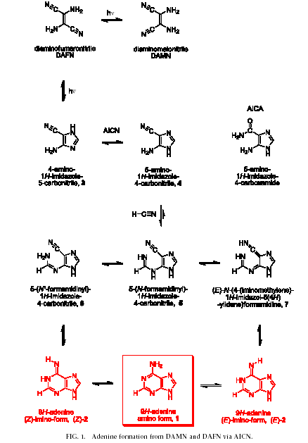
Adenine Synthesis in Interstellar Space

Slide 37
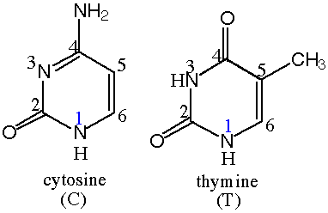
Pyrimidines

Slide 38
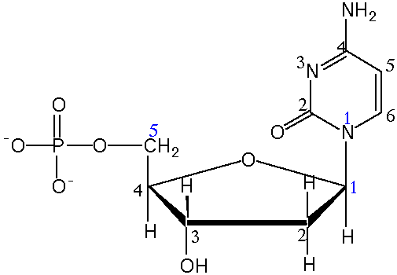
nucleotide

Slide 39
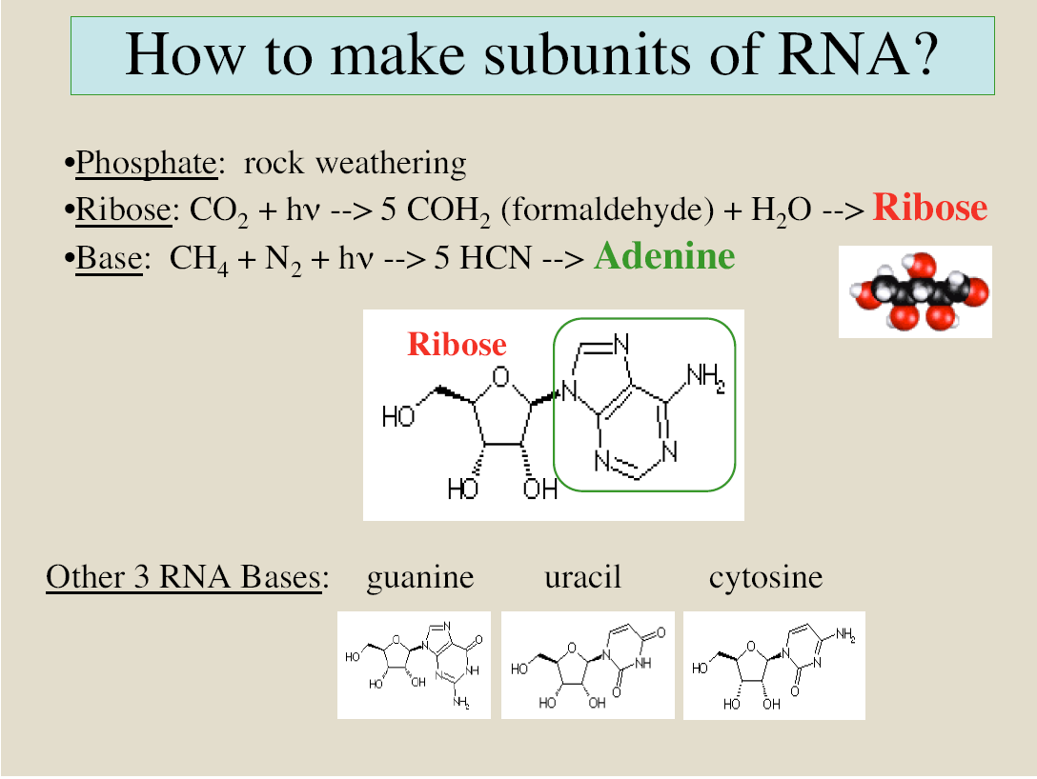

Slide 40
Polymerization : From a Simple Compound to a Complex One
Molecules of the same type composed to polymers: amino acids composed to polypeptides, some with enzymatic functions. Nucleotides have composed to RNA-like chains.
Orgel has exhibited spontaneously attaching nucleotides to an RNA-like chain.
Notes:
40

Slide 41
Evolution in Vitro
RNA-replicase
RNA-replicase
U, C, G, A
RNA molecule
U, C, G, A
all new RNA molecules are complementary with original RNA - serves as a template
in vitro Evolution-
Population of different RNA molecules is created .
After some generations one molecule takes over (different molecule every tube)

Slide 42
Requirements from the first replicating molecule
It must have informational properties.
It must have been capable of directing the ordered assembly of its sub-units to form additional copies of itself.
The sub-units must be readily available.
The genetic material must be stable to enable the rate of replication to exceed the rate of decomposition.
Flexibility – to enable an evolutional path.

Slide 43
A Problematic Issue in Creating RNA
It’s not likely that RNA molecule was created in prebiotic conditions mainly because of the difficulty in attaching pyrimidines (C, U) to ribose to form pyrimidines nucleosides.
A period of time when environment enabled RNA to be created
Primitive clay self-replicating system, from which an RNA system evolved
A simpler RNA-like molecule, maybe only with purines (A, G) and from which an RNA system evolved
Joyce, 1989

Slide 44
1) Arguments for an RNA world
In Miller’s experiments, ribose (component of RNA) was created and deoxy-ribose (in DNA) was harder to produce. Deoxy-ribose tends to decompose better than ribose.
RNA is simpler then DNA.
It exists in viruses (and no DNA)

Slide 45
2) Arguments for a RNA world
Most of the biological co-enzymes are nucleotides or compounds that could be derived from nucleotides.
It has been proved experimentally that it has enzymatic functions, for example:
  (Cech): Tetrahymena’s ribosomal RNA contains self splicing introns.
  (Altman): E.Coli’s ribonuclease-P cuts phosphodiester bonds during maturation of the t-RNA molecule.
The DNA-protein system cannot work without RNA. Maybe it is an outcome of RNA history

Slide 46
3) Arguments for an RNA world
Accretion of planet
Stabilization of crust
Fall off of meteors
Fossil evidence of DNA/protein life
4.6
4.2
3.8
3.6
3.4
Time in billion years
Hydrosphere in place
Isua
Warrawoona stromaotolites

Slide 47
Arguments against an RNA World Model:
Prebiotic conditions - How could an RNA molecule emerg in the prebiotic condition
Emerging of RNA as an outcome of polymerization
efficiency, fidelity of catalytic functions in prebiotic world
RNA self replicating without enzymes
RNA - proteins system
No self replicating RNA molecules has been found
DNA-RNA-proteins system

Slide 48
 | Joyce’s Theory | De Dove’s Theory | Orgel’s Theory
Basic Hypothetical Assumptions | The existence of a soup of activated mononucleotides | Interaction of RNA variants and aminio acids.The existence of a primitive peptide-assembly machinery. | The existence of a RNA world in which RNA catalyzed all reactions and replicated.
Findings | No RNA molecule replication. Simpler genetic system preceded RNA. | The existence of RNA replication , and a mechanism of selection by amplification. Darwinian evolution at the molecular level. | Pool of random oligonucleotides. Isolation of a catalyst that joins together with oligonucleotides.
Flaws | Racemic mixtures of nucleotides makes replication very difficult. | No mechanism of seperation of the double stranded RNA is offered. | Inability to synthesis ribose in adequate quantity and purity. Modest success in synthesizing nucleotides directly from their components.

