Slide 1
Mangroves
Prof. Mrs. Manisha Gurme
Dept.Of Botany
Dayanand Science College,Latur.
B.SC. 1 st Year

Slide 2
Introduction:
In tropical and sub-tropical regions halophytes form a typical seashore vegetation called Mangrove formation.
In our country mangroves can be seen on seacoasts of Bombay (Elephanta caves) and Kerala,near the estuarine deltas of the Ganges and Godavari and in Andaman and Nikobar islands. All these places are frequently
water-logged.
The mangrove formations have a characteristic vegetation which forms a dense forest of small evergreen trees.
Notes:
Estuarine

Slide 3
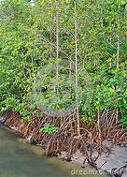
Mangrove Vegetation in India

Slide 4
The habitat is characterised by,
-Sandy,loose,swampy and saline soil.
-High rainfall.
-High humidity in the atmosphere and
-Almost uniform temperature throughout the year.

Slide 5
Characteristic adoptive features of Mangroves
The Mangroves show many characteristic adoptive features.Some are listed below,
1) Stilt roots: Mangroves develop many shallow normal roots.In addition to normal roots many stilt or prop roots develop from the aerial branches of stem for efficient anchorage in muddy or sandy soil.

Slide 6
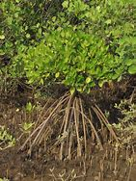
Stilt Roots

Slide 7
2) Formation of Pneumatophores :
-The soil in coastal region is poorly aerated and it contains very little amount of oxygen because of water-logging.Under such conditions ,the roots of halophytes donot get sufficient aeration.In order to compensate this lack of aeration,the halophytes develop special type of negatively geotrophic roots called pneumatophores or breathing roots.
-The pneumatophores usaully develop from the underground roots and project in the air above the surface of the mud and water.

Slide 8
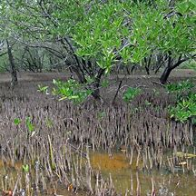
Pneumatophores

Slide 9
The pneumatophores appear as peg like structures.
The tips of these respiratory roots may be pointed.
They possess numerous lenticels on their surface and internally having prominent arenchyma enclosing large air cavities.
Through these lenticels gaseous exchange takes place and arenchyma helps in the conduction of air down to roots.

Slide 10
Pneumatophores showing lenticels

Slide 11
3)Vivipary:
- The mangroves show the phenomenon of viviparous germination i e the seeds start germinating while the fruit is still attached to the mother plant.
-There is no resting stage in the seed and its germination takes place immediately after it is formed.
- This is supposed to ensure the germination of the seed into a new plant under adverse conditions when it fall on the ground.
- The seedling falls down in an upright manner and the radicle of root gets embedded in soil.

Slide 12
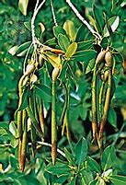
Viviparous Germination

Slide 13
In this way the already developed plumule portion doesnot come in contact with saline soil which may be otherwise injurious to it.
4)Shrubs and trees:
Mangroves are mostly shrubs and trees.
5) Xeromorphic nature:
Stem is sacculent.
-Leaves are small,sacculent,thick and spiny to check transpiration.
-Leaves have water storage tissues.
-Leaves have thick cuticle.
-Stomata are sunken.

Slide 14
6) Economic Importance:
-Mangroves have great economic importance.They provide timber,fodder,vegetables,starch,medicines,bark,etc.
-They also act as good sand binders.
-Alcohol is obtained by distilling the juice secreted by the inflorescence of Nepa species.
-The species like Ceriops and Heretiera are dominant in the Sunderban region of India.Avicennia alba and Avicennia marina are charateristic of Godavari delta of Andhra.

Slide 15
Thank You

