Slide 1
B. Sc. I year Paper I Microbes Bacteria
Miss. Sude N. R.
Department of Botany
Dayanand Science College, Latur

Slide 2
Bacteria
Very small, primitive, microscopic, mostly unicellular prokaryotes
Discovery- Anton Von Leeuwenhoek (1675)
Animalcules
Bacteriology: independent field for study
Occurrence: omnipresent (water, air, soil, hot & cold temperatures)

Slide 3
General characters of Bacteria
Unicellular, minute, primitive, microscopic & prokaryotic
Mode of nutrition- Autotrophic, saprotrophic and parasitic
Motile or non-motile
Shows variety of forms- Spherical, rod shaped, spiral or helical, comma shaped, etc.
Smallest living organism
Typical prokaryotic structure- cell wall and protoplasm
Aerobic or anaerobic
Flagella- locomotary organ
Kingdom Monera
Reproduce sexually and asexually

Slide 4
Ultrastructure of Bacterial cell
bacterial cell is composed of well developed cell envelope, cytoplasm and nuclear material
Cell envelop:
Glycocalyx
Cell wall
Cell membrane
Cytoplasm
Ribosome
Lamellae & Chromatophore
Mesosome
Cytoplasmic inclusions
Nuclear Material
Plasmid
Fig: Ultrastructure of Bacterial cell

Slide 5
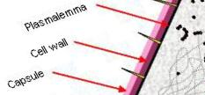
Cell Envelop
Glycocalyx:
Outer layer, may be present or absent
Nature variable- Thin (Slime) or Thick (Capsule)
Capsulated: pathogenic
Non-capsulated: non-pathogenic
Cell wall:
Next to glycocalyx, Thick and rigid
Peptidoglycan= N-acetylglucosamine (NAG) + N-acetyl muramic acid (NAM)
Porin proteins form aqueous channel through which several components pass in and out (Permeable)
Cell membrane:
Innermost layer called boundry or limiting layer of the cytoplasm
Thin, papery, delicate
Lipoprotein in nature
Semipermeable
Related to many physiological processes

Slide 6
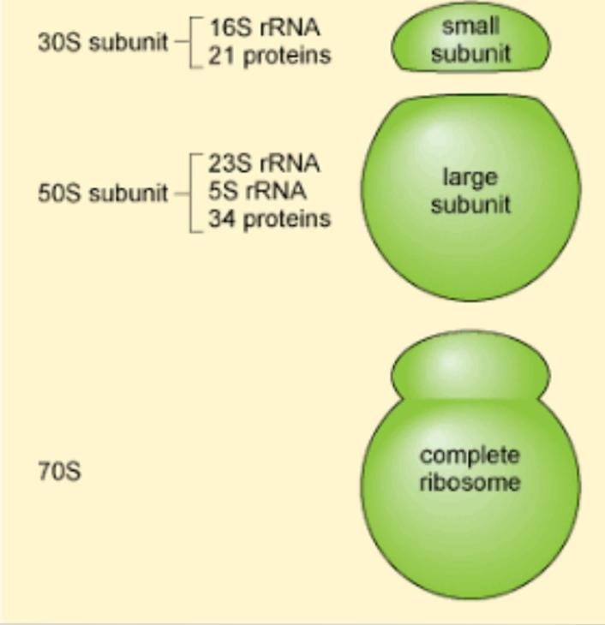
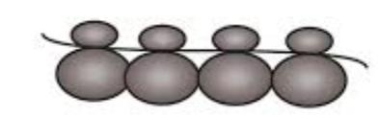
Cytoplasm
Granular and viscous in appearance
Contains ribosomes, polysomes, Mesosomes, Lamellae, Chromatophore, cytoplasmic inclusions, nucleoid, plasmids, etc.
Cell organelles like mitochondria, golgi body, endoplasmic reticulum, chloroplast are absent
Contains reserved food material in the form of complex mixture of proteins, carbohydrates, lipids, vitamins & glycogen granules
Ribosome: (Ribo=ribonucleic acid; soma=body)
Cell organelle containing nucleic acid RNA
70S type (30S + 50S)
Nucleoprotein in nature
Act as site for protein synthesis
Polysome/ Polyribosome:
A cluster of ribosomes held together by a strand of messenger RNA
Fig: Ribosome
Fig: Polysome

Slide 7
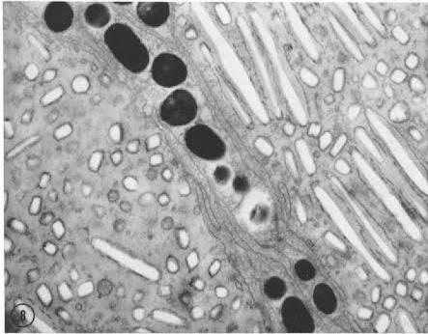
Lamellae & Chromatophore:
Present in photosynthetic bacteria and cyanobacteria instead of chloroplast
Lamellae consist of two parallel unit membranes which may be small or long, extending throughout the cytoplasm
Chromatophore are hollow, spherical structure (300A° diameter)
Bacterial photosynthetic apparatus contain pigments with enzymes
Mesosomes:
Extensions Of plasma membrane
Diverse function vary from cell to cell & from one growth phase to another
Initiate DNA replication and septum formation during cell division
Cytoplasmic inclusions:
The cytoplasm shows variety of small bodies collectively called inclusions
Granules: Cytoplasm appears granular due to the reserve materials like organic polymers, inorganic metaphosphate, etc.
Vesicles: Some aquatic bacteria and cyanobacteria have membrane bound gas vesicle or vacuole to provide buoyancy in floating
Fig: Chromatophore and Lamellae

Slide 8
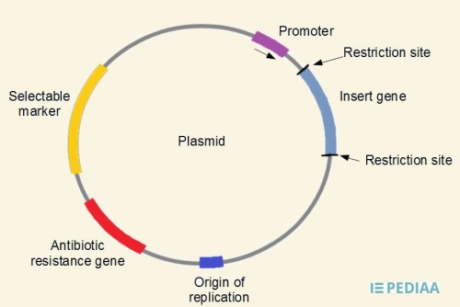
Nucleoid
Nucleus without nuclear membrane
One, double stranded, circular DNA
Similar to eukaryotic nucleus in function i.e. Governs the activities of cell (governer of cell)
Without nucleolus and nuleoplasm
Associated with non-histone protein and RNA
Plasmid:
extra-chromosomal DNA
Circular, double stranded, autonomous
Either free or integrated with chromosome
Flagella:
Organ of locomotion
Cylindrical, hollow strand made of flagellin protein
Pili:
Elongate, rigid, tubular appendages
Serve to connect to cells during conjugation
Fig:Plasmid

Slide 9
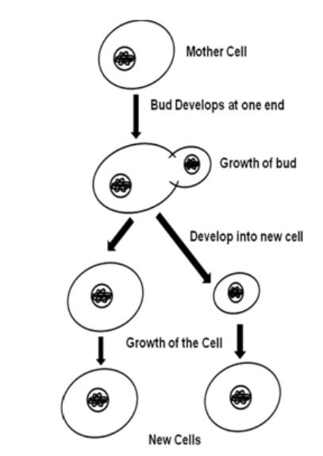
Reproduction in Bacteria
Reproduction: act or process of producing new copies
Vegetative Reproduction:
Budding:
Development of a bud or an outgrowth
Nuclear Division
Separation of Bud
Development of bud
into new cell
Fig: Budding

Slide 10
Asexual Reproduction Binary fission
Most common method of asexual reproduction
Takes place during period of favourable conditions
The process of splitting of Bacterial cell into two new equal daughter cells is called binary fission
DNA Replication:
Chromosome replicates resulting in the production of two circular chromosome
Duplication at replication fork
Semi-conservative replication
Cell division:
Protoplasm divides mitotically resulting into two parts
Plasma membrane at middle of cell forms a construction which grow inwards
Transverse wall thus formed splits the parent bacterial cell into two equal daughter cells.
Fig: Binary fission

Slide 11
Sexual Reproduction Conjugation:
The process in which DNA is passed from one cell to other by physical contact through a conjugation tube is known as conjugation
Discovered by Lederberg and Tatum
E. coli strain shows sexual differences, one acting as donor of genes (male-F⁺) and other as recipient of genes (female-F⁻)
Donor strain produce F pili which act as conjugation tube
Maleness is due to fertility (F) factor & not due to chromosomal gene
In conjugation between F⁺ and F⁻ a copy of F factor passes into female recipient cell converting it into male cell
Fig: Conjugation between F+ male and F- female

Slide 12
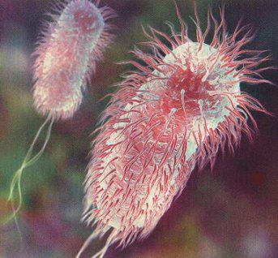
THANK YOU

