Slide 1
Cells and Organs
of the Immune System
David Chaplin, MD, PhD
Dept of Microbiology
BBRB 276, 4-9339
dchaplin@uab.edu
Murray, Rosenthal, & Pfaller, Medical Microbiology, 6th ed.
Chapters 9 & 11
Kindt, Goldsby, & Osborne, Kuby Immunology, 6th ed.
Chapter 2

Slide 2
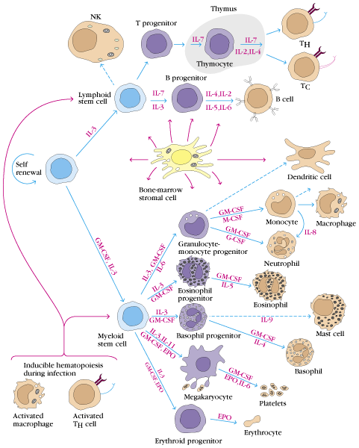
All cells in the immune system are derived from stem cells and either myeloid or lymphoid precursors under the control of cytokines

Slide 3
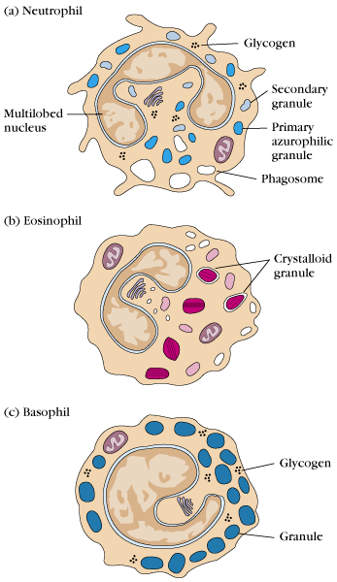
Neutrophils, mast cells basophils and eosinophils are important granulocytic cells involved in phagocytosis or release of innate immune inflammatory mediators

Slide 4
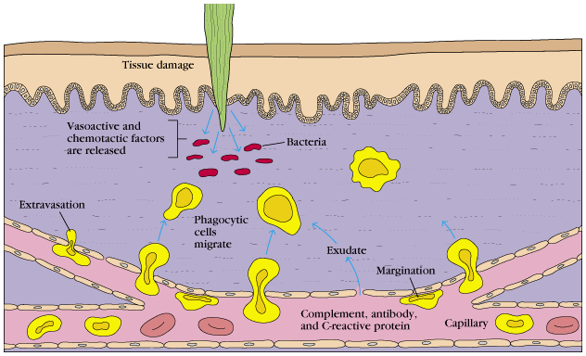
Neutrophils, normally found in circulation, migrate out of blood vessels to sites of infection in effort to phagocytose invading bacteria

Slide 5
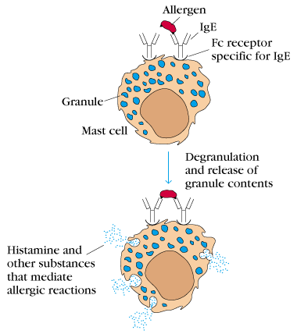
Mast cells release histamine, cytokines and other inflammatory mediators when IgE bound to the surface of the cell is crosslinked by an allergen

Slide 6
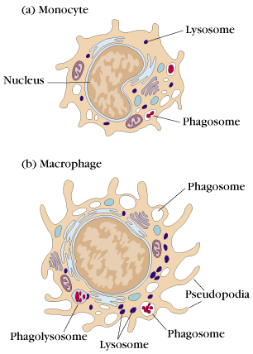
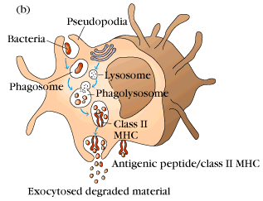
Monocytes are quiescent precursors to macrophages and are found in all tissues in the body. On activation by invading pathogens, cytokines etc., monocytes differentiate into macrophages (an angry monocyte) that can phagocytose pathogens and present antigen to T cells to engage the adaptive immune response

Slide 7
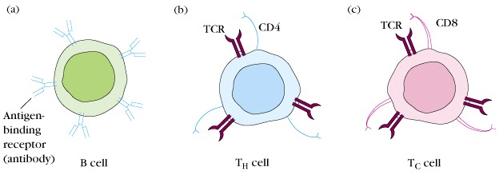
T and B cells are the main cell types of the adaptive immune system. B cells express membrane bound antibody (IgM) on their surface to recognize intact (unprocessed) antigen. T cells express a T cell receptor that recognizes processed antigen bound to the MHC molecules

Slide 8
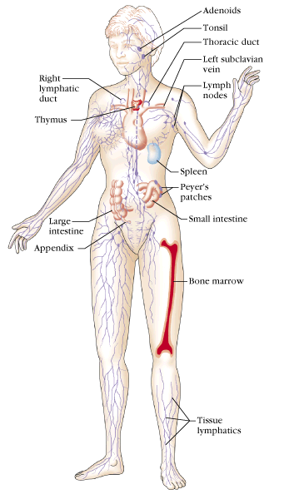
Primary lymphoid organs:
Thymus: encapsulated organ where T cells mature and are selected based in part on their ability to not recognize the host
Bone Marrow: site of remaining hematopoiesis, B cells mature here, mostly in skull, ribs, sternum and pelvis

Slide 9
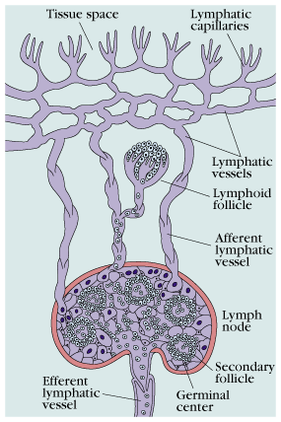
Lymphatic vessels:
Drain the entire body to regional lymph nodes – is a secondary circulatory system moving antigen to lymph nodes where B and T cells can respond

Slide 10
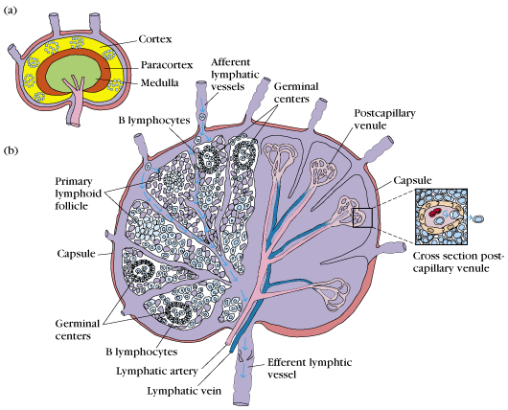
Lymph nodes:
Encapsulated organ found throughout the body. Ag from the periphery is moved here through lymphatics by antigen presenting cells. Lymphoid follicles (collection of T and B cells) in the node on encountering their specific Ag will proliferate generating a germinal center that leads to the formation of fully mature, effector T and B cells

Slide 11
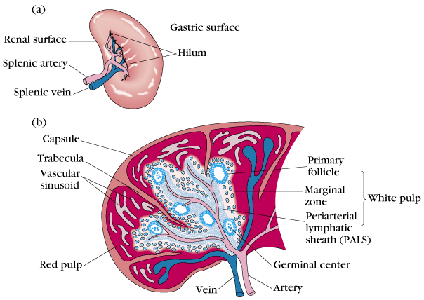
Spleen:
Encapsulated organ found under the liver. Highly vascular organ that filters blood. Is responsible for eliminating blood-borne pathogens. RBCs carrying immune complexes are processed here to remove Ag. Also has follicles that on encountering their specific Ag will proliferate generating a germinal center that leads to the formation of fully mature, effector T and B cells

Slide 12
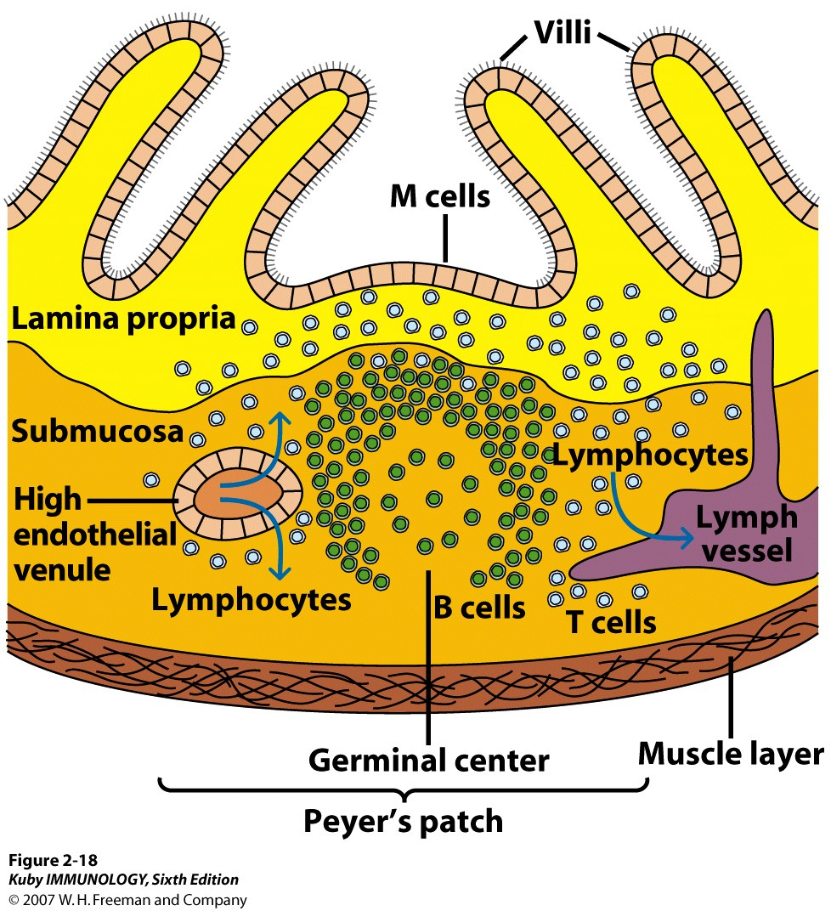
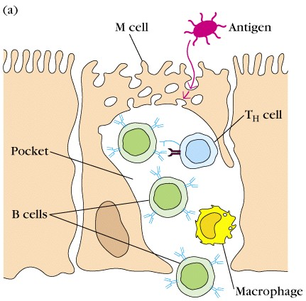
Peyer’s Patches:
Lymphoid tissue in the small intestine composed of T and B cells and Ag-presenting cells – not encapsulated. Part of the Mucosal Associated Lymphoid Tissue: MALT Pathogens move through M cells where they encounter collections of lymphocytes that can generate a germinal center on encountering their specific Ag. Responses here usually generate IgA producing B cells.

