Slide 1
Light Microscope
1. The light microscope operates on the principle that light energy will pass through and around a thin object, such as a microorganism and, with the aid of lenses, form a magnified impression on the visual sensory layer of the eye.

Slide 2
2. The light microscope uses two sets of lenses ( ocular and objective) and is therefore referred to as a compound microscope.

Slide 3
3. The microscope shown is binocular because it has paired ocular lenses. The two sets of lenses and their housing are supported by a base and an arm.

Slide 4
4. The stage is the platform on which the specimen or a slide supporting the specimen is placed. Clips hold the slide in place. The slide may be moved by fingers or by a
mechanical apparatus
associated with the stage.

Slide 5
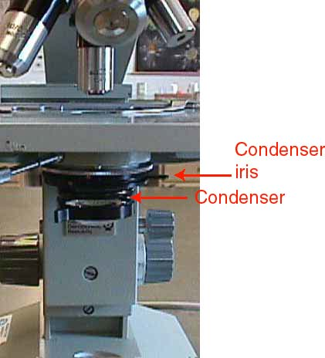
5. A light microscope is usually equipped with a built in light source controlled by an on/off switch on the base. The light is projected upward through a condensor which houses a series of lenses under the stage.

Slide 6
These lenses concentrate the passing light into a strong beam which is projected onto the specimen above. The condenser lenses are controlled by a controlling knob.

Slide 8
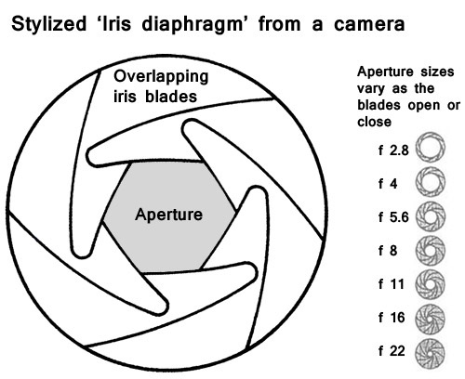
6. Mounted on the condenser is the iris diaphragm, a series of thin brass sheets adjusting the size of the aperture through which the light passes .
Aperture – hole or opening through which light travels

Slide 9
The diaphragm is operated by a lever which spreads the sheets apart or overlaps them.

Slide 10
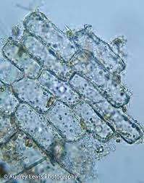
This action controls the angular width of the light beam, increasing the contrast between the light and dark portions of the specimen.

Slide 11
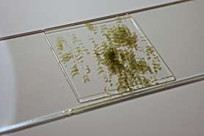
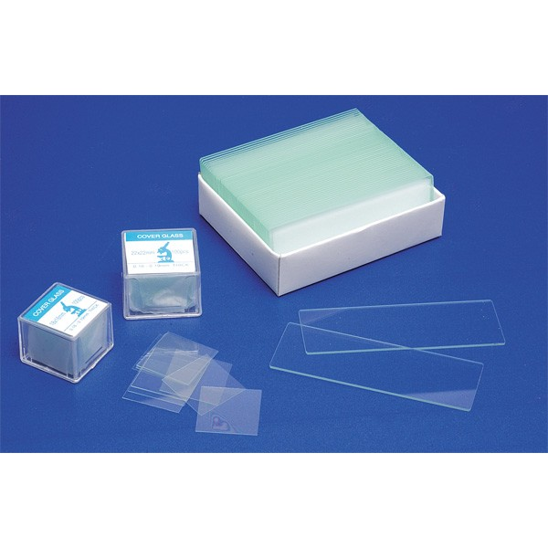
7. The concentrated beam of light passes through and around the thin or thinly cut specimen placed on a glass slide and usually covered with a glass or plastic coverslip.

Slide 12
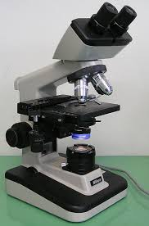
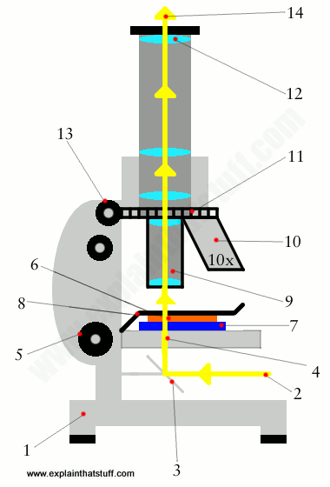
8. Light passing up through and around the specimen enters the objective placed in the light path. Four objectives, housed on a movable turret, are shown.

Slide 13
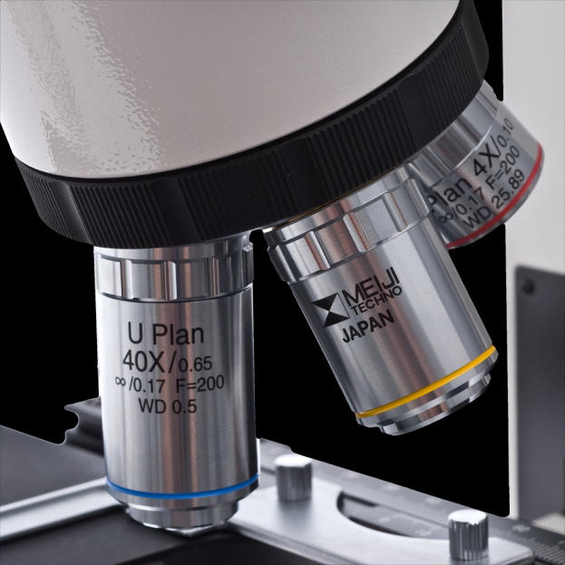
Each objective has a certain magnifying power; for example a scanning objective magnifies 4 times, a low power objective magnifies ten times, a high power objective magnifies 40 times, and an oil immersion objective magnifies 100 times.

Slide 14
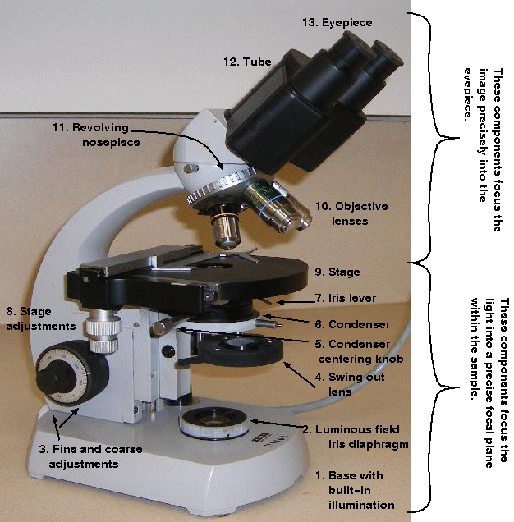
It is wise to start out with the scanning objective for orientation, then switch to progressively higher powers. Upon passing through the objective, the light then enters the tube of the microscope where an image forms.

Slide 15
An ocular or eyepiece is located at the top of the microscope. The oculars magnify the image projected ten times. Thus, the image visualized by the eye can be magnified, 40, 100, 400, and 1000 times, the product of the magnifying powers of the ocular and the objective in use.

Slide 16
9. Light microscopes have two focusing controls. The coarse adjustment control is generally the larger of two grooved knobs at the lower side of the microscope’s arm. It is used to bring the specimen roughly in focus

Slide 17
A more refined, precise focus can be achieved by rotation of the smaller fine adjustment knob.

