Slide 1
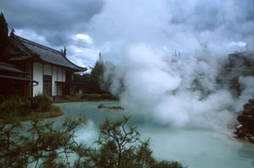
Sulfolobus Tokodaii
A genome from Japan
By Patricia Ueng

Slide 2
Sulfolobus Tokodaii
A member of the archaea (third branch of life next to eukaryotes and bacteria.
It was isolated from Beppu hot springs in Kyusyu, Japan
It lives in 80 C and pH 2 and 3, an acidic and sulfur-rich environment.
Sequenced in 1983
By the Biotechnology center at the National Institute of Technology and Evaluation in Tokyo, Japan
It converts hydrogen sulfide to sulfate.

Slide 3
Why Sequence THIS archaea?
Sequence comparison identified remnants of plasmid pNOB8 (essential for sulfolobus survival) from an ancestral species, which is integrated in the sulfolobus tokodaii genome.
The researchers detected 14 genes that resemble those in eukaryotes that have not been found before in other archaea. This leads the researchers to conclude Sulfolobus tokodaii is one of the most closest related to eukaryotes.
It was sequenced due to the confirmation of the activities would provide valuable information for sulfide metabolism in this microorganism and facilitate the improvement of this system for industrial applications (e.g. wastewater treatment, pollution treatment!!!)

Slide 4
Facts of the Sulfolobus Tokodaii
Genome length: 2.69 Mbp
G+C% content: 32.8%
1 chromosome (it is special because it does not have extra-chromosomal genetic unit)
2,826 genes with about 2.69 millions base pairs long (1 million larger than the other two closely related species)
It is closely related to Aeropyrum pernix and Pyrococcus Horikoshii.

Slide 5
Sites
On NCBI, there were 5875 articles available for Sulfolobus Tokodaii
Complete genome for Sulfolobus Tokodaii
Protein: Sulfolobus Sulfataricus
45 protein coding genes
Sulfolobus Tokodaii - Database of Genomes Analyzed in NITE
Sulfolobus Tokodaii general info - The Institute for Genome Research

