Slide 1
M.Sc. II (Sem-IV)
Lecture- 03
Modes of Propagation
&
Meridional and Skew ray
Presented By
Mr. L. H. Kathwate
(M.Sc. B. Ed. NET, SET, GATE)

Slide 2
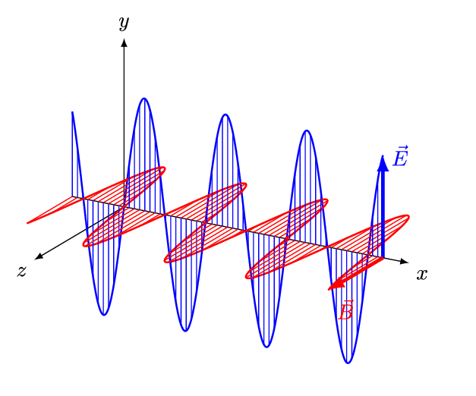
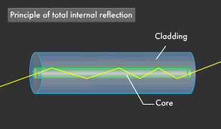
MODES OF PROPAGATION
In optical fibres the light propagates in the same way as electromagnetic wave propagates.

Slide 3
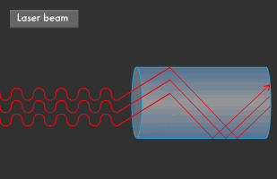
Figure: Light propagates in optical fibre

Slide 4
MODES OF PROPAGATION
The light ray path along which the waves are in phase inside the fibre are known as modes.
In optical fibre communication two bands are presently extensively used.
800 nm to 900 nm
1200 nm to 1400 nm
where the fibres have low losses.

Slide 5
MODES OF PROPAGATION
There are several types of modes of propagation that an electromagnetic wave guided in a guide can follow.
There are TE, TM mode, hybrid EH or hybrid HE modes.
In free space, electromagnetic wave travels as a TEM wave.
Both the E and H fields have Components in the Z-direction in hybrid (EH or HE) modes.

Slide 6
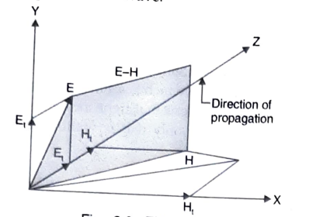
MODES OF PROPAGATION
Case-I: If E_{t} > H_{t} (i. e. transverse component (E_{t}) of the electric field is greater than the transverse component of the magnetic field) the mode is called EH mode. This simply indicates that the electric field has a greater contribution to the transverse field.

Slide 7
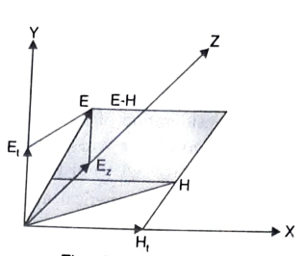
MODES OF PROPAGATION
Case-II: If H_{t} > E_{t} (i. e. transverse component (E_{t}) of electric field is lower than transverse component of magnetic field) the mode is called HE mode. This simply indicates that the magnetic field has greater contribution to the transverse field.

Slide 8
MERIDIONAL AND SKEW RAYS
A light ray is the path which is followed by a fixed point in the E-H plane, plane moves with the as the speed of light ‘c’ in a direction normal to itself.
The light ray that propagate through the fibre may be meridional rays or skew rays.

Slide 9
MERIDIONAL RAYS
Meridional rays are rays that pass through the axis of the optical fiber.
The rays are said to be meridional, if all of them comprising a mode, pass through the longitudinal or Z-axis of the fibre core.
The meridional rays are completely guided.
The propagation of meridional rays is possible only in the TM or TE modes.

Slide 10
SKEW RAYS
Skew rays are rays that travel through an optical fiber without passing through its axis.
The rays which follow a spiral path of reflecting segments down the fibre core are referred to as skew propagation rays.
Skew rays are rays that travel through an optical fiber without passing through its axis.
The skew rays take place entirely in the hybrid HE or EH modes.
But some of these modes produce losses due to leakage and radiation

Slide 11
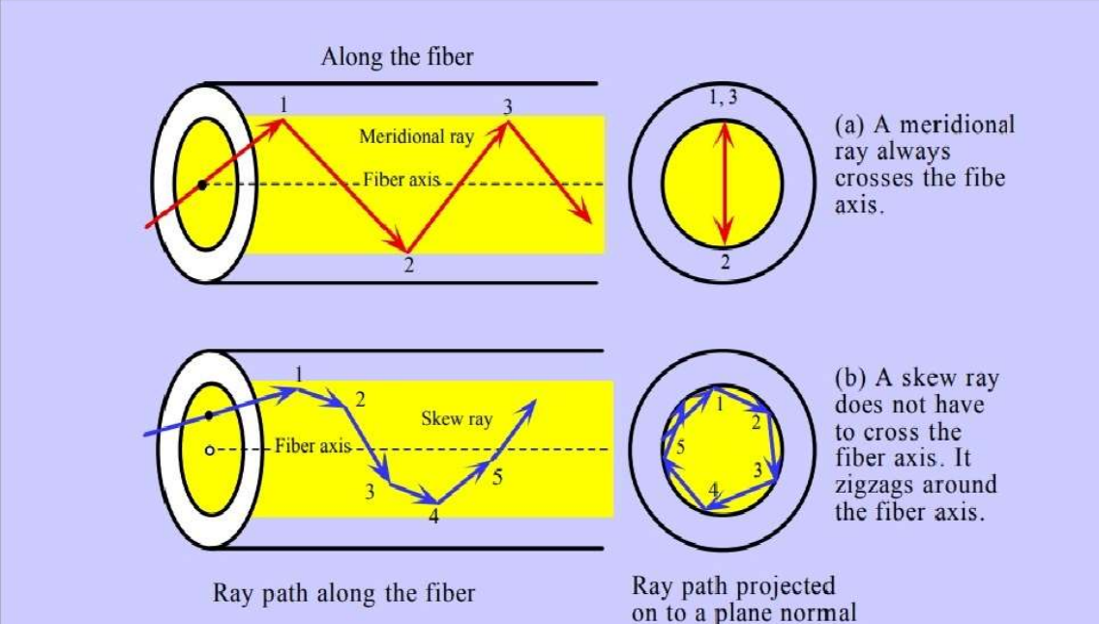
MERIDIONAL AND SKEW RAYS

Slide 12
Number of modes & cutoff parameters
We know that a number of modes like TE, TM, hybrid HE and hybrid EH are possible in fibres. (But not all within a single fibre).
Out of all these modes, only certain modes will have a particular internal reflection angle φ and external incidence angle θ₀, associated with it.
Now consider the propagation of light rays of monochromatic light of wavelength λ₀ between the parallel walls of a glass fibre of core diameter (d), as shown in Figure.

Slide 13
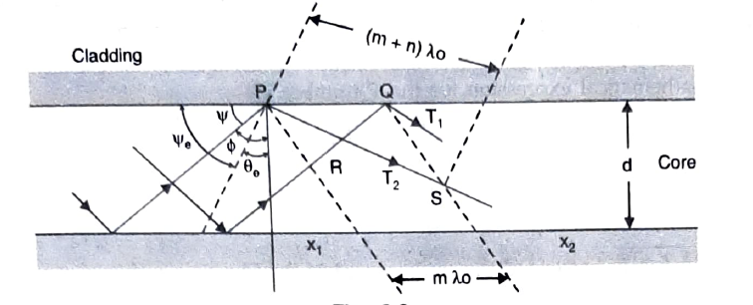
Let us assume that the fibre has an internal cut-off angle θ_{c}. If the incident angle of any ray is less than θ_{c}, the ray will be refracted out through the core.
In the figure, there are two rays T₁ and T₂, which contribute to an equiphase wavefront at right angles to the ray’s propagation path.

Slide 14
This simply indicates that the ray T₁ at R and the ray T₂ at P have the same phase.
Similarly, X₂ is another plane parallel to X₁ and has two points Q and S.
Now if the fibre supports the propagation of wavefront X₁, in a mode, then the rays that will arrive at X₂ plane by either a reflected path (T₁) or by direct path, should have exactly the same phase.
The distance traversed by a reflected ray is larger than that of a direct ray.
Now to provide the proper phase relationship, the difference between the direct and reflected path lengths should be an integral number of wavelength.

Slide 15
$QR=mλ_{o}$ where m is not necessarily an integer (may be non-integer).
The reflected path $PS\left(m+n\right)λ_{o}$is not necessarily an integer.
The angle that a mode ray makes with the wall of the fibre is given by:
$$sinψ=\left(\frac{N}{2}\frac{λ_{o}}{d}\right)<1$$
Where $ψ+φ={90}^{o}$
Parallel wavefronts will be formed only for integral values of n and accordingly, ψ can assume its value.

Slide 16
A distinct mode is available with each integer value of n.
But there cannot exist an infinite number of modes in a fibre.
The number of modes is limited as sin ψ cannot exceed unity (that corresponds to that the wavefront bounces back and forth between the walls, and does not move along the fibre axis).

Slide 17
So we can conclude that for propagation, the diameter of the fibre core should be greater than the wavelength of the incident light. But this is the theoretical limit. In practice, the cut-off actually occurs before this.
Because we know that:
$$sinθ_{c}=\frac{μ_{2}}{μ_{1}}$$
So, as we increase the values of n, ψ also increases and reaches its critical value.

Slide 18
ψ_{c} = 90- θ_{c} If we go on increasing n, then ψ will exceed ψ_{c}, and thereby propagation will be stopped.
However, the number of modes can be increased by making the large difference between the refractive indices of the core and the cladding material.
Another way of increasing the number of modes (that can propagate in the fibre) is to increase the ratio d/λ_{o} large provided the condition is satisfied.
$$\frac{λ_{o}}{d}<\frac{2}{n}$$

Slide 19
But the change in λ_{o} to make $\frac{λ_{o}}{d}$ large is not practical due to the limited availability of the wavelengths of light.
However, the same benefit can be obtained by fabricating fibre with a larger core diameter.
The number of modes supported by a fibre is determined by an important parameter called cut-off parameter.
It is also called as normalized frequency of cut-off or V number.
The mathematical expression for the V-number is:
$$V=π\frac{d}{λ_{o}}\sqrt{μ_{1}^{2}−μ_{2}^{2}}$$

Slide 20
or
$$V=π\frac{d}{λ_{o}}NA$$
Each of these modes has a particular value of V parameter; below that value the mode will cut off.
A large number of modes are possible, but only those modes which have cut off frequencies that are less than the V-number for the fibre, will propagate.

