Slide 1
DSC Latur Department of Physics
M.Sc. F. Y (Sem-I).
Lecture- 04
Inertial Frame of Reference
&
Motion of particle in resistive medium Presented By
Mr. L. H. Kathwate
M.Sc. B.Ed., NET, SEt, GATE

Slide 2
Inertial Frame of Reference
An inertial frame of reference is a frame where Newton’s law holds true. That means if no external force is acting on a body it will stay at rest or remain in uniform motion.
For Inertial Frame of reference;
$$F=0;a=0$$
On the other hand for non-inertial Frame of reference;
$$F=0;a≠0$$

Slide 3
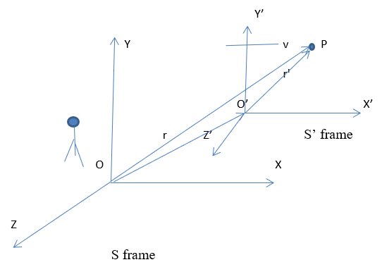
Note: Those entire frame, which are moving with constant velocity relative to an inertial frame are also inertial.
Proof:

Slide 4
$$OP=oo^{′}+o′P$$
$$r=vt+r′$$
$$r^{′}=r−vt$$
$$\frac{dr′}{dt}=\frac{dr}{dt}−\frac{d(vt)}{dt}$$
$$\dot{r′}=\dot{r}−v\frac{dt}{dt}−t\frac{dv}{dt}$$
$$\dot{r′}=\dot{r}−v$$

Slide 5
Differentiated above equation w.r.t time we get;
$\frac{d\dot{r′}}{dt}=\frac{d\dot{r}}{dt}$ - $\frac{dv}{dt}$
$$\ddot{r^{′}}=\ddot{r}$$
Hence, Those entire frame, which are moving with constant velocity relative to an inertial frame are also inertial.

Slide 6
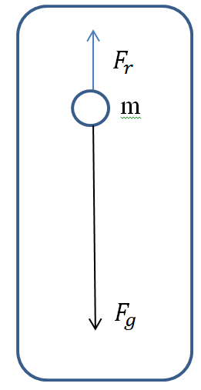
Motion of particle in resistive medium:

Slide 7
Let net force acting on the particle is;
$F_{net}=F_{g}+F_{r}$ (1)
Where; $F_{g}= mg$ Gravitational force and
$F_{r}=−kv$ Resistive medium force.
Using these equations (1) becomes;
$F_{net}=mg−kv$ (2)
According to Newton’s II law of motion force can be defined as;
$F=ma=m\frac{dv}{dt}$ (3)

Slide 8
Therefore equation (2) becomes;
$m\frac{dv}{dt}=mg−kv$ (4)
On simplifying equation (4) we get;
$\frac{dv}{dt}=g−\frac{k}{m}v$
$\frac{dv}{dt}+\frac{k}{m}v=g$ (5)
This equation looks like a first order differential equation;
$\frac{dy}{dx}+p\left(x\right)y=q$ (6)

Slide 9
Whose solution is; y $\left(IF\right)= \int{\left(IF\right).qdx+c}$Where; $integrating factor ;IF=e^{\int{p(x)dx}}$
On comparing equation (5) and (6) we have
$p\left(x\right)=\frac{k}{m} ; q=g ;y=v$
$$∴IF=e^{\int{p(x)dx}}=e^{\int{\frac{k}{m}dt}}=e^{\frac{k}{m}\int{dt}}=e^{\frac{k}{m}t}$$
Equation (7) becomes;
$v. e^{\frac{k}{m}t}= \int{e^{\frac{k}{m}t} g dt+c}$

Slide 10
$v. e^{\frac{k}{m}t}= g\frac{e^{\frac{k}{m}t}}{\frac{k}{m}}+c=\frac{mg}{k}e^{\frac{k}{m}t}+c$
$$v. e^{\frac{k}{m}t}=\frac{mg}{k}e^{\frac{k}{m}t}+c$$
Or
$v. =\frac{mg}{k}+ce^{−\frac{k}{m}t}$ (8)
To find the value of ‘c’ $At;t=0 ;v=0$ equation (8) becomes;
$$0=\frac{mg}{k}+c$$
$$c= − \frac{mg}{k}$$

Slide 11
Using value of c in equation (8) we get;
$$v=\frac{mg}{k}− \frac{mg}{k}e^{−\frac{k}{m}t}$$
or
$v=\frac{mg}{k}(1− e^{−\frac{k}{m}t})$ (9)
The equation (9) represents velocity of particle when
it moves in resistive medium.

Slide 12
If $t→∞$ equation (9) becomes;
$v=\frac{mg}{k}(1− e^{−\frac{k}{m} (∞)})$
$Since { e}^{−(∞)}=0$ then above equation becomes;
$v=\frac{mg}{k}$ (10)
The equation (9) represents terminal velocity of particle when it moves in resistive medium.

Slide 13
Terminal velocity: “If a particle is falling under gravity in a resisting medium then the velocity when the downward acceleration is zero called terminal velocity”.

