Slide 1
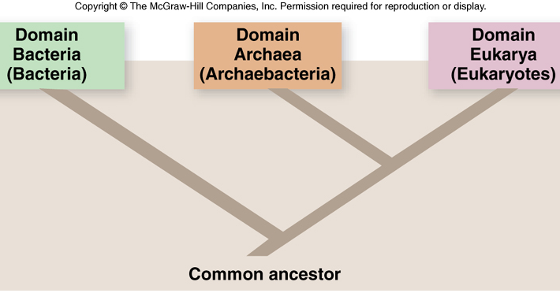
Three Domains of Life

Slide 2
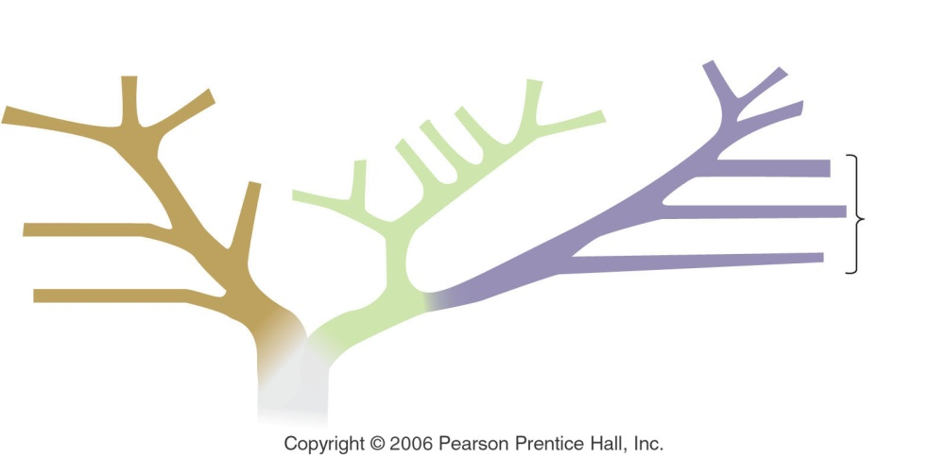
The Microbial World
All three biological domains include microbial organisms (or “microorganisms”)
Although microorganisms include some of the smallest organisms, they play critical roles in the evolution of life on our planet and in the ecology of both terrestrial and marine environments
Bacteria
Archaea
Animals
Fungi
Plants
Protists
Eukarya

Slide 3
The Microbial World
Microorganisms are the most important primary producers in many marine environments
Via photosynthesis and chemosynthesis, they manufacture organic matter from CO₂
As a result, they directly or indirectly feed most marine organisms
Microorganisms make essential nutrients available to other primary producers

Slide 4
Viruses
Although they may not technically constitute a living organism (???), viruses are a critical component of the marine food web
Viruses are particles made up of nucleic acid (RNA or DNA) protected by a protein coat
They are parasites that reproduce and develop only with the aid of a living cell
Viruses are minute, measuring 20-200 nanometers (a nanometer is one-billionth of a meter)!
Notes:
Protein coat is specific to host cell that the virus invades

Slide 5
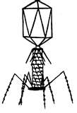
You can swim, but you can’t hide
Viruses are everywhere in the marine environment
They parasitize bacteria and plankton (and everyone else) releasing organic matter into the ocean
Provides organic compounds to be grazed upon by other members of the microbial community
Releases nutrients which may be used by photosynthetic organisms
May be responsible for half of the bacterial mortality in aquatic ecosystems and substantial amounts in phytoplankton

Slide 6
Viruses
The amount of viruses in a given environment is directly related to the abundance of the microbial life, which they invade
Viruses are now recognized as the most abundant ‘biological’ organisms in the ocean
For every liter of Long Island Sound water, there are 100,000,000,000 viruses!
Notes:
100,000,000 per mL

Slide 7
Prokaryotes
Prokaryotes are the smallest and structurally simplest true-living organisms, and the oldest life forms on Earth
Prokaryotes are unicellular organisms which lack a nucleus and other membrane-bound organelles
Prokaryotes include all members of Domains Archaea and Bacteria

Slide 8
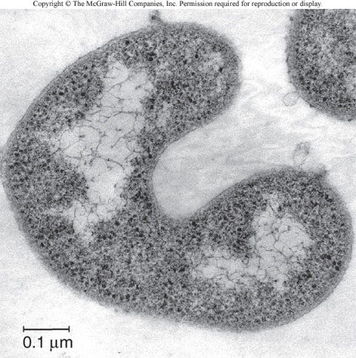
Prokaryotes: Domain Bacteria
Bacteria (Domain Bacteria) appear to have branched out very early on the tree of life and are genetically distinct from Archaea and eukaryotes (Domain Eukarya)
They are abundant in all parts of the ocean
Bacteria are vital to life on Earth because they ensure the recycling of essential nutrients in oceanic food webs

Slide 9
Bacteria
Most organic matter is decomposed by bacteria
Bacteria constitute a major part of the organic matter that feeds countless bottom-dwelling animals
Organic particles sinking in the water column are composed mostly of bacteria!
Very important food source!

Slide 10
Marine Snow
Marine snow is a continuous shower of mostly organic detritus falling from the upper layers of the water column
Detritus is non-living particulate organic material, and is typically colonized by communities of microorganisms
Includes dead or dying animals and plants, phytoplankton, fecal matter, sand, soot and dust
http://www.noc.soton.ac.uk/obe/personal/rsl/Rsl_web.htm

Slide 11
Marine Snow
A single cell sinks at a rate of ~1-2 meters day⁻¹
Aggregates sink ~150-200 meters day⁻¹
Sinking cleanses pollutants from surface waters and brings much-needed nourishment to deep sea organisms
Sediment traps capture sinking debris
Flux of particulate matter mirrors productivity at the surface; peak separated by 2 weeks

Slide 12
Feeling small?
Particulate matter is defined as anything larger than 0.2µm
Anything smaller is considered to be dissolved
Particulate organic matter is only 10% of the total organic material in the ocean; dissolved organic matter makes up the rest (90%)
Of all the fish, all the whales, all the bacteria, all the organic debris in the oceans, 90% of it is dissolved
Viruses are considered to be dissolved organic material

Slide 13
Bac(k) to Bacteria…
Bacteria feed primarily on dead organic material
Some bacteria, however, are photosynthetic; the cyanobacteria
Cyanobacteria have chlorophyll as well as a bluish pigment called phycocyanin
“blue-green algae”
Among the first photosynthetic organisms
Notes:
Important role in accumulation of o2 on Earth

Slide 14
Bacteria
Cyanobacteria are widely distributed
Because of their size, cyanobacteria are believed to be the most abundant photosynthetic organisms in the ocean
In addition to being free-living, some bacteria have evolved to live in close association with other marine organisms
Symbiotic bacteria

Slide 15
Symbiotic Bacteria
Many of the organelles found in eukaryotic organisms evolved from symbiotic bacteria
Examples of symbiotic bacteria include those involved in the digestion of wood by shipworms, those responsible for bioluminescence and those found in association with mussels, clams and tubeworms that live around hydrothermal vents

Slide 16
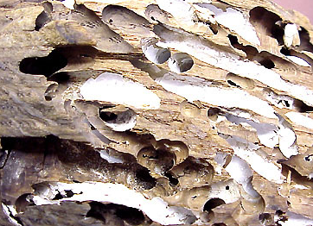
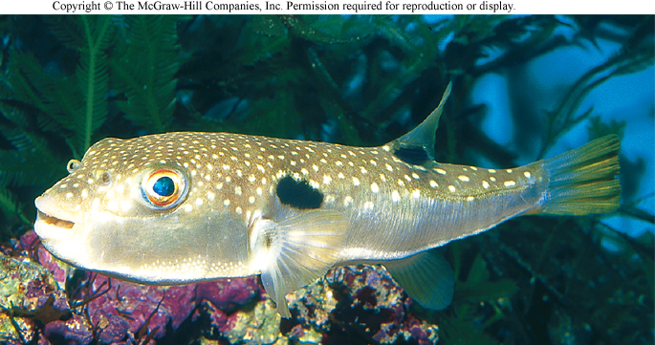
Symbiotic Bacteria
Shipworms (Teredo) are actually wood-eating bivalve molluscs!
http://www.divernetxtra.com/biolog/pics/0900flash1.jpg
bioweb.uwlax.edu/zoolab/lab-5a/mollusca-bivalvia-7.htm
Bacteria sheltered in light-emitting photophores of flashlight fish
Tetrodotoxin produced by bacteria in (immune) pufferfish

Slide 17
Prokaryotes: Domain Archaea
Archaea (Domain Archaea) are among the simplest, most primitive forms of life
Oldest fossils ever found (3.8 billion years old) appear similar to Archaea
Archaea are prokaryotes, unicellular organisms that lack a nucleus and other membrane-bound organelles
Thought to have had an important role in the early evolution of life

Slide 18
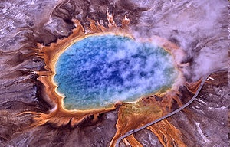
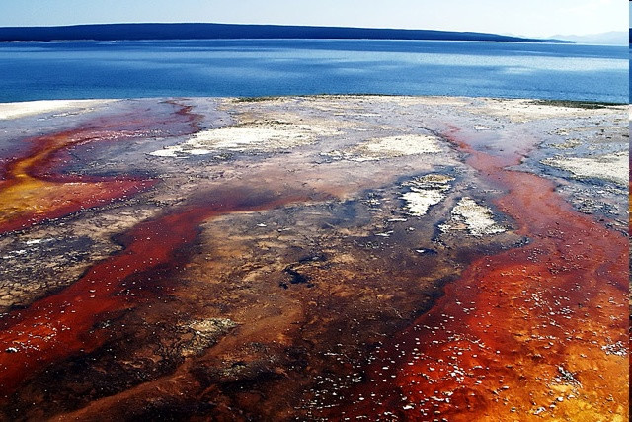
Archea - Extremophiles
Some groups of Archaea were discovered only recently
First in extreme environments on land – hot sulfur springs, saline lakes, and highly acidic or alkaline environments
“Extremophiles”
http://www.dpchallenge.com/image.php?IMAGE_ID=448561
Notes:
“lovers of extremes”; although not all Archaea are extremists! Found commonly in many marine environments

Slide 19
Archaea
Archaea were subsequently found in extreme marine environments, such as in very deep water, where they survive at pressures of 300-800 atmospheres
Some archaea live at the high temperatures of hydrothermal vents, and cannot grow in temperatures under 70-80°C (158-176°F); 1 hydrothermal vent archaeum can live at 121°C (250°F) – the highest of any known organism

Slide 20
Evidence for life on Earth?
Many of the harsh conditions which extremophiles require to survive were characteristic of our early Earth
Likely that Archaea evolved to dwell in such conditions billions of years ago & survive today in similar (specific) environments

Slide 21
Got Chemosynthesis?
Not all prokaryotic autotrophs derive energy from photosynthesis (although most do)
Some bacterial autotrophs – called chemosynthetic – derive energy not from light, but from chemical compounds
Hydrogen sulfide (H₂S) and other sulfur, nitrogen and iron compounds provide energy to convert CO₂ into organic matter
Base of food web at hydrothermal vents

Slide 22
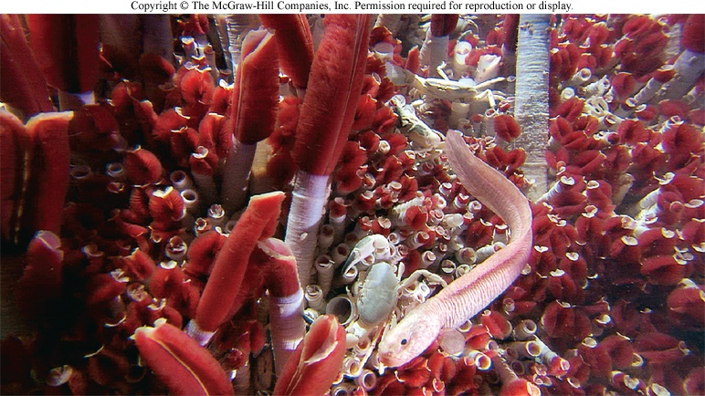
I need to vent about something here
The hot water emerging from hydrothermal vents is rich in hydrogen sulfide (H₂S) which is toxic to most organisms, but an energy-rich molecule
Water near the vents contain so many microbes that they cloud the water!
Symbiotic and non-symbiotic
Notes:
You’re not getting interested in microbes, are you???

Slide 23
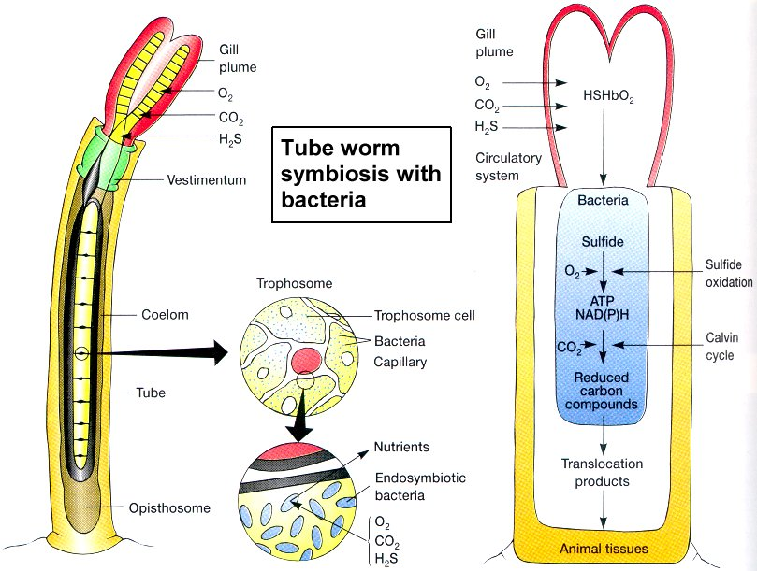
biology.kenyon.edu/sloncbio3/symbiosis.html

Slide 24
Anaerobics class
Of the heterotrophic prokaryotes, not all use oxygen to respire
Anaerobic bacteria and archaea grow where oxygen is not present, such as anoxic sediments, and are actually killed by even small doses of oxygen!
These anaerobes use sulfate, and other reduced molecules instead of oxygen to respire
Responsible for ‘rotten-egg’ smell of some areas

Slide 25
Eukaryotes: Domain Eukarya
Eukaryotes (Domain Eukarya) possess a nucleus, a membrane that encloses the DNA, in each of their cells
While all prokaryotes (domains Archaea and Bacteria) are uni-cellular, eukaryotes include both uni-cellular and multi-cellular organisms
Kingdoms Protista, Fungi, Plantae, and Animalia

Slide 26
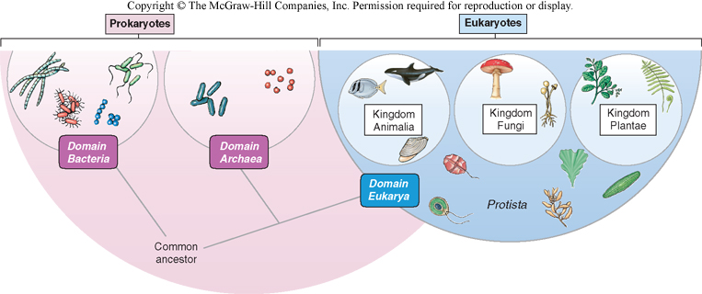
Microbial Eukaryotes
Most microbial marine eukaryotes belong to the Kingdom Protista

Slide 27
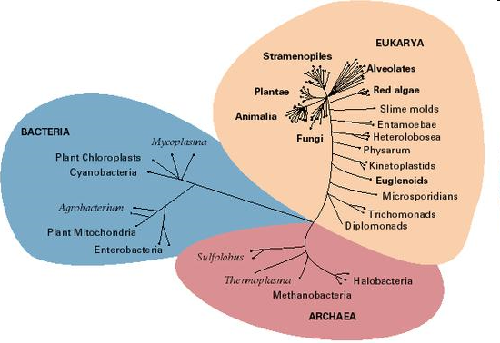
Kingdom Protista (the Protists)
Kingdom Protista is the ‘trouble-maker’ of the classification system
Can be autotrophic or heterotrophic
Can be unicellular or multi- cellular
But all are eukaryotic! (Domain Eukarya)
Protists
Notes:
Archea have classified Kingdoms; Bacteria do not (yet)
On the contrary, Eukaryota is composed of well-defined Kingdoms including Plants, Fungus and Animals; the exception is Protists which we’ll discover are not monophyletic and include groups that are similar in design, but not in evolutionary processes

Slide 28
Protists
Debates over classification persist
Different groups possess different evolutionary histories
Some are more plant-like (e.g., multi-cellular seaweeds)
Some are more animal-like (e.g., heterotrophic and mobile)
Some are photosynthetic and heterotrophic (what we call “mixotrophic”)
Notes:
Animal-like, but unicellular; my evolution professor told me that if I ever want to be frustrated and live an unfulfilled life to be an evolutionist!

Slide 29
Algae
Algae are a diverse group of protists
Nearly all algae perform photosynthesis using photosynthetic pigments
As protists, algae are distinct from plants and lack a cell wall, specialized tissues, and flowers
They also lack true leaves, stems and roots
Unicellular or multi-cellular
Multicellular algae are seaweeds!

Slide 30
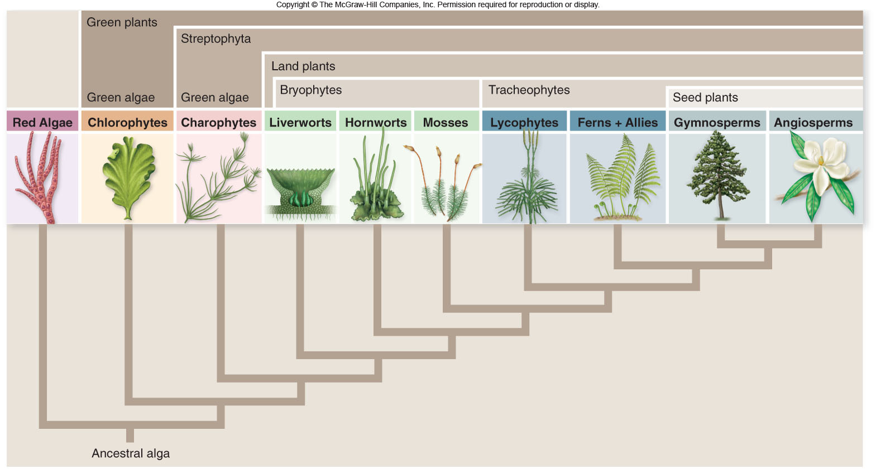
Plants evolved from green algae (which is now considered a plant, not a protist!)
Notes:
Protists are the black sheep of the classification system

Slide 31
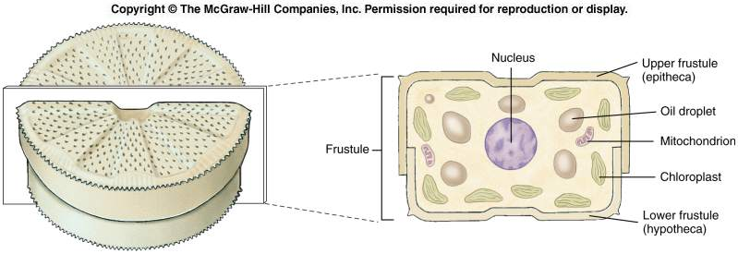
Unicellular Algae: The Diatoms
Diatoms are unicellular, although many species aggregate to form chains
Diatom cells are enclosed by cell walls made of silica; this glassy shell or frustule consists of 2-tightly fitting halves
Notes:
Pill hat design; reproduce by halving the shell, each creates a new smaller shell such that smaller shell is now the larger, continues until reaches critical ‘mass’ (too small)!, must create auxiospores which rise to create a new larger shell!

Slide 32
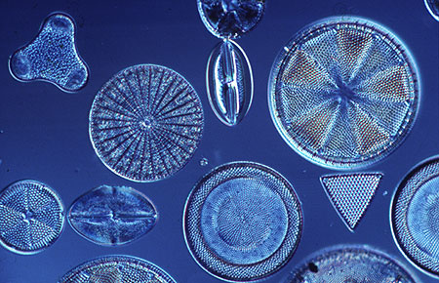
Diatoms
The glass frustule allows light to pass through so that photosynthetic pigments can capture light energy for photosynthesis
UV protection?
Aid in sinking?
Protection from predation?
Notes:
UV protection, sin

Slide 33
Diatoms
Diatoms are very important primary producers in temperate and polar regions
Account for a large share of the organic carbon produced on Earth
Favorable environmental conditions (light and nutrients) promote periods of rapid reproduction known as blooms
The glass frustules of dead diatoms eventually settle to the sea floor; diatomaceous ooze
Notes:
Blooms often consist of smaller and smaller diatoms because of asexual repro and loss of silica from water column; slime in your fish tank is usually millions of cells of algae
Diatomecious ooze mined and used in products for filtering swimming pools, for clarifying beer, temperature and sound insulators, mild abrasives in toothpaste!

Slide 34
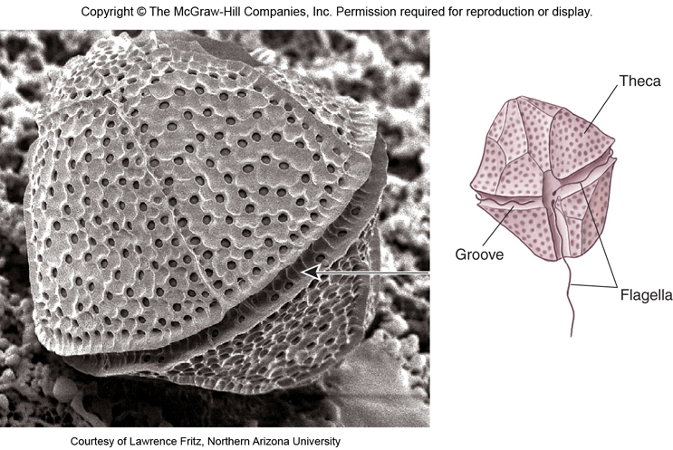
Dinoflagellates
Dinoflagellates are another important group of planktonic, unicellular protists
Two flagella; one wrapped along a groove along the middle of the cell, the other trailing free

Slide 35
Dinoflagellates
Dinoflagellates may be autotrophic, heterotrophic or both (mixotrophic)!
Nearly all dinoflagellates are marine
Important primary producers, especially in tropical regions
Some species release toxic substances and can cause harmful “red tides”
And some are bioluminescent
Notes:
About half of diatoms are marine

Slide 36
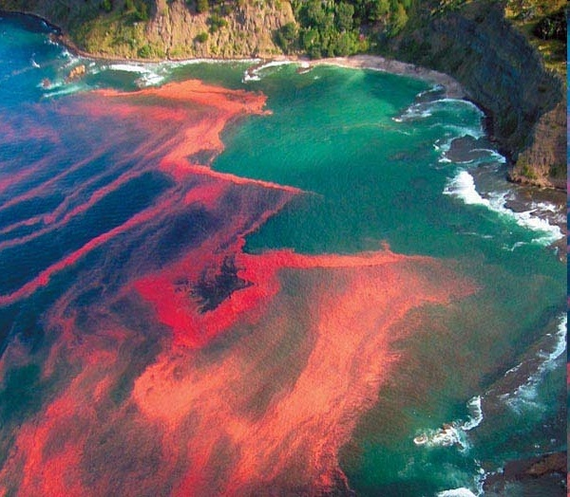
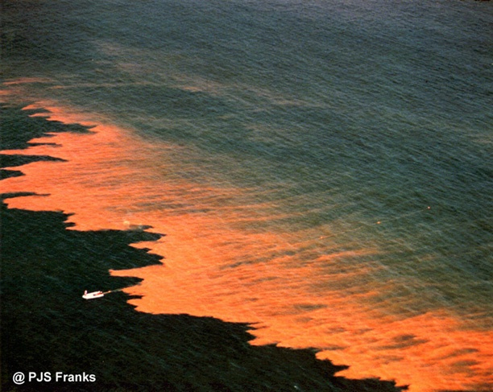
Dinoflagellates
In addition to blooms of “red tide”, some dinoflagellates release toxins responsible for open sores on fish, crustaceans and bivalves

Slide 37
Zooxanthellae
A group of dinoflagellates called zooxanthellae live in close association with animals such as coral, sea anenomes, sponges and giant clams
Symbiotic: zooxanthellae photosynthesize within the body of an animal host, releasing organic matter and receiving nutrients (in the form of waste products) and shelter in return
Loss of the colorful zooxanthallae is behind the phenomenon of coral bleaching

Slide 38
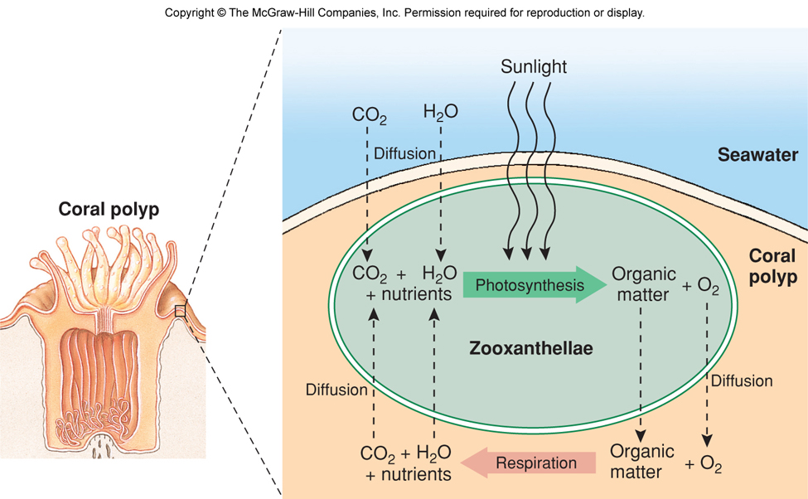
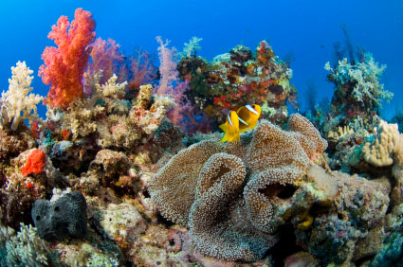
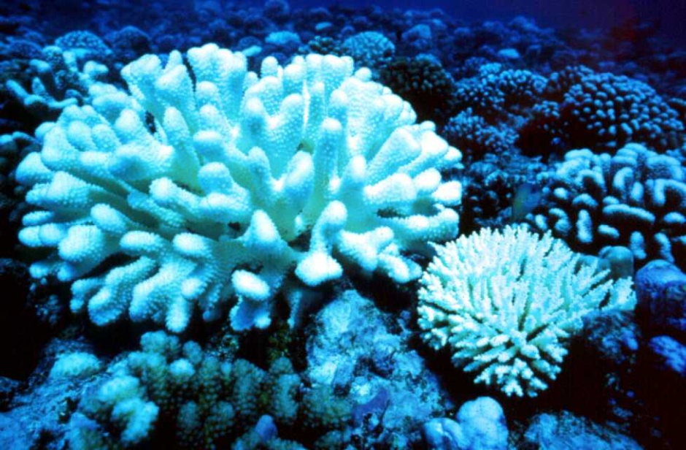
www2.watertown.k12.wi.us/pagesfifth_grade_websites.cfm
www.cgrer.uiowa.edu/peoplecarmichael/atmos_course/ATMOS_PROJ_99/jlmichfin/main.html

Slide 39
Corals (and zooxanthellae) are stressed by environmental change
A water temperature change of only 1°C above the normal summer high temperature for a few weeks leads to coral bleaching
Coral expels zooxanthellae or the zooxanthellae expels itself
El Niño events can drive coral bleaching
May be reversible – corals can re-acquire new zooxanthellae if the stress is not too severe

Slide 40
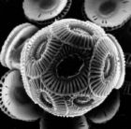
Coccolithophorids
Coccolithophorids are unicellular protists covered with ornamental plates made of calcium carbonate (CaCo₃)
Form seasonal blooms in North Atlantic
Produce dimethyl sulfide, which alters climate patterns!
Long considered to be the “smell of the sea”

Slide 41
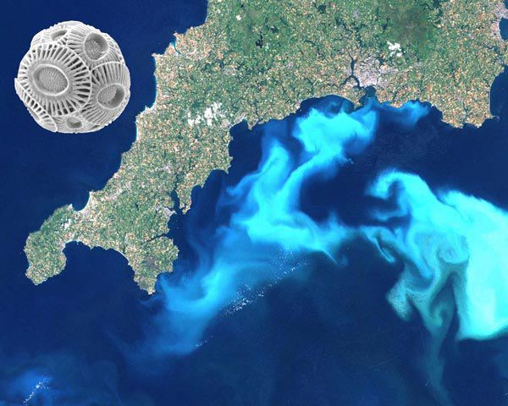
Coccolithophorids from space!

Slide 42
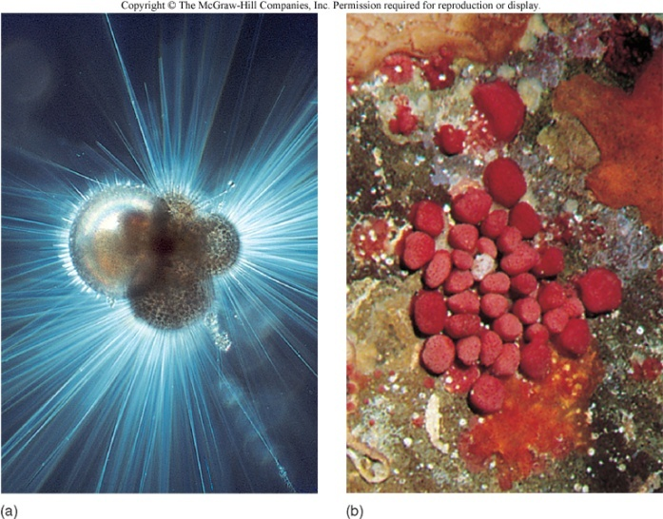
Foraminiferans
Foraminiferans (“forams”) are marine protists that also have a shell made of CaCo₃
Animal-like; possess pseudopodia – extensions of the cytoplasm used for trapping diatoms and other suspended material in the water
Benthic or planktonic
Important indicators of past climate change
Form foraminiferous oozes
Notes:
Which is then moved into the interior of the cell as if on a conveyor belt; white cliffs of Dover

Slide 43
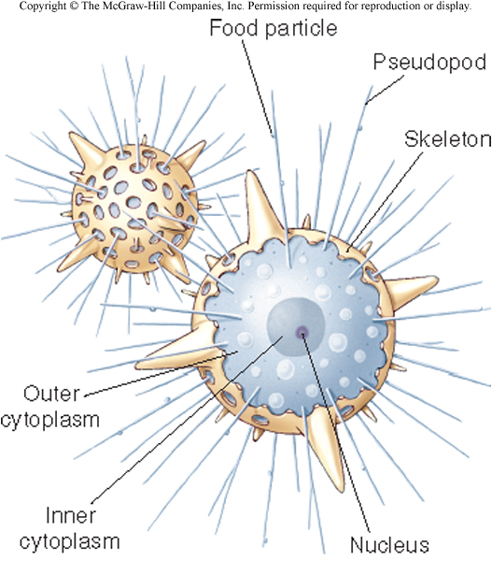
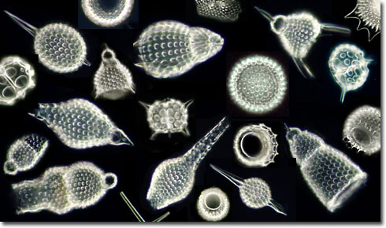
Radiolarians
Radiolarians are planktonic marine protists that secrete elaborate shells made of silica and other materials
Cells are typically spherical with radiating spines
Animal-like with pseudopodia
Radiolarian ooze!
http://micro.magnet.fsu.edu/micro/gallery/radiolarians/radiohead.jpg
Notes:
Radiolarian ooze!

Slide 44
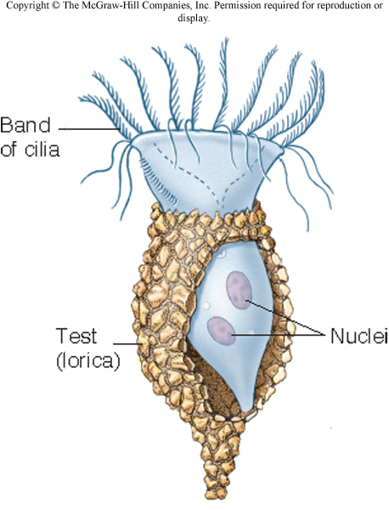
Ciliates
Ciliates are protists with many hair-like cilia used in locomotion and feeding
Planktonic or benthic
Tintinnids are common ciliates that build vase-like cases or loricas made up tiny particles such as sand grains
Important grazers in the microbial loop!

Slide 45
And finally…
Fungi are eukaryotic organisms belonging to the Kingdom Fungi
All are heterotrophic
Can be unicellular or multicellular
1,500 known species of marine fungi
Absorb nutrients from their environment
Important decomposers in the marine environment, but also parasitic (disease-causing)

Slide 46
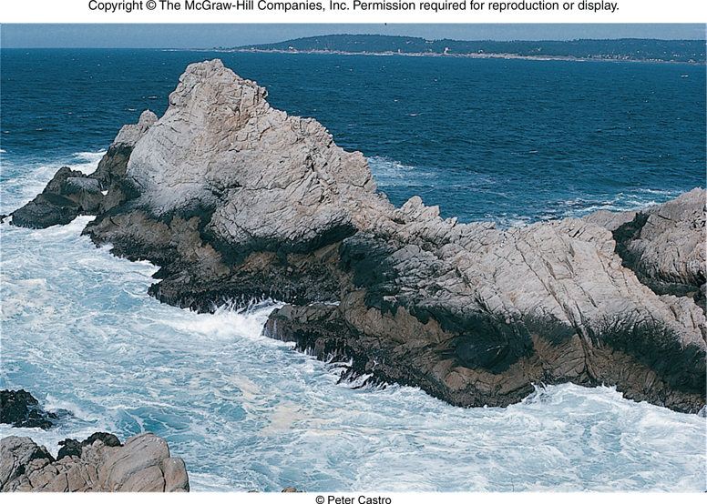
Marine Fungi

