Slide 1
PHY-404:Fibre Optics and Optical Fibre Communication

Slide 2
Propagation of light in medium
Light waves across the electromagnetic spectrum behave in similar ways.
When a light wave encounters an object, they are either transmitted, reflected, absorbed, refracted, polarized, diffracted, or scattered depending on the composition of the object and the wavelength of the light.

Slide 3
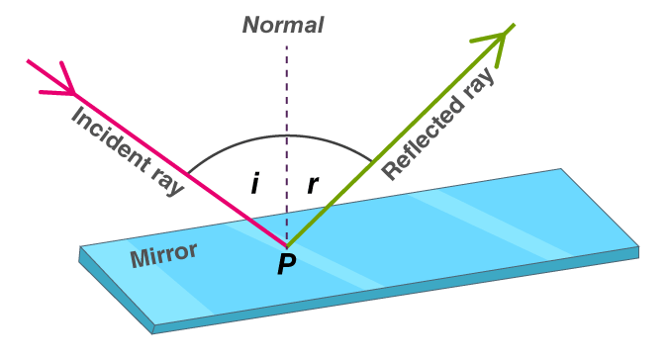
Propagation of light in medium
Reflection
Reflection is when incident light (incoming light) hits an object and bounces off. Very smooth surfaces such as mirrors reflect almost all incident light.
Figure: Reflection of light

Slide 4
Propagation of light in medium
Absorption
A diagram showing arrows for incoming energy hitting a surface and waves beneath the surface to illustrate the energy being absorbed by the surface.
Absorption occurs when photons from incident light hit atoms and molecules and cause them to vibrate. The more an object's molecules move and vibrate, the hotter it becomes. This heat is then emitted from the object as thermal energy.

Slide 5
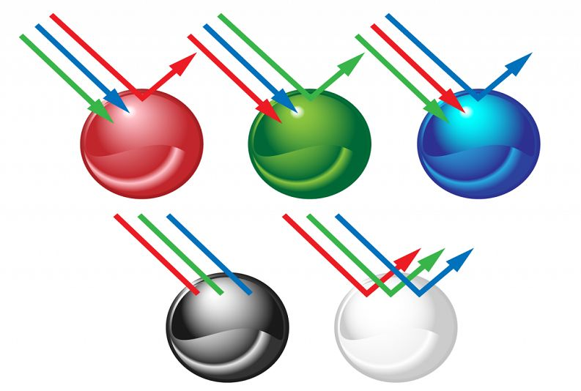
Propagation of light in medium
Figure: Absorption of light

Slide 6
Propagation of light in medium
Diffraction
Diffraction is the bending and spreading of waves around an obstacle. It is most pronounced when a light wave strikes an object with a size comparable to its own wavelength. An instrument called a spectrometer uses diffraction to separate light into a range of wavelengths—a spectrum. In the case of visible light, the separation of wavelengths through diffraction results in a rainbow.

Slide 7
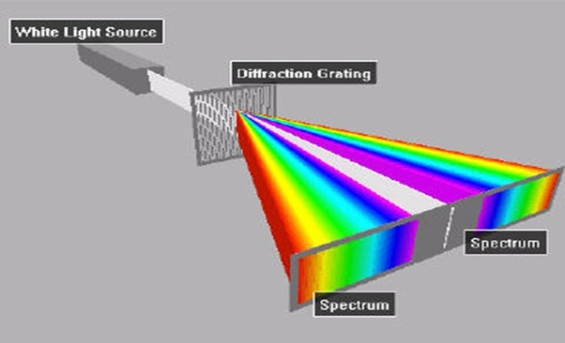
Propagation of light in medium
Figure: Diffraction of light

Slide 8
Propagation of light in medium
Scattering
Scattering occurs when light bounces off an object in a variety of directions. The amount of scattering that takes place depends on the wavelength of the light and the size and structure of the object.

Slide 9
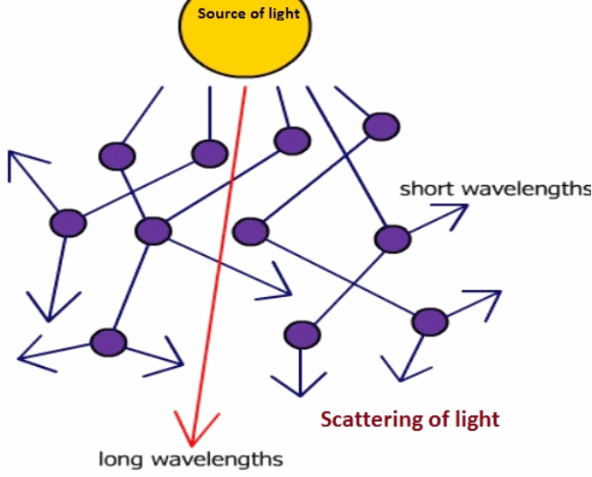
Propagation of light in medium

Slide 10
Propagation of light in medium
The refractive index can be defined as the ratio of the velocity of a light ray in an empty space to the velocity of light in a substance, n = c/v.

Slide 11
Propagation of light

Slide 12
Important terms

Slide 13
Important term

Slide 14
Important terms

Slide 15
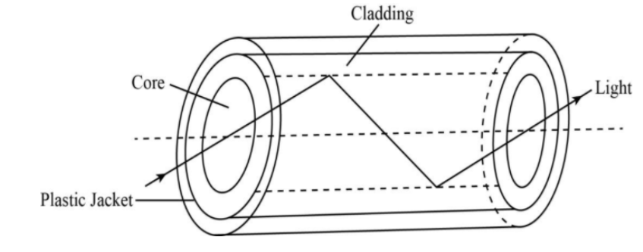
Propagation of light
In optical fibers, propagation of light takes place due to total internal reflection. When light falls one end of the optical fiber; it gets refracted into the fiber. The refracted ray of light falls on the interface separating the fiber and coating an angle which is greater than the critical angle. Thus the TIR can take place. The light travels the entire length of the fiber and arrives at other ends of the fiber without any loss in its intensity even if the fiber is rounded and curved.

Slide 16
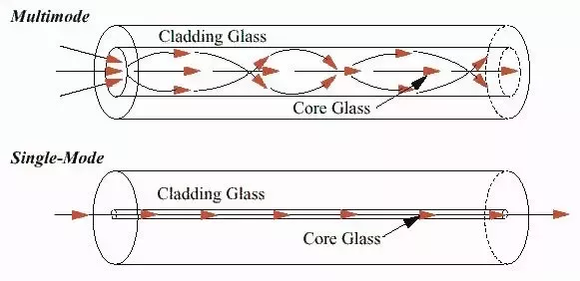
Propagation of light
Propagation of light in optical fiber

Slide 17
Acceptance angle & acceptance Cone
The acceptance angle is the maximum angle of a ray (against the fiber axis) hitting the fiber core which allows the incident light to be guided by the core.

Slide 18
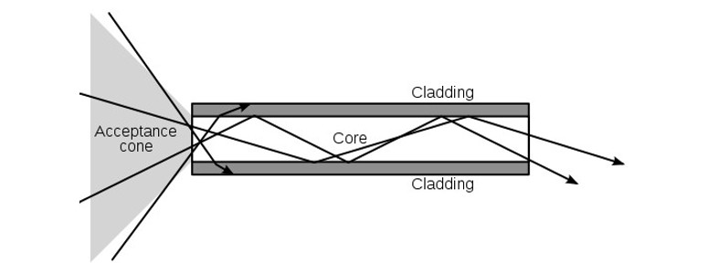
Acceptance angle & acceptance Cone
The cross section of an optical fiber is circular; the light waves accepted by the core are expressed as a cone. The larger the acceptance cone, the larger the numerical aperture(NA); this means that the fiber is able to accept and propagate more light.

Slide 19
Numerical aperture

