Slide 1
Antibodies: Structure And Function

Slide 2
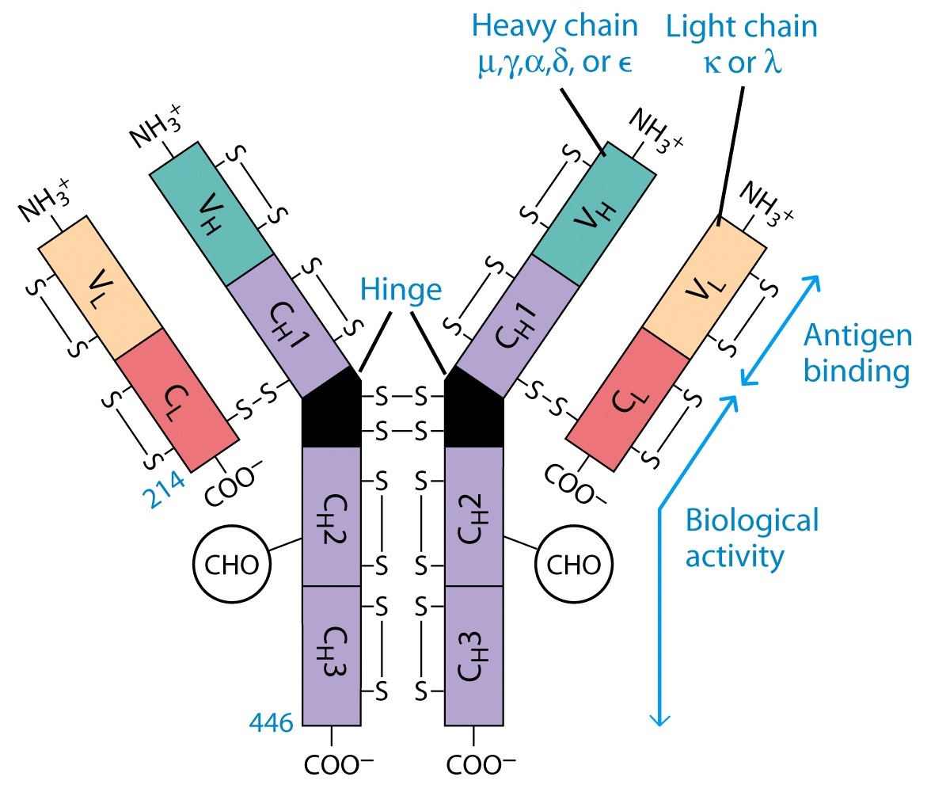

Slide 3
Antibody Structure
Antibodies Are Made Up Of:
2 Light Chains (identical) ~25 KDa
2 Heavy Chains (identical) ~50 KDa
Each Light Chain Bound To Heavy Chain By Disulfide (H-L)
Heavy Chain Bound to Heavy Chain (H-H)
First 100 a/a Of Amino Terminal Vary of Both H and L Chain Are Variable
Referred To As V_{L} , V_{H}, C_{H} And C_{L}
CDR (Complementarity Determining Regions) Are What Bind Ag
Remaining Regions Are Very Similar Within Same Class

Slide 4
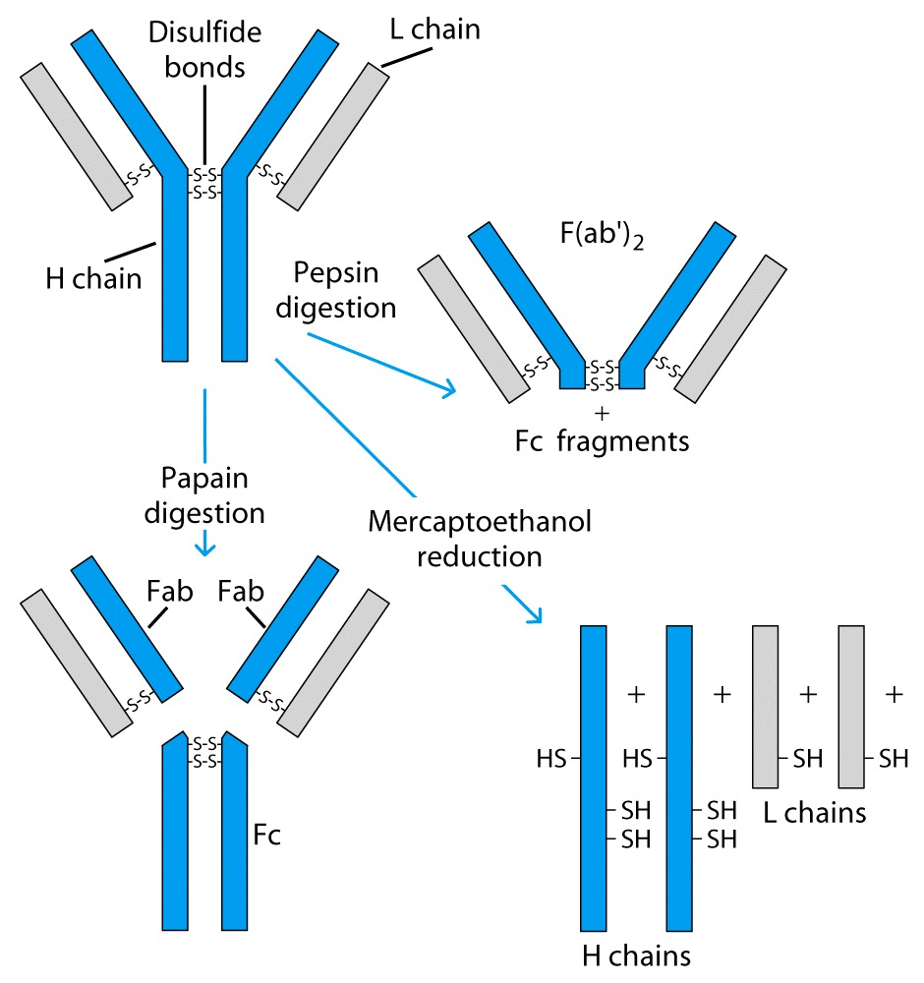

Slide 5
Antibody Structure
Repeating Domains of ~110 a/a
Intrachain disulfide bonds within each domain
Heavy chains
1 V_{H} and either 3 or 4 C_{H} (C_{H}1, C_{H}2, C_{H}3, C_{H}4)
Light chains
1 V_{L} and 1 C_{L}
Hinge Region
Rich in proline residues (flexible)
Hinge found in IgG, IgA and IgD
Proline residues are target for proteolytic digestion (papain and pepsin)
Rich in cysteine residues (disulfide bonds)
IgM and IgE lack hinge region
They instead have extra C_{H}4 Domain

Slide 6
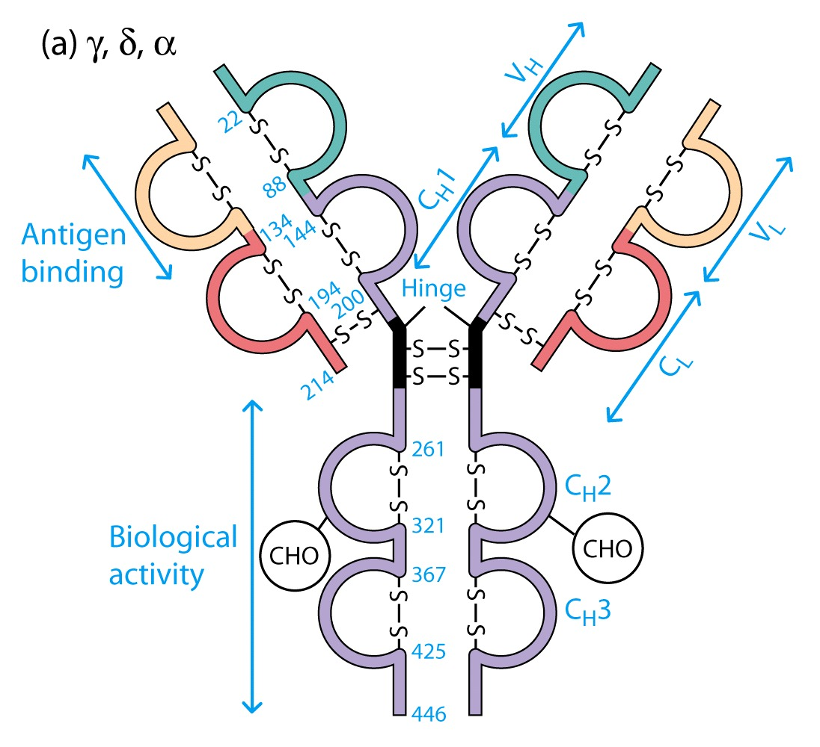

Slide 7
Enzymatic Digestion Of Antibodies
Digestion With Papain Yields
3 Fragments
2 identical Fab and 1 Fc
Fab Because Fragment That is Antigen Binding
Fc Because Found To Crystallize In Cold Storage
Pepsin Digestion
F(ab`)2
No Fc Recovery, Digested Entirely
Mercaptoethanol Reduction (Eliminates Disulfide Bonds) And Alkylation Showed

Slide 8
Sequencing Of Heavy Chains
Sequencing Of Several Immunoglobulins Revealed
100-110 Amino Terminus, Highly Variable (V)
Five Basic Sequence Patterns
α,γ, δ, ε, μ
IgA, IgG, IgD, IgE and IgM
The Above Classes Are Called Isotype
Each class can have either κ or λ light chains
Minor Differences Led To Sub-classes For IgA and IgG
IgA1, IgGA2 and IgG1, IgG2, IgG3, IgG4

Slide 9
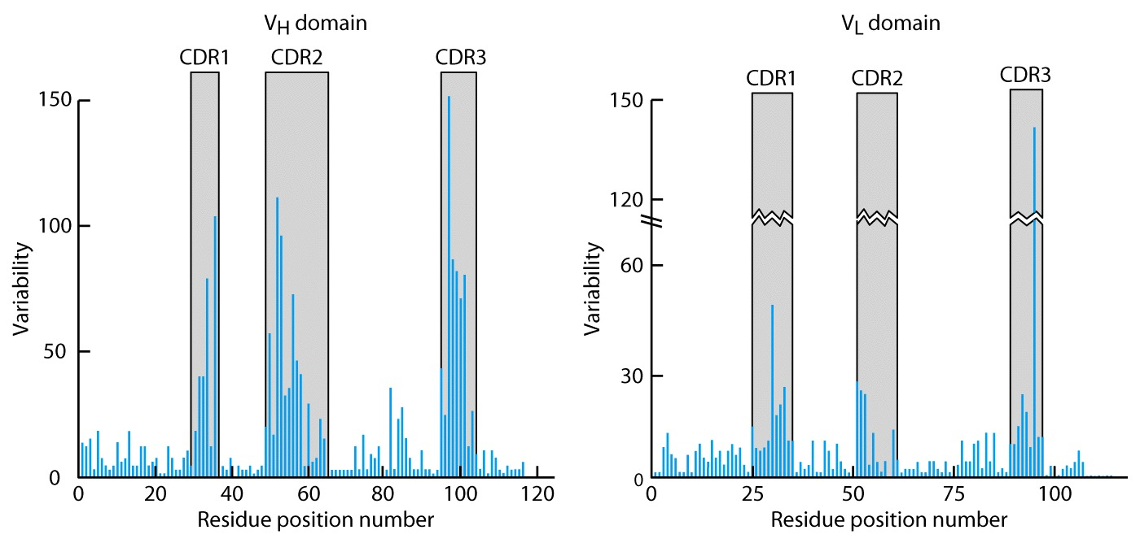
CDR Are Hypevariable

Slide 11
Monoclonal Antibodies
Immunize Animal With Antigen
Multiple Clones Are Generated, Good For In Vivo
For Clinical Diagnosis, Research, One Clone That Reacts To Single Epitope Is Preferred
Solution By Kohler and Milstein
Fuse A Myeloma Cell (Cancerous) With A Normal Plasma Cells
Resulting Clones Can Be Cultured Indefinitely
Produces An Antibody Recognizing One Epitope

Slide 12
B-Cell Receptor
BCR Is An Antibody On Surface Of Cell mIg
Very Short Cytoplasmic Tail, Cannot Transduce Signal
Heterodimeric Molecule Ig-α/Ig-β Transduces (long cytoplasmic tail)

Slide 13
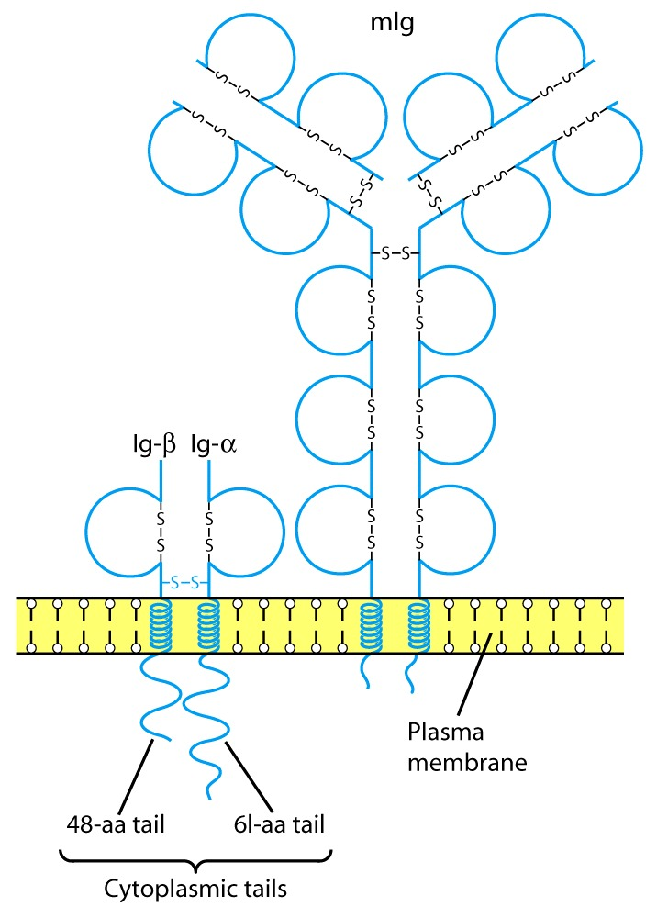

Slide 14
Fc Receptors (FcR)

Slide 15
Fc Receptors (FcR) Functions
To Transport Abs Across Membranes
Secretion of IgA Across Epithelium into lumen
Transport of maternal Abs Across Placenta (IgG)
Many Cell Types Use FcR
Ex. Mast Cells, Macrophages, Neutrophils, B, T, NK
Opsonization, ADCC
Poly IgR
Transport of IgA across epithelium
FcR_{N}
Transport of maternal IgG to fetus

Slide 16
Antibody Classes And Biological Activities
IgG
Most abundant immunoglobin 80% of serum Ig
~10mg/mL
IgG1,2,3,4 (decreasing serum concentration)
IgG1, IgG3 and IgG4 cross placenta
IgG3 Most effective complement activator
IgG1 and IgG3 High affinity for FcR on phagocytic cells, good for opsonization

Slide 17
Antibody Classes And Biological Activities
IgM
5-10% of serum immunoglobulin
1.5mg/mL
mIgM (also IgD) expressed on B-cells as BCR
Pentameric version is secreted
First Ig of primary immune response
High valence Ig (10 theoretical), 5 empirical
More efficient than IgG in complement activation

Slide 18
Antibody Classes And Biological Activities
IgA
10-15% of serum IgG
Predominant Ig in secretions
Milk, saliva, tears, mucus
5-15 g of IgA released in secretions!!!!
Serum mainly monomeric, polymers possible not common though
Secretions, as dimer or tetramer+J-chain polyptetide+secretory component (Poly IgR)

Slide 19
IgA Antibody Transport Across Cell (Transcytosis)

Slide 20
Antibody Classes And Biological Activities
IgE
Very low serum concentration, 0.3μg/mL
Participate in immediate hypersensitivities reations. Ex. Asthma, anaphylaxis, hives
Binds Mast Cells and Blood Basophils thru FcεR
Binding causes degranulation (Histamine Release)

Slide 21
Antibody Classes And Biological Activities
IgD
Expressed on B-cell Surface
IgM and IgD, Expressed on B-cell Surface
We Do Not Know Any Other Biological Effector Activity
Low serum concentrations, ~30μg/mL

Slide 22
Cross-Linkage of Bound IgE Antibody With Allergen Causes

Slide 23
Antibodies Act As Immunogens
Antigenic Determinants on Abs Fall in 3 Categories
Isotypic
Allotypic
Idiotypic
Isotypic
Constant Region Of Ab
If you inject Ab in a different species Anti-Isotype is generated
If within same species, No Anti-isotype

Slide 24
Antibodies Act As Immunogens
Allotype
Even though same isotypes within one species small differences (1-4 a/a) arise in different individuals (form of polymorphism)
If injected with such Ab you generate anti-allotype Ab
Ex. During pregnancy
Blood transfusion

Slide 25
Antibodies Act As Immunogens
Idiotype
Unique V_{H} AND V_{L} binds antigen but can also behave as antigenic determinant
If you inject a monoclonal antibody into a genetically identical recipient then anti-idiotypic antibodies are generated
No anti-isotypic and no anti-allotypic Abs will be generated

Slide 26
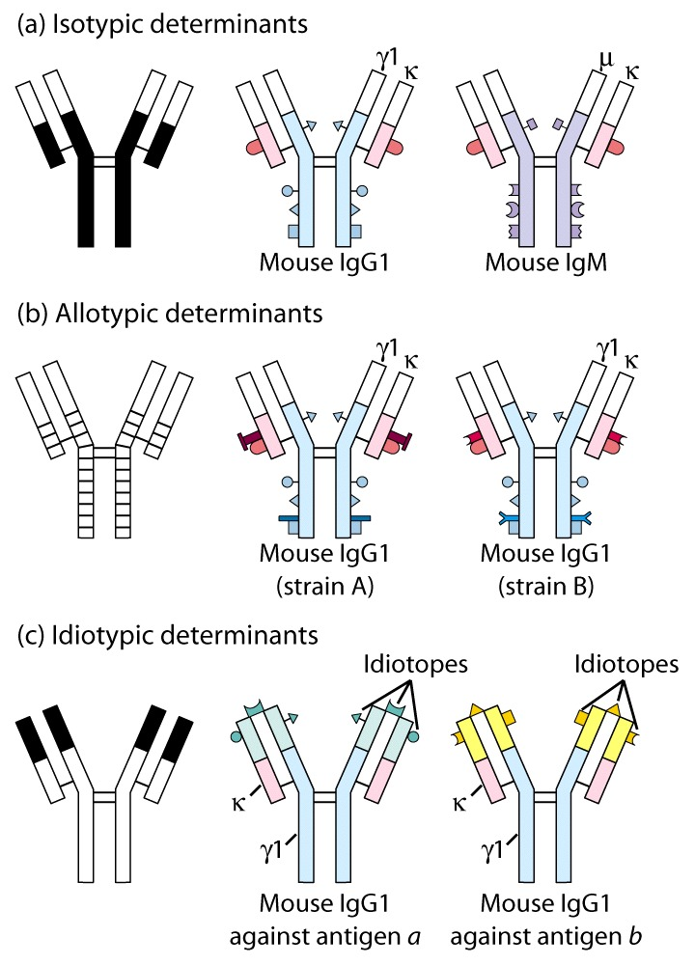

Slide 27
Monoclonal Antibody Applications
Diagnostic Tests
Abs are capable to detect tiny amouns (pg/mL) of molecules
Ex. Pregnancy hormones
Diagnostic Imaging
mAbs that recognize tumor antigens are radiolabeled with iodine I-131
Immunotoxins
mAbs conjugated with toxins
mAbs To Clear Pathogens
www.elusys.com

