Slide 1
WEL-COME
ASST. PROF. Dr. MADHURI DESHMUKH
Dayanand Science College Latur
PRESENT
Structure Of Viruses

Slide 3
Screen clipping taken: 15/01/2021, 12:59 PM

Slide 7
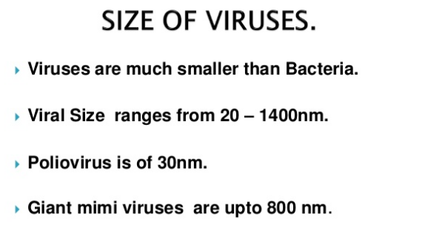

Slide 8
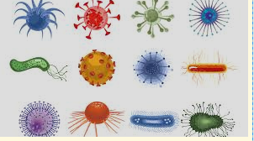
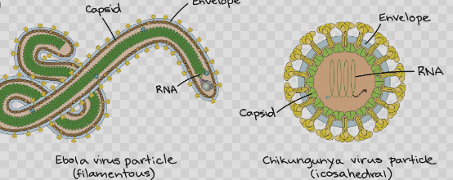

Slide 10
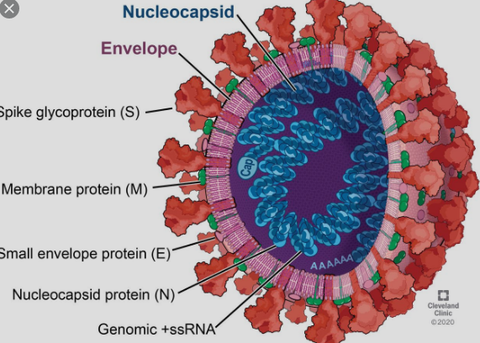
Structure of Corona Virus

Slide 19
THANKS

