Slide 1
DSC Latur Department of Physics
M.Sc. F. Y (Sem-I). Lecture- 03 Elementary Principles Presented By Mr. L. H. Kathwate M.Sc. B.Ed., NET, SET, GATE

Slide 2
What is Newtonian mechanics?
If the mechanics deals with Newton’s laws of motion then it is called Newtonian mechanics.
In this mechanics we studied physical quantities such as force, displacement, velocity, and acceleration etc. Which are vector quantities and hence also known as vector mechanics.

Slide 3
What is analytical mechanics?
If the mechanics is deals with study of Lagrangian, Hamiltonian and others then it is called analytical mechanics.
In this mechanism we study scalar quantities and its potential energy.

Slide 4
Newton’s laws of motion
Sir Issacs Newton
Newton’s First Law of Motion- Law of Inertia
Newton’s Second Law of Motion- Law of Force
Newton’s Third Law of Motion: Action-Reaction Law

Slide 5
Newton’s first laws of motion
Newton's first law states that every object will remain at rest or in uniform motion in a straight line unless compelled to change its state by the action of an external force. This is normally taken as the definition of inertia.

Slide 6
The key point here is that if there is no net force acting on an object (if all the external forces cancel each other out) then the object will maintain a constant velocity.
If that velocity is zero, then the object remains at rest. If an external force is applied, the velocity will change because of the force.

Slide 7
Newton’s second laws of motion
The second law explains how the velocity of an object changes when it is subjected to an external force.
The law defines a force which defines rate of change of momentum with respective time. Mathematically it can be expressed as;
$$F=m×a=m\frac{dv}{dt}=\frac{dp}{dt}$$

Slide 8
Newton’s third laws of motion
The third law states that for every action (force) in nature there is an equal and opposite reaction.
In other words, if object A exerts a force on object B, then object B also exerts an equal force on object A.
The third law can be used to explain the generation of lift by a wing and the production of thrust by a jet engine.

Slide 9
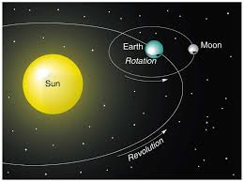
Particle
In the physical sciences, a particle is ideally defined as any point like object at which total mass is constant.
Example: To study the motion of earth around the sun we assume sun as particle.

Slide 10
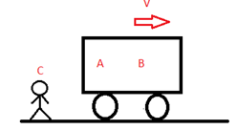
Frame of Reference:
In physics, a frame of reference consists of an abstract coordinate system and the set of physical reference points that exclusively fix the coordinate system and standardize measurements within that frame.

Slide 11
Types of frame of reference
Once we have chosen our reference they can be of two types:
Inertial Frame of Reference
Non-inertial Frame of Reference
Inertial Frame of Reference
An inertial frame of reference is a frame where Newton’s law of motions are holds true. That means if no external force is acting on a body it will stay at rest or remain in uniform motion.

Slide 12
Events
An events stands for anything that can occurs suddenly or instant at a point in space.
Observer
A person or an equipment that can locate , record, measured and interrelated to events is known as observer.

Slide 13
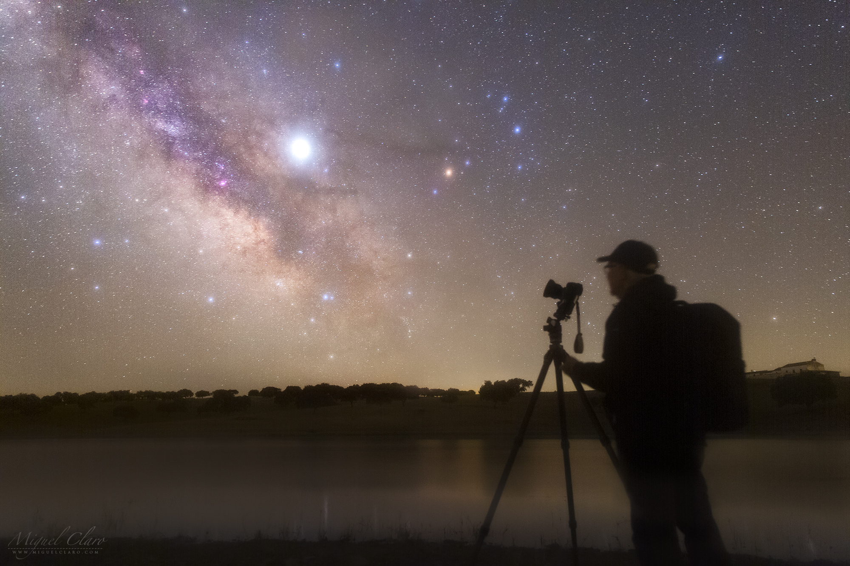

Slide 14
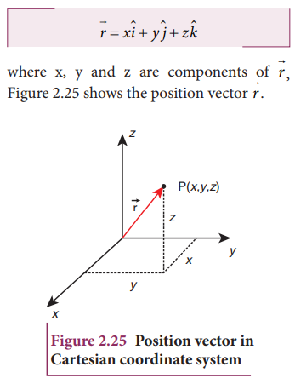
Position vector
The position vector $\hat{r}$ is defined as a fixed vector which locates point in space relative to another point.
$$\hat{r}=x\hat{i}+y\hat{j}+z\hat{k}$$

Slide 15
Velocity vector
Rate of change of displacement (r) w.r.to time (t).
$$\vec{v}=\frac{d\vec{r}}{dt}=\frac{d }{dt} (x\hat{i}+y\hat{j}+z\hat{k} )$$
$$\vec{v}=\frac{dx}{dt} \hat{i}+\frac{dy}{dt}\hat{j}+\frac{dz}{dt} \hat{k}$$
$$\vec{v}= \dot{x}\hat{i}+\dot{y}\hat{j}+\dot{z} \hat{k}$$

Slide 16
Acceleration
Rate of change of velocity (v) w.r.to time (t).
$$\vec{a}=\frac{d\vec{v}}{dt}=\frac{d }{dt} (\dot{x}\hat{i}+\dot{y}\hat{j}+\dot{z} \hat{k} )$$
$$\vec{a}=\frac{d\dot{x}}{dt} \hat{i}+\frac{d\dot{y}}{dt}\hat{j}+\frac{d\dot{z}}{dt} \hat{k}$$
$$\vec{a}=\ddot{x} \hat{i}+\ddot{y}\hat{j}+\ddot{z} \hat{k}$$

Slide 17
Magnitude of position vector:
$$\hat{r}=x\hat{i}+y\hat{j}+z\hat{k}$$
$$\left|\vec{r}\right|=\sqrt{x^{2}+y^{2}+z^{2}}$$
Magnitude of velocity:
$$\vec{v}= \dot{x}\hat{i}+\dot{y}\hat{j}+\dot{z} \hat{k}$$
$$\left|\vec{v}\right|=\sqrt{{\dot{x}}^{2}+{\dot{y}}^{2}+{\dot{z}}^{2}}$$
Magnitude of acceleration:
$$\vec{a}=\ddot{x} \hat{i}+\ddot{y}\hat{j}+\ddot{z} \hat{k}$$
$$\left|\vec{a}\right|=\sqrt{{\ddot{x}}^{2}+{\ddot{y}}^{2}+{\ddot{z}}^{2}}$$

